Slide 1
Slovakia Spending Review Incremental Health Reform Strategies
Tony Hockley
Bratislava 31st May 2016
t.c.hockley@lse.ac.uk
+44 77 68 23 73 89

Slide 2
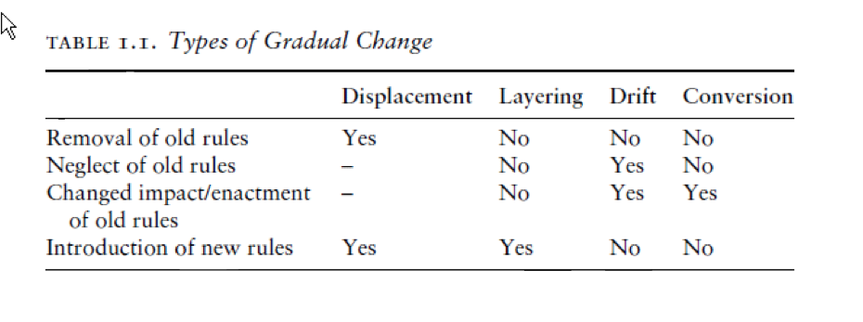
Incremental Reform tactics
Displacement: the removal of existing rules and the introduction of new ones
Layering: the introduction of new rules on top of or alongside existing ones
Drift: changed impact of existing rules due to shifts in the environment
Conversion: changed enactment of existing rules due to their strategic redeployment
Mahoney & Thelen “Explaining Institutional Change” (2010) p16
Notes:
All health systems face considerable present bias, generating strong forces of loss aversion. Major reforms are unpopular, politicised, and often short-lived.
By contrast, strategic incremental reform may reduce scope for opposition and politicisation. Also enables learning effects.
James Mahoney (NWU) & Kathleen Thelen’s (MIT) typology of incremental reform offers a useful guide for policy review and reform strategies.
Will use their typology to frame practical examples.

Slide 3

Choosing a Gradualist Strategy
Mahoney & Thelen (2010) p19

Slide 4
Drift: Elderly Bed Capacity & Cost
1948 National Assistance Act
1983 Regulation clarified limit on help with private care home fees
Private bed capacity grew 242% 1983-96
Benefit Spend grew from £10m 1979 - £2bn 1991
1990 NHS & Community Care Act
1995 Guidance on NHS Responsibilities
1999 Royal Commission
2011 Dilnot Commission

Slide 5
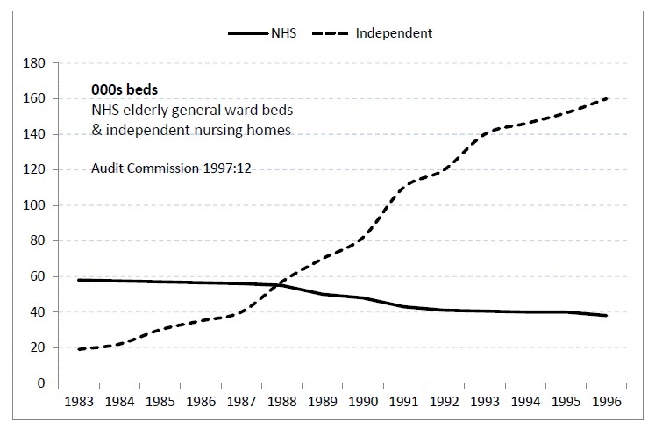
Hospital Geriatric Bed Supply
Audit Commission (1997)

Slide 6
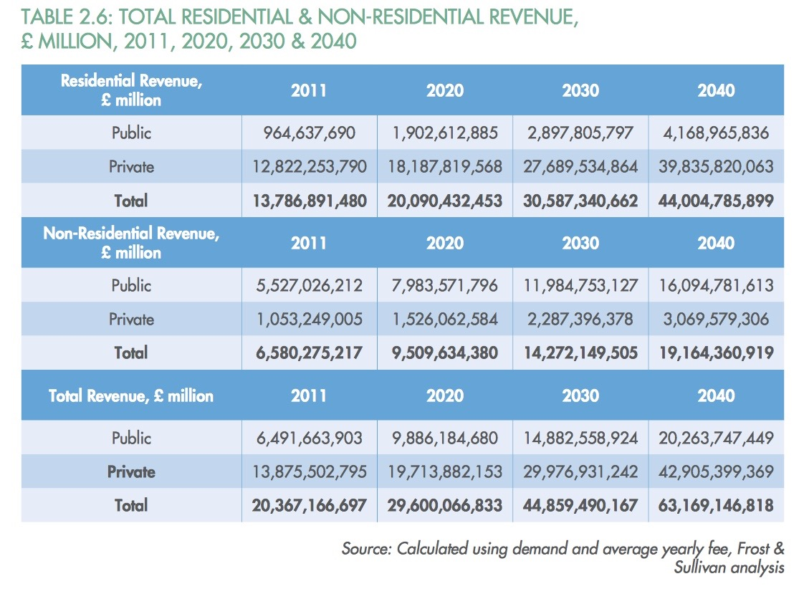
“Geriatric” Hospital Care
“Analysis of UK Long Term Care Market” Technology Strategy Board (2013)

Slide 7
Layering: Paying for Medicine
Raise NHS Prescription Charge
1979-80 Cost per item rose from 20p to £1
Restrict Reimbursement
1985 Limited List imposed to restrict reimbursable items
Promote Switch
1992 Streamlined process introduced to “switch” medicines from Prescription-Only Medicine to Pharmacy status (POM-P)
Ration
1997 Creation of National Institute for Clinical Excellence (NICE)
UK Self-Medication Market £2.3bn (2014)
970m items
Notes:
1983 Nurofen, Imodium, Triludan switched
Note: Each step may be a small battle, but less likely to be reversed than major reforms.

Slide 8
Reform Success Factors
Provider Support
Quality – Reward link
Autonomy Enhancement
Improved Status
New opportunities
User Support
Quality gain
Justifiable Cost
Technological advance
Incremental reform: winning support for change
= “new status quo”

