Slide 1

Spending Reviews in the field of Healthcare
Some lessons from European experience
Claude WENDLING
European Commission
Structural Reform Support Service (SRSS)
& Patrick BROUDIC, Consultant
June 2016

Slide 2
Specificities of healthcare
A sector that reflects societal / political preferences and institutional compromises.
Benchmarking is a useful tool
But any strategy must reflect local characteristics
Need for long-term planning, which may well escape the framework of medium-term budgeting
  Medical demography changes visible only after 15 / 20 years given time lapse for training of new physicians
  Effects of ageing ?

Slide 3
Distribution of public health spending
A relative stability of the breakdown of spending across different sectors in the EU
Inpatient care still the most important component.
Inpatient care, Out-patient care and Pharmaceuticals together still make up 70% of public health expenditure

Slide 4
Distribution of public health expenditure by areas in the EU, 2003 to 2013
Source: DG ECFIN (2016) calculation based on Eurostat, OECD and WHO health data.

Slide 5
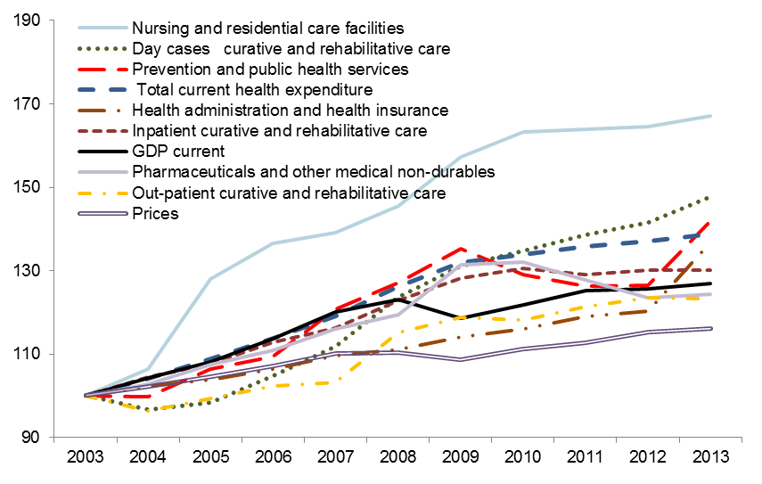
Evolution of public health expenditure by main areas
(2003 = 100) in the EU, 2003-2013
Source: Eurostat, DG ECFIN (2016)

Slide 6
Public health spending and policy outcomes
Importance of interactions between the different sectors and strategies of the actors to "maximise their part of the pie".
Complex dynamics across and within sectors mean that it is possible, with right incentives / regulation, to preserve or even improve outcomes while reining in costs.
Examples:
  Increase of the use of generics
  Encouragement to 'good practices' in terms of prescription by physicians
  Development of ambulatory care
But strong vested interests and lobbies can limit reallocation of resources towards a more efficient / effective use.

Slide 7
More detailed approaches
Hospitals
Pharmaceutical products

Slide 8
Hospitals

Slide 9
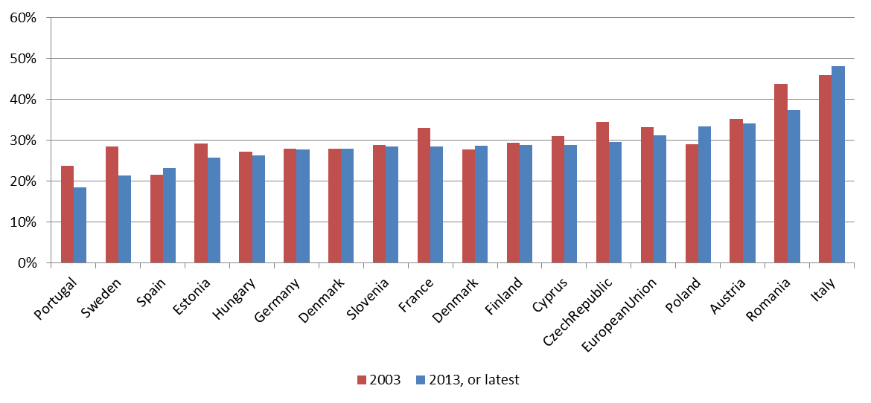
Significant discrepancies and diverse dynamics regarding share of inpatient care expenditure
Shares of expenditure of inpatient in total current health expenditure, 2003 and 2013
Source: Eurostat, DG ECFIN (2016)

Slide 10
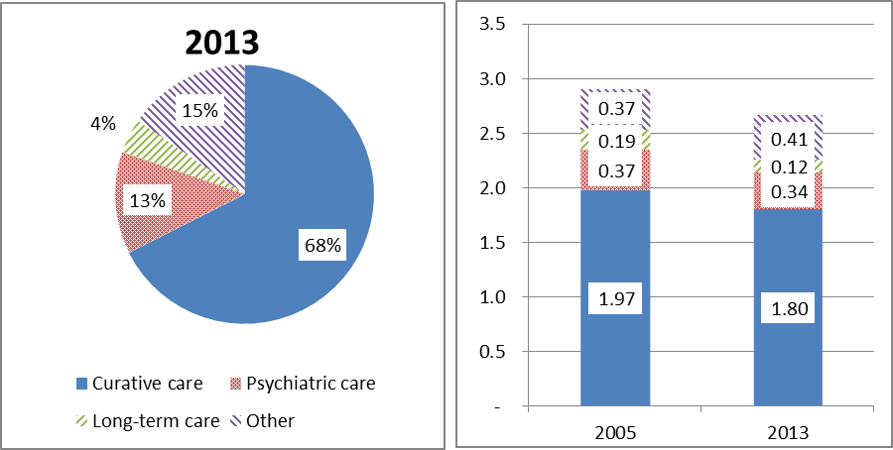
Streamlining of the hospital capacity has been significant in the EU over the last decade
As % of all beds | Beds in million
Source: Eurostat, DG ECFIN (2016)

Slide 11
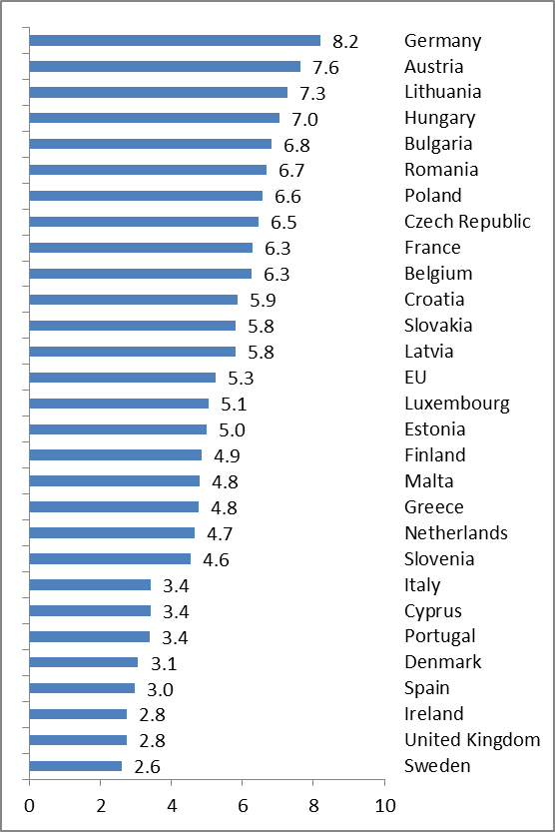
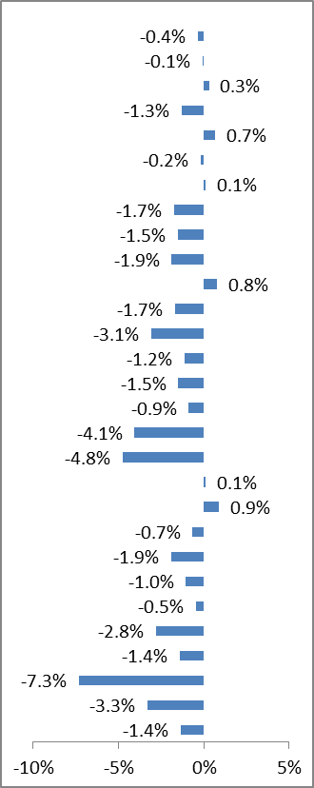
But the process has gone at a various speed across countries and strong differences remain
Beds per thousand inhabitants, 2013 or latest | Annual growth rate 2003-2012
Note: Includes beds in all hospitals, including general hospitals, mental health hospitals and other specialty hospitals, such as prevention and rehabilitation hospitals.
Source: Eurostat, DG ECFIN (2016)

Slide 12
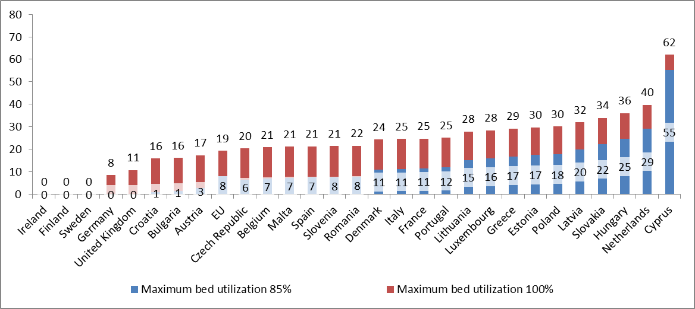
There remains a significant overcapacity in curative care in 2013
Note: Bulgaria and the average share of curative in inpatient discharges in the EU. Estimates for all countries based on latest available data. Bed overcapacity is calculated as one minus the number of beds needed (effectively used bed-days divided by 365 days and the assumed maximum bed utilization of 85 or 100%) in curative care divided by the number of beds available for curative care, with the result multiplied by 100
Source: Eurostat, DG ECFIN (2016)

Slide 13
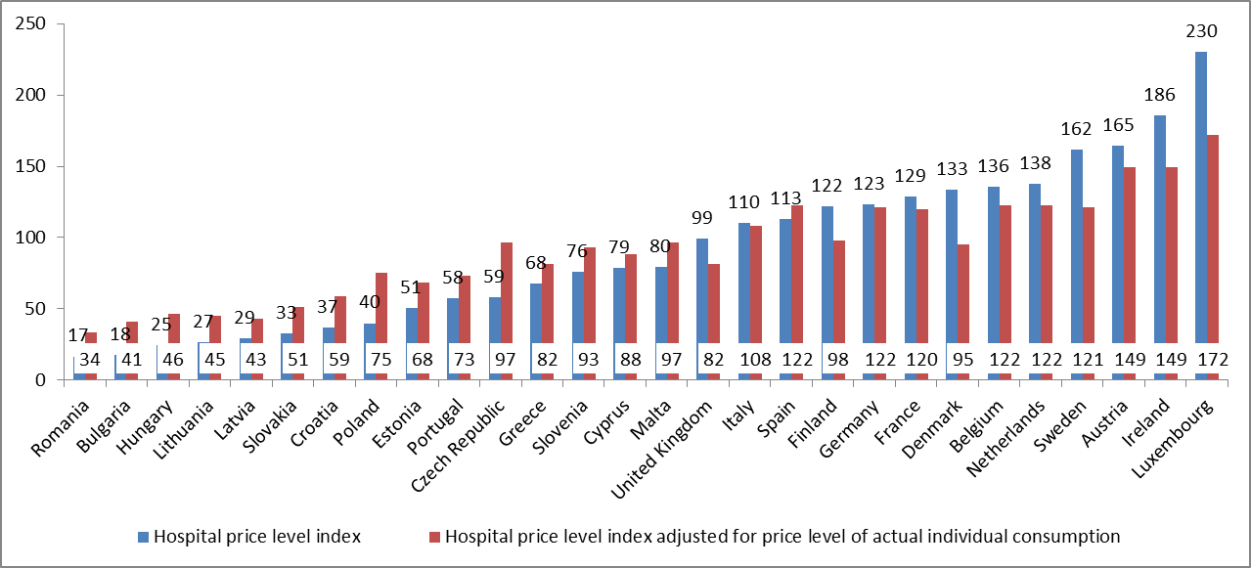
Hospital Services, Price level indices (EU28=100), 2014
There are strong discrepancies in terms of hospital price level
Hospital Services, Price level indices (EU28=100), 2014
Source: Eurostat, DG ECFIN (2016)

Slide 14
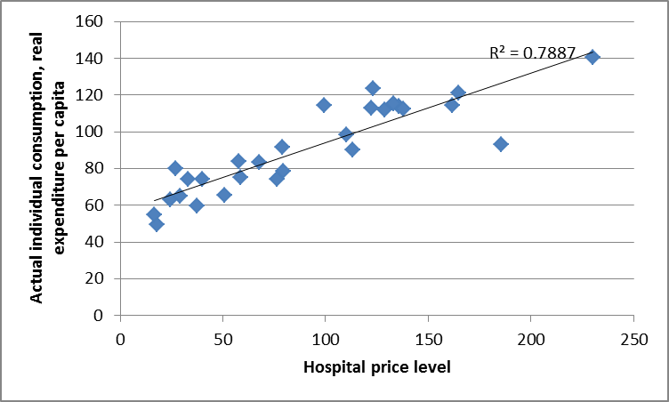
There is a strong correlation between price level indices for hospital services and volume of Actual Individual Consumption per capita (data 2011 / EU 28 =100)
Note: Total actual individual consumption (AIC) corresponds to household consumption adjusted for social transfers in kind, that is the health, education or housing services provided by government for free or at low cost.
Source: 2013 Eurostat/OECD Hospitals PPPs Survey; OECD Purchasing Power Parities Statistics 2013

Slide 15
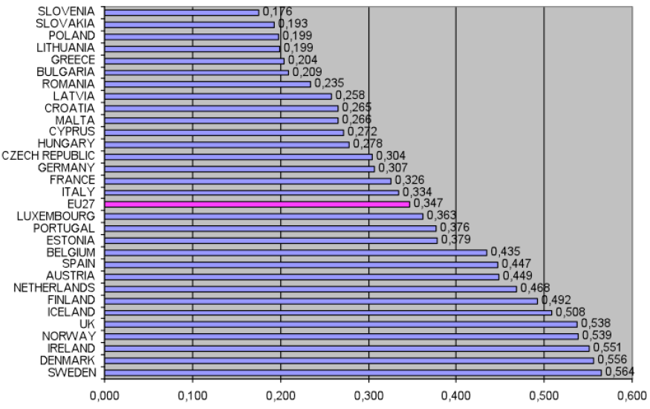
Hospitals' eHealth Deployment Composite Index: Country Ranking
There is a strong link between eHealth development and overall level of economic development
Source: Codagnone and Lupiañez-Villanueva (2011)

Slide 16
Countries with more beds and hospitalizations per capita tend to have lower hospital price levels and lower levels of eHealth deployments.
Richer countries have generally higher price levels than poorer countries, but the actual variation is higher than differences in wealth would suggest.
EHealth deployment correlates negatively with lower shares of preventable hospitalizations and positively with hospital price levels.
➔ Reorganization and rationalisation of hospital care particularly in countries with a high bed density is an important factor towards the effective deployment of eHealth and its potential to increasing quality of care.

Slide 17
Levers for performance (1) ?
Improving continuity of care
Better performing primary care systems, including functioning gate-keeping systems.
Planning of hospital capacities with a whole system perspective from primary to highly specialized care, as well including social care.
Improving emergency care
Improving primary care accessibility, encouraging use of tele-medicine and introducing fast-track systems to redirect patients to appropriate care settings.
No proven impact on cost containment however.

Slide 18
Development of ambulatory care (FR)
PRADO : PRogramme d'Accompagnement du retour à Domicile
Based on the fact that FR was (in 2013) 23rd on 25 OECD countries with regard to average length of stay (4.3 days vs. OECD average of 3.2)
Concerns discharges post maternity, orthopedic treatment, heart insufficiency. Provision of advice to patients and hospitals to have better care
Timeline and results:
launch in 2014
Objective 2017: 650,000 patients concerned / 400,000 in maternity / 90,000 in orthopedics / 160,000 for other affections

Slide 19
Levers for performance (2) ?
Increasing hospital autonomy
No hard scientific evidence on the impact of increased hospital autonomy on cost containment.
Possible conflict with integrated care logic which requires that hospitals are well placed within the communities and the spectrum of healthcare services offered at primary care and post-hospital level.

Slide 20
Levers for performance (3) ?
Improving Financing of hospitals
Trend in EU countries towards a combination of global budgets with a more or less important activity-based financing component.
Combining activity-based payments with global budgets seems more promising than choosing only one of these tools.
Cost-sharing with patient: positive impact on overall public spending on health in the short run, but controversial as it poses a potential access barrier to care.

Slide 21
Levers for performance (4) ?
Benchmarking performance
Enhancing hospital competition
Hospital competition enhanced by insurer competition may have positive effects on cost containment.
To be balanced against desired health policy goals, because of lack of information about quality and lack of product homogeneity.

Slide 22
Levers for performance (5) ?
Reducing operational costs
Improving the staff mix (nurses / doctors)
Increasing staff performance.
No systematic evaluation of the long-term impact of strategies to reduce input costs.
Improving procurement
Little research results available on which procurement practices help containing costs, but trend towards centralisation.

Slide 23
Improving procurement : PHARE project
Definition: Programme to improve procurement practices in hospitals in France
Basis: 18 bn€ of supplies / year (60% medical supplies)
Tools: negotiation with bidders, standardisation, use of full-cost reasoning, more proactive procurement policy
Gains: - 5% ie 900 M€ expected over three years (2012-2015), gains materialised seem closer to 500 M€ at this stage, programme continues.
http://social-sante.gouv.fr/professionnels/gerer-un-etablissement-de-sante-medico-social/performance-des-etablissements-de-sante/article/achats-hospitaliers-le-programme-phare

Slide 24
Levers for performance (6) ?
Privatizing hospitals
No hospital ownership form that excels above the others, but specific circumstances in which privatisation may boost performance.
Fostering mergers and networks
Economies of scale seem to be exhausted relatively early at a hospital bed size of 100 to 200 beds.
Little empirical evidence of mergers and hospital networks on cost containment.

Slide 25
Levers for performance (7) ?
Exploring public-private partnership
While experience with PPPs in the EU is diverse, many projects seem to have not fulfilled expectations.
No scientific evidence that PPPs are cost-effective compared with traditional forms of publicly financed and managed provision of health care.

Slide 26
Pharmaceutical products

Slide 27
Classification of policies to increase effectiveness of pharmaceutical spending
According to the nature of the measure:
- pricing
- product reimbursement
- market entry
- expenditure controls
According to the constituency targeted
- distributors (retailers and pharmacists)
- patients
-physicians
Source: Espin, J. and J. Rovira (2007), PPRI (2008), Zuidberg (2010), Commission services (DG ECFIN).

Slide 28
Policies related to pricing : price regulations
External reference pricing: ERP - also called cross-country referencing and international price comparison – is applied in 24 EU Member States (except Denmark, Sweden and the UK). It benchmarks product prices in one country against prices of the same product in a selected basket of other countries.
Internal reference pricing: 20 EU Member States set the price to be paid by the public payers by comparing prices of equivalent or similar products in a chemical, pharmacological or therapeutic group. This is the system of internal reference pricing determining the maximum price to be reimbursed by a third payer ("reference price"). The patient pays the difference between the retail price and the "reference price", in addition to any co-payment arrangement. The "reference price" applies to all pharmaceuticals within the corresponding group of products.
Price updates: Prices may be updated regularly according to pricing regulations.
VAT: Mostly, medicines have a value-added tax below the standard VAT rate. Sometimes, the VAT depends on the group of pharmaceuticals.
Source: Espin, J. and J. Rovira (2007), PPRI (2008), Zuidberg (2010), Commission services (DG ECFIN).

Slide 29
Policies related to product reimbursement and market entry
Product reimbursement
Health-technology assessment: Reimbursement may be conditional on meeting specific clinical and/or economic (cost-) effectiveness criteria. Health-technology assessment (HTA) is an assessment of the additional cost-effectiveness of an innovative medicine relative to existing treatment alternatives. This gives evidence-based guidance to pricing (and reimbursement).
Positive/negative lists: All EU Member States have positive lists specifying which specific pharmaceuticals are reimbursed. A few countries also have negative lists, excluding specific pharmaceuticals from reimbursement.
Market entry
Time to market entry: Pricing and reimbursement procedures may delay the market entry of medicines. In the EU, the time span for taking pricing and reimbursement decisions is regulated by the Transparency Directive. In addition, companies may deliberately choose to delay market entry.
Source: Espin, J. and J. Rovira (2007), PPRI (2008), Zuidberg (2010), Commission services (DG ECFIN).

Slide 30
Policies related to expenditure controls
Discounts/rebates: Discounts and rebates are imposed upon manufacturers and pharmacists, such that they have to return a part of their revenue.
Clawback: Clawback policies are applied to pharmacies, requiring them to pass a part of their turnover to third party payers.
Payback: Payback requires manufacturers to pay back a share of their revenue, if a pre-specified budget ceiling for public pharmaceutical expenditures is exceeded.
Risk-sharing arrangements: These are financial or performance-based schemes which trigger lower prices or refunds from the manufactures if pre-agreed targets are not reached.
Price freezes and cuts: Prices are frozen or cut by law or as an outcome of a negotiated agreement.
Public tendering: Increasingly more countries are using public procurement in the outpatient sector to decrease the prices of pharmaceuticals. Currently, the Netherlands and Germany are well known examples for ample use of public tendering.
Source: Espin, J. and J. Rovira (2007), PPRI (2008), Zuidberg (2010), Commission services (DG ECFIN).

Slide 31
Policies targeted at distributors
(wholesalers and pharmacists)
Generic substitution: Pharmacists may be induced or mandated to dispense the cheapest bioequivalent medicine, which is often called "generic substitution". It is mandatory in 8, indicative in 14 and disallowed in 7 EU Member States.
Mark-ups: 23 EU Member States apply wholesalers' and all EU Member States apply pharmacists mark-ups on the price of the pharmaceuticals as set by law. These can be linear, regressive, a fixed-fee (NL) or fee-for-service (SI, the UK).
Source: Espin, J. and J. Rovira (2007), PPRI (2008), Zuidberg (2010), Commission services (DG ECFIN).

Slide 32
Policies targeted at patients
Information/education campaigns: Patients may be targeted by information campaigns raising awareness of rational use of medicines, e.g. for antibiotics and generics.
Co-payment: Most EU Member States have co-payment, applying differentiated reimbursement rates, such as 100% reimbursement for essential, 80% for chronic and 60% for other pharmaceuticals (AT, IT, DE, NL and UK have 100% reimbursement; prescription fees may apply though). Often, vulnerable groups are protected from excessive out-of-pocket payments through specific rules.
Source: Espin, J. and J. Rovira (2007), PPRI (2008), Zuidberg (2010), Commission services (DG ECFIN).

Slide 33
Policies targeted at physicians
Monitoring of prescribing behaviour: At least 22 EU Member States monitor prescription behaviour to some extent, e.g. by using electronic prescriptions.
Clinical practices/prescription guidelines: Most EU Member States have indicative, nonbinding prescription guidelines for physicians. In few countries, physicians must prescribe by the international-non-proprietary-name (INN) instead of the medicine name. INN is mandatory in five, indicative in 18 and disallowed in four EU Member States.
Pharmaceutical budgets: A maximum pharmaceutical budget may be defined per period, region, field of specialty and physician (at least 9 EU Member States).
Prescription quotas: These may define a target of the percentage of generics to be prescribed by each physician or may target the average cost of prescriptions (at least 6 EU Member States).
Financial incentives: Physicians may be incentivised or punished financially by following or ignoring prescription guidelines, quotas and budgets (at least 11 EU Member States).
Education and information: Physicians may receive prescribing advice, IT decision support etc. This is the case in most EU Member States.
Source: Espin, J. and J. Rovira (2007), PPRI (2008), Zuidberg (2010), Commission services (DG ECFIN).

Slide 34
Example of a policy tailored at physicians (FR)
Set up in July 2009 of CAPI (Contrat d'Amélioration des Pratiques Individuelles, Contract for Improvement of Individual Practices) on a voluntary basis.
CAPI provided incentives for physicians: three-year contract with financial incentives for optimisation of prescription practices and detection of some chronic diseases such as diabetes.
16,000 physicians signed a CAPI between July 2009 and July 2011., ie 30% of the total eligible population
70% of physicians got an incentive of 3,000 € on average for their efforts.
CAPI set the framework for a generalisation of performance incentives for all physicians after 2012.

Slide 35
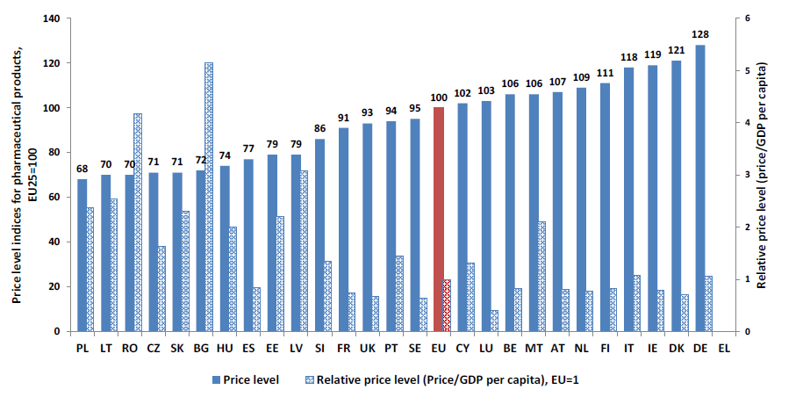
Price level index for pharmaceutical products in 2005, EU25=100
Source: Eurostat (2007); Commission services (DG ECFIN)

Slide 36
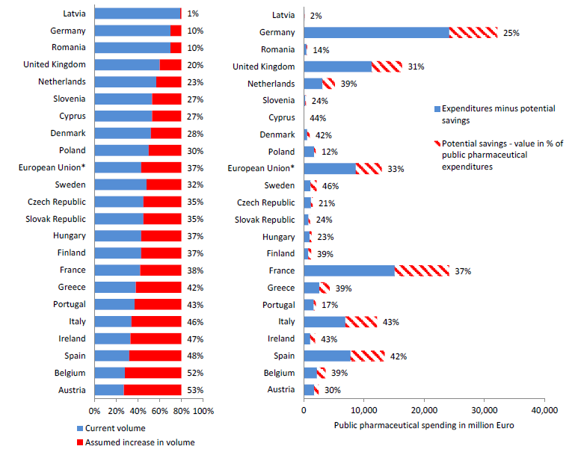
Potential savings by increasing the volume of generics to 80% of market share, in million Euro and % of public pharmaceutical expenditure in 2009
Note: In the right graph, expenditure for the EU is divided by 10. Cyprus: public sector only.
Source: IMS (2010), EGA (2011), Commission services (DG ECFIN).

Slide 37
Sources exploited in this document:
"Cost Containement Policies on Hospital Expenditure in the European Union", Christoph SCHWIERZ, to be published in 2016
"Cost containment policies in public pharmaceutical spending in the European Union", Giuseppe CARONE, Ana XAVIER and Christoph SCHWIERZ, European Commission, DG ECFIN (2013)

