Slide 1
Meeting with MAREG and Developement organized by SRSS
F. García Morán
Chief IT Advisor
European Commission

Slide 2
My Job Description
"Advice the EC Services, other EU Institutions, Member States and, in close collaboration with International Organizations, Public Administrations around the world on Digital Policies, eGovernment (Digital Public Services), IT Governance, IT Management and Operations and IT Security"
Helping the TFGR since 2013 and now SRSS for Greece and Cyprus and SGUA for Ukraine

Slide 3
About me
Degrees in mathematics and Computer Science
Always worked for public administration and always on IT related matters
Work for the EC since November 86 (29 years)
From 2005 to 2013 Director General of Informatics (DG that I helped to create in May 2004)
Grew the DG from 600 to 1500 people based on quality of service and charge back. Carried out successfully major projects of cosolidation of IT Infrastructure and Services. Developed major complex administrative and policy support system

Slide 4
The history of the eCommission
4
2010
2015
e-Commission 2011-2015
e-Commission 2006-2010
Level 4:
Transformed government
e-Commission 2001-2005
Level 3:
Integrated government
Level 3:
Integrated government
Level 2:
On-line government
Level 2:
On-line government
Level 1:
Simple website
Complexity

Slide 5



Academic Year 2014-2015
The Future of Public Services
Digital & Co-produced

Slide 6




Slide 7
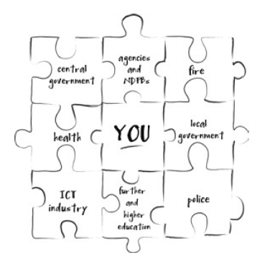
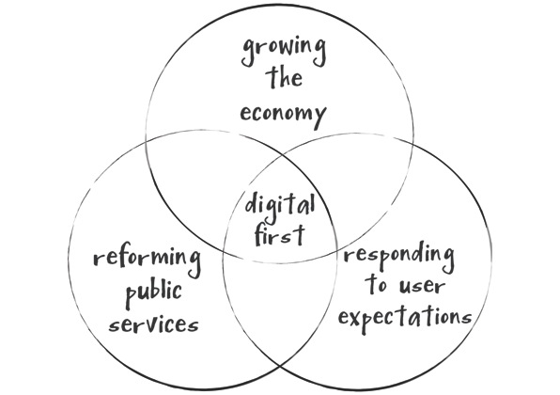
Citizen Centric & Digitally Enabled

Slide 8
Some messages on eGov in Greece
Greece has made important efforts to set up a eGovernment Strategy and the associated action plan (to be updated)
The Strategy contains already all the necessary elements to proceed with the implementation
The Strategy can be updated based on progress and implementation experiences (see eCommission)
Two areas for improvement
  Governance
  Implementation/Delivery

Slide 9
Why Goverance is important in eGov?
Ensures alignment with political priorities
Ensures the participation of stakeholders in the decision making process in a decentralized organization
Drives and Steers the implementation of digital services
Take the right decisions on programmes and project portfolio
Ensures transparency in the decision making process and the optimal use of (scarce) resources by setting priorities

Slide 10
Governance Structures
The Political level
  Political orientations, high level priorities, monitoring
The Operational Level
  Prepare decisions for the political level
  Operational decisions on implementation
  Follows-up closely programmes and project portfolio
The Technical level
  Prepares detailed opinions on programmes/projects/technology for the operational level
The Chief Information Officer (CIO) and the Corporate Programme/Project Office

Slide 11
Membership
The Cabinet of the PM (only at the political level)
Core Ministries and entities (MAREG, DEV, Finances, Infrastructures, etc)
Policy clusters representatives (rotating)
CIO

Slide 12
CIO
Charismatic leader
Good knowledge of the "business" of public administration
Sound technical background and credentials
Good listener
Service (not power) oriented
Team player

Slide 13
Core 7 IT competences to be kept in Gov
Strategy
Enterprise and IT Architecture
Project/programme management
Service management
Technology management
Contract mangement
Customer Relationship Management
Private sector can provide the day to day operations (outtasking)

Slide 14
Some advice on implementation
Consolidate IT Resources
  People, Infrastructures and Information Systems
  Define strategy, execute in a flexible but consistent way
Manage projects
  Ensure alignment with eGov strategy
  Demonstrate added value
  Roles, responsiblities, governance
  Methodology (ex. EC's PM2)
  Ensure core resources are avaialble
  Ensure alignment
Avoid duplications (everywhere !!!)

