Slide 1
A brief overview of regulation of pharmaceutical spending in France
Bratislava, June 2016
Based on elements provided by the French Directorate for Social Security (2012)

Slide 2




Legal and institutional framework
Reimbursement decision process
European Medicines Agency / Ansm
Marketing Authorization
HAS - Commission de transparence (CT)
Health Technology Assessment
Haute Autorité de santé
Comité Economique des Produits de Santé (CEPS)
Pricing
Reimbursement rate
Ministres de la santé et de la sécurité sociale
Ministries: inclusion in positive reimbursement list
Notes:
To remind you with the global path of a drug, HAS intervenes juste after the market autorisation approval to give an opinion about the opportunity of listing on remibursement lists and helps pricing definition.
1st step: Marketing authorization.
Assessment : CHMP / EMEA
Decision : European Commission
2nd step: Introduction into national healthcare systems
Assessment: « Health Technology Assessment »
Some common principles, many national specificities
Decision: Country specific
France : “Formulary” = Positive list of reimbursed drugs
Our opinions are sent to the ministry of Health where the CEPS will deal with prices and to the NHI that will deal with reimbursement.
After inclusion on the lists, the drug is usually marketed and will be followed by regulatory bodies and by HAS through a 5 year renewal process…

Slide 3
Legal and institutional framework
Health Technology Assessment: the decision driver
“Commission de transparence”: the evaluation committee
  20 voting members (healthcare professionals - mainly doctors)
  Meeting every 2 weeks
  An evaluation department of 25 people
1st index: « Service médical rendu » (SMR)
  “Cette appréciation prend en compte l’efficacité et les effets indésirables du médicament, sa place dans la stratégie thérapeutique, notamment au regard des autres thérapies disponibles, la gravité de l'affection à laquelle il est destiné, le caractère préventif, curatif ou symptomatique du traitement médicamenteux et son intérêt pour la santé publique. Les médicaments dont le service médical rendu est insuffisant au regard des autres médicaments ou thérapies disponibles ne sont pas inscrits sur la liste” (R163-3 du CSS)
  4 levels: major or important, moderate, light, insufficient
  SMR = a driver for reimbursement rate
    Major or important medical service: 65%
    Moderate medical service: 30%
    Light medical service: 15%
    Insufficient medical service: no reimbursement
2nd index: « Amélioration du service médical rendu » (ASMR)
  Measures the imrovement in medical service, compared to existing therapies
  ASMR = a driver for pricing
      About 300 new evaluations in 2010: 80% important medical service, 90% no improvement.
      Public evaluation, available on HAS website www.has-sante.fr

Slide 4
Legal and institutional framework
Pricing negotiations and decisions: Comité Economique des Produits de Santé
10 members – 10 votes:
  1 Pdt + 1 Vice Pdt appointed by health, finance and economy ministers
  4 ministries departments (DSS for social security finance, DGS for public health, DGCIS for industry policy, DGCCRF for competition)
  3 representatives of national health insurance funds
  1 representative of complementary health insurance funds
Mission:
  pricing of reimbursed medicines
  regulation of pharmaceutical public spending
  Sustainability of social security finance + equal access to best existing medicines for all patients
  + fair pricing of pharmaceutical innovation
Meeting every week + a team of 10 people preparing and following up decisions
Pricing rules
  Law
  Framework agreement between CEPS and Industry
  Ministerial instructions

Slide 5
Legal and institutional framework
Legal framework for pricing decisions: 2 main rules
L.162-16-4 du CSS « Le prix de vente au public de chacun des médicaments […] est fixé par convention entre l’entreprise exploitant le médicament et le CEPS […] ou, à défaut, par décision du comité, sauf opposition conjointe des ministres concernés qui arrêtent dans ce cas le prix dans un délai de 15 jours après la décision du comité.
La fixation de ce prix tient compte principalement de l’amélioration du service médical rendu apportée par le médicament, le cas échéant des résultats de l’évaluation médico-économique, des prix des médicaments à même visée thérapeutique, des volumes de vente prévus ou constatés ainsi que des conditions prévisibles et réelles d’utilisation du médicament. »
  Prices = results of negotiated agreements between CEPS and companies
  Prices are set on a comparative basis with already reimbursed medicines, using index of medical improvement from HAS evaluation
  Agreements not only deal with prices but also with sales volumes and real-life use of medicines ➔ additional clauses
R163-5 du CSS « Ne peuvent être inscrits sur la liste prévue au premier alinéa de l'article L. 162-17
[…] les médicaments qui n'apportent ni amélioration du service médical rendu appréciée par la commission mentionnée à l'article R. 163-15 ni économie dans le coût du traitement médicamenteux »
  If no medical imrovement ➔ reimbursement only with a price generating savings

Slide 6
Legal and institutional framework
Framework agreement between CEPS and Pharmaceutical Industry
Information exchange on sales
For very innovative medicines (major, important or moderate improvement in medical service - ASMR): price no lower than UK, Germany, Spain and Italy prices
Annual claw-back system
+ procedures (Ex: fast-track for innovative medicines), individual agreements model, …
➔ For any information on CEPS activity + to read the framework agreement, see CEPS annual report (english version available) on www.sante.gouv.fr/les-activites- du -ceps.html

Slide 7
Tools for regulation
Annual claw-back system
Pharmaceutical taxes
Price reductions and clawback on individual products
Outlisting and co-payment increase
Generics
Distribution margins
Prescription regulation

Slide 8
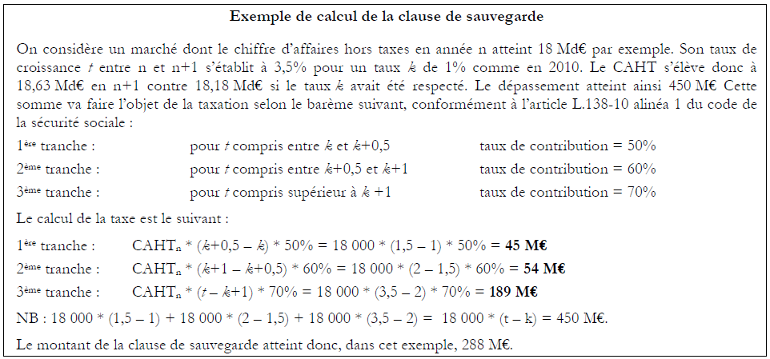
Tools for regulation
Annual claw-back system
A tax (L.138-10 du CSS). In case reimbursable pharmaceutical sales grow faster than K% (K = 1 in 2010, K = 0.5 in 2011 and 2012)
  For growth between K and K+0.5, tax rate = 50%
  For growth between K+0.5 and K+1, tax rate = 60%
  For growth above K+1, tax rate = 70%
Split between companies on the basis of their sales (30%), their growth when above K% (40%) and their promotion budget (30%)

Slide 9
Tools for regulation
Annual claw-back system
This tax is not applicable to companies under agreement with CEPS…
… but in that case, they fall under the annual claw back system introduced by the framework agreement between CEPS and industry
  K growth rate is split between pharmacotherapeutic classes into different growth rates, taking into account the specific trend of each class (patent expired, innovation…)
  If pharmaceutical sales exceed K growth rate, a contribution is collected in each class whose growth rate is exceeded. ( % of the exceeding growth)
  Split between companies selling drugs in each over-growing class, part on the basis of their sales and part on the basis of their excess turnover amount
  ➔ see growth rates applicable for each class in appendix 4 of CEPS annual report
  Ex: in 2010, K = + 1%, proton pump inhibitors = -7%, antidiabetic agents = +10%
  ➔ No contribution in 2010 (sales growth = 0.5% < 1%) nor in 2011 (sales growth = 0.3% < 0.5%)

Slide 10
Tools for regulation
Pharmaceutical taxes
  Tax on wholesalers sales and direct-to pharmacies sales (L.138-1 du CSS) = 1.9% of sales + 2.25% of sales increase or decrease (min = 1.4%, max = 2.7%) :
  Tax on promotion spending (L. 245-1 du CSS)
  Tax on pharmaceutical sales (L. 245-6 du CSS) = 1% of sales (1.6 % from 2012):

Slide 11
Tools for regulation
Price reductions and clawback on individual products
Negotiated by CEPS
Price reductions on patented drugs mainly in the following situations:
    Price consistency in pharmacotherapeutical classes
    Reduced european prices
    Revised medical evaluation (possible at any moment and at least every 5 years)
Price reductions and/or clawback coming from specific clauses
  Volume clauses (can be pooled)
  Posology clauses
  Daily treatment cost clauses

Slide 12
Tools for regulation
Outlisting and co-payment increase
Outlisting only on the basis of medical evaluation (insufficient medical service – SMR)
  82 drugs in 2003
  152 drugs in 2006
  41 drugs in 2008
  28 drugs in 2011
  17 drugs in 2012
Co-payment increase
  2010: creation of 15% reimbursement rate for « light medical service » drugs
  2011: reduction from 35% to 30% of reimbursement rate for « moderate medical service » drugs
  But still 100% reimbursement for all medicines for patient with chronic or severe disease
  ➔ theoretical reimbursement mean rate = 66.10% but real reimbursement mean percentage = 76.25 % in 2010

Slide 13
Tools for regulation
Generics
Price reductions
  Price of generics = Price of original drug – x% (40% in 2005, 50% in 2006, 55% in 2008, 60% in 2012)
  Price of original drug reduced by 15% (20% since 2012) when generics come to the market
  After 18 months, price of original drug reduced by 12.5% and price of generics reduced by 7%
« Tarifs forfaitaires de responsabilité » (TFR) – fixed accountability tariffs
  When substitution remains too low, original drugs are reimbursed on the basis of generic price
  Substitution targets to meet: 55% (60% since 2012) after 12 months, 60% (65% since 2012) after 18 months, 65% (70% since 2012) after 24 months, 80% after 36 months (since 2012)
Incentives for generic substitution by pharmacists
  Substitution list published by AFSSAPS
  Same margin (in value) on generic than on original drug for pharmacists
  Maximum clawback = 17% on generics (2.5% on orginal drug)
    ➔ Generics = 25% of volumes, 13% of sales (€ 2.6 billion) in 2010
    ➔ on substitution list, Generics = 68% (only) of volumes, 54% of sales

Slide 14
Tools for regulation
Distribution margins
Public price = ex-factory price + wholesaler margin + pharmacist margin + VAT(2,1%)
Wholesalers margin:
  Before 2012:
  Since 2012: flat margin = 6.68% of ex-factory price with € 0.30 min and € 30.06 max
Pharmacists margin:
➔ Towards a fix markup per dispensing?

Slide 15
Tools for regulation
Prescription regulation
National health insurance funds acting to promote more efficient prescription
  Payment for performance system for doctors (since 2012)
  ➔ Targets of prescription on substitution list
e-prescription on softwares under HAS certification
  Incentives for doctors
  Compulsory certification of prescription softwares since 2015
  Compulsory prescription by active substance since 2015

