Slide 1

Feedback on the assessment of the transport sector
Slovakian spending review 2016
Updated after the meeting
Feedback SRSS by Sébastien Renaud
Bratislava 01/05/2016
V 1.0

Slide 2
Overview
Context
Recommandations
A solid and ambitious pre-assessment
A few areas of concern:
Potential cost increases
Address the issue of car traffic
A few remarks:
What is the objective for the transport network?
Comparison between Member States should be focused on relevant candidates
Clarity on costs and financing sources is essential
Use financial elements and competencies as a starting point for the analysis
Assess the transport infrastructure from a planning standpoint
Look into additional areas of investigation
Use benchmarks with care

Slide 3
1 - Use financial elements and competencies as a starting point for the analysis
Additional analysis of funding is necessary
The study needs to provide a clear view of public spending in the field of transport
The split between the various echelon of the public sector (State, Region, Municipalities) is necessary
Financing sources for the transport network could be investigated
Competences are a useful driver
The missions of the Ministry of transport could provide a useful basis for the review
The allocation of competencies between sources can also be insightful
There may be additional competencies that don't fall directly under modal transport
Look into the allocation of resources
Allocation of resources for the various competencies is relevant to the investigation
Knowledge of the age pyramid is a key element to assess potential savings on the HR budget

Slide 4
1a – a good knowledge of budget is the base
Example of detailed funding (France)
Additional breakdown:
Fiscal spending (payback on tax on gaz, electricity, VAT, direct financing to public transport)
Allocation of funding per agency on all 3 elements
Sources of financing
Action | functioning | Investment | Intervention
Development of Road infra |  |  | 9
Public transport |  |  | 2 475
Maritime transport | 260 | 3 | 50
Maintenance and management of road network | 164 | 154 | 5
Regulation, security and services on land | 1 | 2 | 44
Regulation, security and services at sea and air |  |  | 24

Slide 5
1b – spending reviews need to understand the substance of the ministry
Example of spending review approach (RGPP)
Document scenarios for staff reduction to achieve ½
Identify potential to reduce functioning and investment budget
Axes for investigation
Correlation between missions and resources
Analyze staffing and financial means
Use existing audits and internal benchmarks
Identify potential savings
Scope of work
Central administration
Local administration
Main operators
New ministerial mandates
Mutualization of support functions
Fusion of directions
Relevance missions / organization
based on quality of service and working conditions, select missions that must be:
maintained,
abandoned,
externalized.
Level of deconcentration
Fusion, sharing of services
Relationships state / local authorities
Impact / financing
Performance management / tutelage
July 2007
July/ August 2007
Sept / Oct 2007
Preparation of assessment work
Define categorization of missions and expenditures
Identify the most relevant cost indicators (to compare productivity)
Define efficiency ratios for each nature of expenditure
Data collection
Compute efficiency ratios for each direction of the central administration based on information sent by administrations
Assign staffing to every mission and the workload associated to every mission
Analysis of potential savings
Effect of productivity trend in recent years
Gains linked to existing projects
Comparison of efficiency ratios and productivity ratios for each mission
Estimated gains linked to inter-ministerial reform projects

Slide 6
1b – spending reviews need to understand the substance of the ministry
Questionnaire on intervention policy
Inventory
What do we do?
What are our objectives?
What services do we bring? What contribution?
Who are the beneficiaries (characteristics)?
State financing
Who should pay?
Is the financing by the Sate justified?
Who ought to pay?
What co-financing schemes are possible?
Citizen’s needs and expectations
What are the collective needs and expectations?
Does policy still serves the common good?
What is the level of adequacy service/needs ?
What are the evolution of needs? How many beneficiaries and evolution?
What are collateral effects?
Are the beneficiaries made responsible?
Effectiveness / efficiency
How can we do better with less?
What evolutions can reduce cost while keeping the same level of service?
How to simplify process and procedures?
Is the total cost of the policy justified regarding the provided service?
Can we control spending? If not, how could we control it?
Does the policy cover aspect already covered by other policies?
Can beneficiaries cumulate assistance with other policies?
Does the good practice “1 process = 1 objective” respected?
Adequacy of policy
Should we keep on doing the same
Should we keep the policy?
Should we adjust objectives?
What services should we provide?
Should we adapt tools? Increase the pool of beneficiaries?
Does policy hinder economic interests?
Is it coherent with EU policy?
Scenarios
What transformation scenario?
What scenarios can provide a more effective policy for less money?
How to secure implementation?
State is operator
Who should do it?
Can other operator do it better? (decentralization, externalization, delegated
Must the Sate do it? If yes, with what cooperation?

Slide 7
1b – spending reviews need to understand the substance of the ministry
Questionnaire on operational policy
Inventory
What do we do?
What are our objectives?
What services do we bring? What contribution?
Who are the beneficiaries (characteristics)?
State financing
Who should pay?
Is the financing by the State justified?
Can we make the user aware of its responsabilities
Could co-financing schemes be more effective
Citizen’s needs and expectations
What are the collective needs and expectations?
Does policy still serves the citizen? Are there unsatisfied needs? What does he expect from service?
Are all activities essential?
What activities could be abandoned?
What non financial lever can be used?
Effectiveness / efficiency
How can we do better with less?
What evolutions can reduce cost while keeping the same level of service?
How to simplify structures and procedures?
Do means allocated to the service justified (internal/external comparison, international benchmark)? Evolution of means?
Is it possible in increase agent’s productivity?
Can we set effectiveness and efficiency ratios for structures
What are the good practices applied to reduce costs? Can we save on buys/housing costs?
How to improve use of public infrastructure
What levers can be used to increase productivity (IT, re-engineering, mutualization, simplification)
Can we group structures and share means?
Can we use computerization and dematerialization to further reduce costs?
Can we share support functions?
Adequacy of policy
Should we keep on doing the same?
Should we keep the activiy?
Should we adjust objectives?
What services should we provide?
Should we adapt tools? Increase the pool of beneficiaries?
Can activities be bundled? Can they be externalized or shared (CSP)? Are other structures providing the same service?
Can we optimization the localization of agents on the territory? Should staff be redeployed between front office and back office?
Scenarios
What transformation scenario?
What scenarios can provide a more effective policy for less money?
How to secure implementation
Organization
Who should do it?
Can externalization be used to provide some of the services?
Should operators be merged? Or activities re-internalized?
Can one develop alternative ways of providing service?

Slide 8
1b – spending reviews need to understand the substance of the ministry
Questionnaire on support functions
Inventory
What do we do?
What are our objectives?
What services do we bring? What contribution?
Who are the beneficiaries (characteristics)?
Adequacy of support function
Should we keep on doing the same
Should we keep the function?
What services does it provide?
Organization
How to do it?
Who does best provide the service?
Are there any other structure providing similar service?
Can activities be bundled? Is externalization to a Share Service Center (CSP) possible?
Effectiveness / efficiency
How can we do better with less?
What evolutions can reduce cost while keeping the same level of service?
How to simplify structures and procedures?
Do means allocated to the service justified (internal/external comparison, international benchmark)? Evolution of means?
What are the good practices applied to reduce costs? Can we save on buys/housing costs?
Can we use computerization and dematerialization to further reduce costs?
Can we share support functions?
Scenarios
What transformation scenario?
What scenarios can provide a more effective policy for less money?
How to secure implementation

Slide 9
2 - Need for transport infrastructure to be included in a larger planning scheme
National plan
The planned transport infrastructures for Slovakia are an important element to take into account
The development of this transport blueprint should be a priority of the Ministry of transport
Improve data collection and analysis
The quality of data is an essential element that needs to be developed
The definition of standards for data exchanges for any organization receiving public funding is an efficient way to ensure the centralization of data.
Develop a cost/ benefit analysis
The selection of transportation project (and therefore the definition of the transport network blueprint) requires the use of a "cost / benefit" methodology.

Slide 10
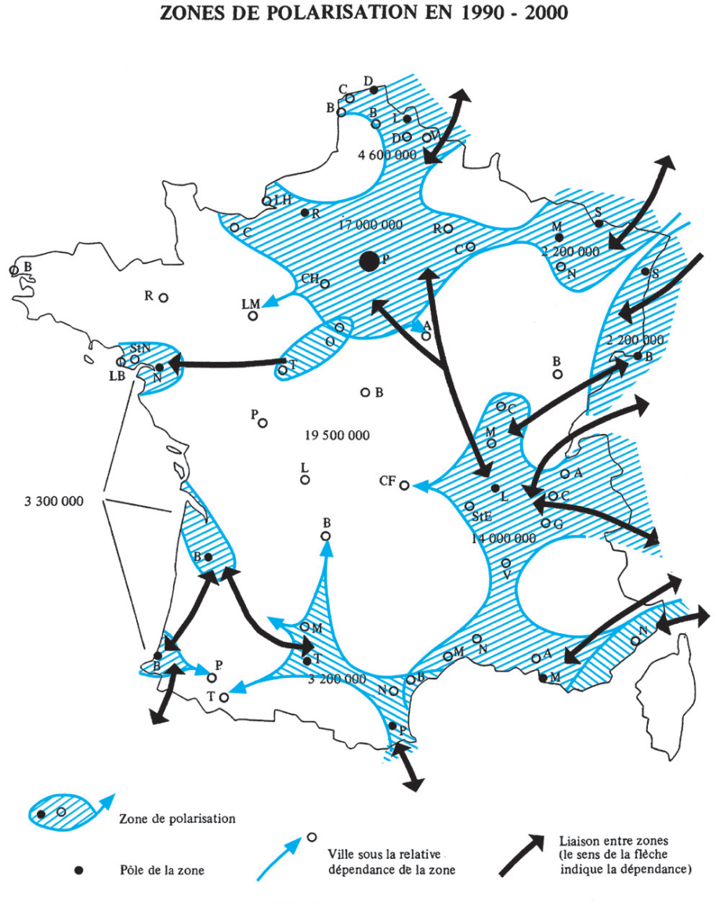
2a – the planning of transport is a necessary political decision supported by expertise
Planning of the transport network
Delegation for territorial infrastructure:
The Datar was a service build to prepare and implement the decision of the steering body (Committee Inter-ministerial for territorial infrastructures). It has now been replaced by the SNIT.
The decision is quite political but the assessment of projects is a technical work.

Slide 11
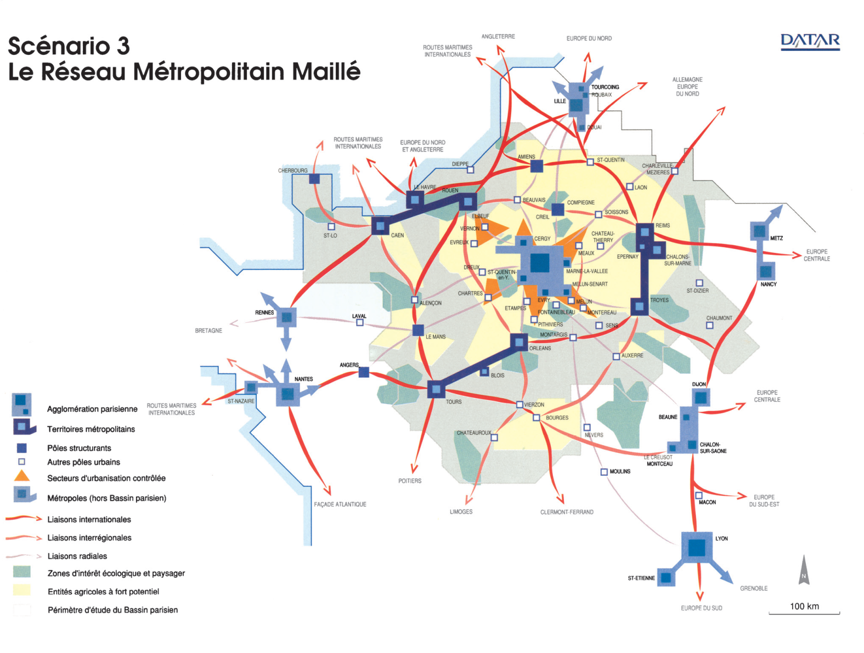
2a – the planning of transport is a necessary political decision supported by expertise
Planning of the transport network

Slide 12
2b - A functional review addresses a larger scope than the sole reduction of costs
Example spending review objectives (RGPP)
Objectives:
Reinforce the strategic potential of the Ministry to reinforce its economic impact
Move from a "do" approach to a "make do" approach through:
Decentralisation
Externalization
Separation of the various functions
Suggested approaches:
Reorganization of the Ministry (central and decentralized)
Optimisation of intervention spending (better use of infrastructure and programming of investments, "green" investments)
Creation of national operators (road, study centers, air transport)
Externalization of missions (engineering by the State, driver's licencing, training schools)
Improve controls
Optimization of means of various agencies
Budget:
Initial: 57 000 FTE and 10.942M€
Suggested savings over 4 years: 14 000 FTE to 19 000 FTE and 725M€

Slide 13
2c – use of indicators and data is central to the assessment of a program
Examples of key indicators for transport at state level
The program infrastructure and transport services
Encompasses services and infrastructure for Road, rail, maritime, ports and airports & safety, security, regulation of these sectors
Objectives:
Optimise the transport system to avoid the creation of new infrastructures
Improve the performance of systems to connect regions
Improve energy efficiency and achieve environmental excellence
Key indicators
Objective 1: build planned project for a minimal cost and modernize networks:
Difference between final costs and estimates
Cost/benefit ratio of operations
Objective 2: improve the quality of infrastructures:
Cost of operation of renewal and maintenance (rail) (cost per km)
Quality of networks (road, maritime) – IQOA, IQRN: availability or quality
Objective 3: improve regulation in road transport and develop alternative modes:
Part of non road transport in all transport
Market share of large maritime ports
Control of road transports (intensity of controls in various sectors)

Slide 14
2d – The development of a cost/benefit approach is a central driver
Cost / Benefit analysis in France
Framework
Regulatory obligation of the "environmental code"
Must be presented during the "public debate" (on the interest of the project) and on the "public inquiry" (to declare the public utility of the project for land expropriation).
The level of precision increases with the life cycle of the project
Various reports suggested value for various criteria (Boiteux II report) which enable the computation a large number of benefits. Still some elements are not included (biodiversity)
What must be computed
NPV benefit= -Project cost – variations of investment for maintenance + sum of economic advantages of all stakeholders + residual value of infrastructure (projects assessed over 30 years)
Benefit for collectivity= B/I
Internal rate of return: actualization rate that cancels the benefit
Immediate rate of return
Recommendations
Sensitivity analysis are crucial to assess the validity of results
A number of areas of investigations must be assessed. Effects on:
Mobility and accessibility
Urbanism and land use
Tourism and "image" of the territory
Businesses and industries
Services offered to populations
Demography and movement of populations
Environment and nuisances (including induced traffic)
Reduction of social inequalities is factor in include

Slide 15
2d – The development of a cost/benefit approach is a central driver
Key data from the Boiteux report
Value of time (€ of 2010)
Whole of France:
profes: 17,5€/h
Perso: 10€/h
Leisure: 5.8€/h
Ave: 7,9€/h
Paris region:
profes: 22,35€/h
Perso: 12,6€/h
Leisure: 8,7€/h
Ave: 10,7€/h
Other externalities (€ 2000)
Noise: from -0,4% to 1,1% of depreciation
Pollution:
Urban area: 2,9€/100 veh.km (cars), 28,2€/100veh.km (trucks)
Average: 0,9€/100veh.km (cars) 6,2€/100veh.km (trucks)
Diesel train: 458 €/100veh.km (urban) 100 €/100veh.km (average)
Value of life (€ 2000)
Death: 1,5M€
Serious injury: 225 000€
Light injury: 33 000€

Slide 16
3 – Look into additional areas of investigation
Look for additional sources of funding
Define areas of externalization
Look into IT usage for operations
Quality of public spending
Management of costs and delays
Procurement procedure
Land expropriation
Access to funding
Ex-ante & in-itinere public spending
Private sector involvement through concession and PPP
Taxes for infrastructure users, licence fee
Private sector involvement through concession and PPP (road, airports, train stations, rail)
Move to user fee
Repositioning of activities of the State
Reduce operational costs through network optimization
Improve data collection and development of benchmarks

Slide 17
3a – Various typologies of reform can be looked into
Optimization of processes
Comparison between efficiency levels. It is then possible to bring all entities to the level of the top tier for relatively homogeneous policies. The idea is to compare identical efficiency indicators between numerous administrations to assess the potential gains.
Suppression of redundancies. Numerous policies involve more than one administration that may operate the same controls, or similar actions. These redundancies can be suppressed and gains derived from it. The same may hold true between distinct administrations. (ex: authorization for construction may require the involvement of 2 or 3 administrations that may both control the same information twice).
Rationalization of practices. Administrations may perform similar tasks using different processes. Standardization of practices may bring the economies linked to the most efficient approach. (ex: operate control functions by controlling 100% of high stakes files but only a sample of others)
Simplification of regulatory constraints
Alleviation or adaptation of regulatory constraints (obsolete / redundant / other) could provide operational savings
Externalization
Externalization when agencies or the private sector are more efficient. (ex: production of physical parking cards may be done internally by the administration when it requires a lot of work force that don’t have the adequate machines).
Information system
Targeted information system interfaces set up or dematerialization can provide savings, but would need to be backed up through total cost of ownership / benefit analysis

Slide 18
3a – Various typologies of reform can be looked into
Decrease load
Reduction of portfolio. The idea is to target the main issues within a public policy and reduce the range of action (ex: reduce the categories of roads dealt with by the State and let local authorities handle the remaining ones).
Reduction of local representation. In some cases the level of representation from the State may be deemed inadequate and it is therefore better to reduce their number and strengthen some of them.
Abandon specific public policies. The objective of the approach is to assess public policies with very view recipients or limited results. They may be transferred to other entities (agencies, private sector) or simply abandoned.
Abandon competencies that are already addressed by other instances (European commission, local authorities, private sector). Redundancies must be suppressed.
Focus the action on strategic aspects and piloting (through regulation). The administration may be conducting operational functions on public policies when its main value is really on piloting and regulation and other operators may be able to handle production.
Externalization to the private sector to find other sources of funding.
Apply good practices and rules
Application of the rule : “one public policy must be carried out by one entity”. Splitting of policies between 2 entities reduces the efficiency even if it can be justified in a few cases.

Slide 19
3b – Externalization must be prepared
The condition for a successful externalization can be listed as follow:
The definition of a doctrine that sets the framework for the recourse to externalization. A framework would define the perimeter of activities opened for externalization, the unified and standard process for the assessment and justification of benefits, the definition of minimum predefined gains that have to be achieved to allow the recourse to externalization.
The allocation of mission of control of externalization to existing entities to ensure the quality and monitoring of the process and limit abuses.
The definition of a unified process for the piloting of on going externalization to ensure the quality of service.
The preparation of the HR maneuver through communication, training, reallocation and follow up of the personnel currently providing the service.
The benefits of externalization must also go beyond the sole financial aspects:
Reduce total costs
Reallocate limited resources on key activities or develop a lever for modernization and reform
Increase flexibility
Optimize the quality of service
Gain access to skills which are not available or benefit from innovation.

Slide 20
3c – The good use of EU funds in transport is also an area of benefits
2 relevant operational programs:
Integrated Infrastructure: the most significant OP - will invest €4.66 billion, of which €2.3 billion from the Cohesion Fund and €1.66 billion ERDF, in key infrastructure and transport networks as well as in high-speed broadband deployment
Effective Public Administration: €335 million, with some €278 million coming from the ESF, to ensure investment in strengthened institutional capacity and accountability of Slovakia's public administration as well as effective judicial system, transparency and law enforcement
Recommandations:
Investigate absorption rate (35%)
Ensure the selection of the most "politically relevant projects" : absoption rate may not be the most relevant indicator
Ensure close monitoring of implementation to guarantee delays
Couple national and EU funding to ensure the joint financing of projects.

Slide 21
4 – Use benchmarks and indicators well
Benefits of internal benchmarks
Limit of international benchmarks
Useful to challenge the existing situation to show clear outliers
But often compare totally different situations
Unit costs between countries are usually quite different (wage rates, labor and work rules, fuel, etc.)
Cannot be used to set a clear target
Help assess comparable situations
Provide indicative performance assessment of efficiency in various sectors
Enable refine comparisons within a sector
Benchmarks can be compared over time for the same subject

Slide 22
4a – a few recommendations can be provided regarding benchmarks
Example of valuable benchmarks
Public transport:
The key is to combine "outputs" (ex):
Operations: Vehicule. Hours of service, Passenger.km, Passenger.trips, Fuel consumed (per 100km), Number of peak scheduled vehicules, km of bus lines, number of stops, average distance between stops, ratio of municipalities connected in a region, cost/passenger, speed
Maintenance & quality of service: average age of buses and trains, average price/km of tickets, staff/km of line
Road transport:
Cost of operation/km, traffic/lane, Staff/km for each function, level of congestion, number of km/hab,
Maintenance: Quality of road, cost/km
Modal share of automobile
Rail transport:
Cost of operation/km, traffic/lane, Staff/km for each function, cost/km for passenger, speed
Maintenance: Quality of tracks, cost/km, average age of trains
The most relevant approach is to compare elements
at a low level of granularity
&
define the most relevant indicators

Slide 23
4a – a few recommendations can be provided regarding benchmarks
Key data for road construction and maintenance* (2006 estimated data** no VAT included)
Construction (cost/km***):
France (state operated national roads): 5,4M€/km
Danemark: 5,0M€/km
Sweden: 5,6M€/km
Belgium: 3,7M€/km
Germany: 5,7M€/km
UK: 19,2M€/km
Netherlands: 11,9M€/km
France (highways privately operated):
3,8M€/km to 6M€/km low constraint
4,9M€/km to 7,6M€/km higher constraint
Operation and maintenance:
France:
Maintenance 30 600€/km or 0,34€/100km travelled
Big repairs: 21 300€/km or 0,23€/100km travelled
Overall costs:
France: 44100€/km or 0,49€/100km travelled
Germany: 65500€/km or 0,69€/100km travelled
Danemark: 64000€/km or 0,55€/100km travelled
Spain: 33000€/km or 0,55€/100€/100km travelled
Norway: 42000€/km or 0,48€/100km travelled
UK: 150000€/km or 0,56€/100km travelled
*data from "rapport sur la comparaison au niveau européen des coûts de construction, d'entretien et d'exploitation des routes" (contrôle économique et financier, Conseil général des ponts et chaussées, 2006)
** data could be updated to 2016 prices using the general index of civil engineering construction prices for France, which shows a ratio of 1,163 between 2016 and 2006 prices (i.e. 2016 rices = 1,163 x 2006prices.
*** Unit cost is provided for 1km of a 2x2 lane (i.e.a 1x1 highway is computed using a 50% discount)

