Slide 1
Building Quality & Efficiency
Tony Hockley
Bratislava 31 May 2016

Slide 2
Quality Control?
Timeline
1999 Bristol Royal Infirmary Inquiry created
2000 “NHS Plan” launch:
- “National Service Frameworks”
- National Tariff & “Payment by Results”
Mid-Staffordshire Hospital “high” HSMR
➔ Inquiries 2008 – 2013
2010 QIPP* Programme: Linking Quality & Efficiency
*Quality, Innovation, Productivity, Prevention
http://webarchive.nationalarchives.gov.uk/+/www.nhs.uk/nhsengland/NSF/pages/Nationalserviceframeworks.aspx
Notes:
NSFs for:
Cancer, CHD, Stroke, COPD, Diabetes, Kidney Care, Long-Term Conditions, Mental Health, Elderly (Original Five NSFs/Strategies in red)
QIPP (2010) announced 30% cut in Tariff for unplanned admissions

Slide 3
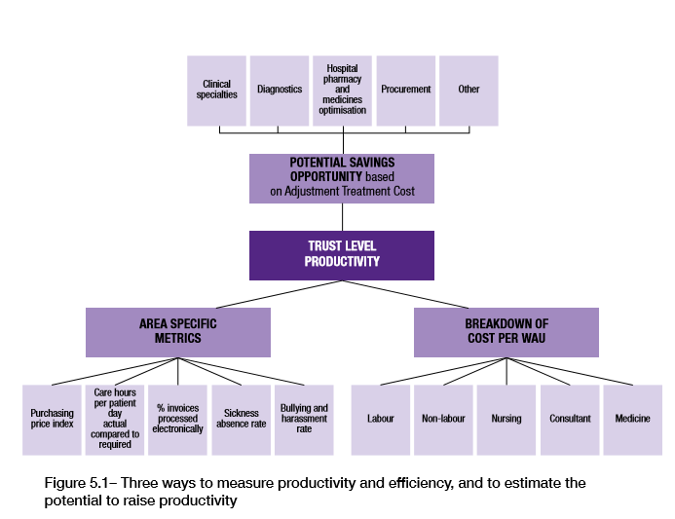
Carter Report 2016 : Hospital Efficiency - 3 Domains
https://www.gov.uk/government/publications/productivity-in-nhs-hospitals

Slide 4
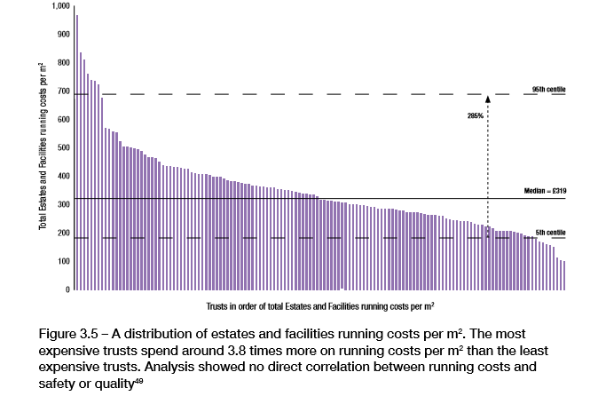
Carter: Facility Management Efficiency
Carter Report (2016)

Slide 5
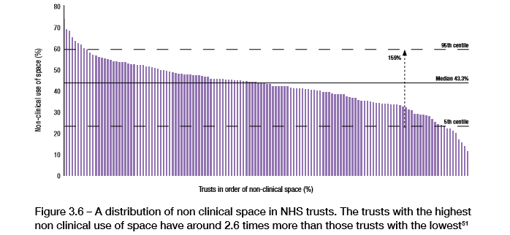
Carter: Targetting Spatial Inefficiency
Carter Report (2016)

Slide 6
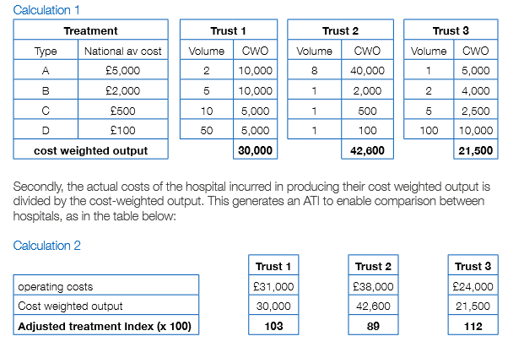
Carter: Benchmarking Relative Efficiency
Carter Report (2016)

Slide 7
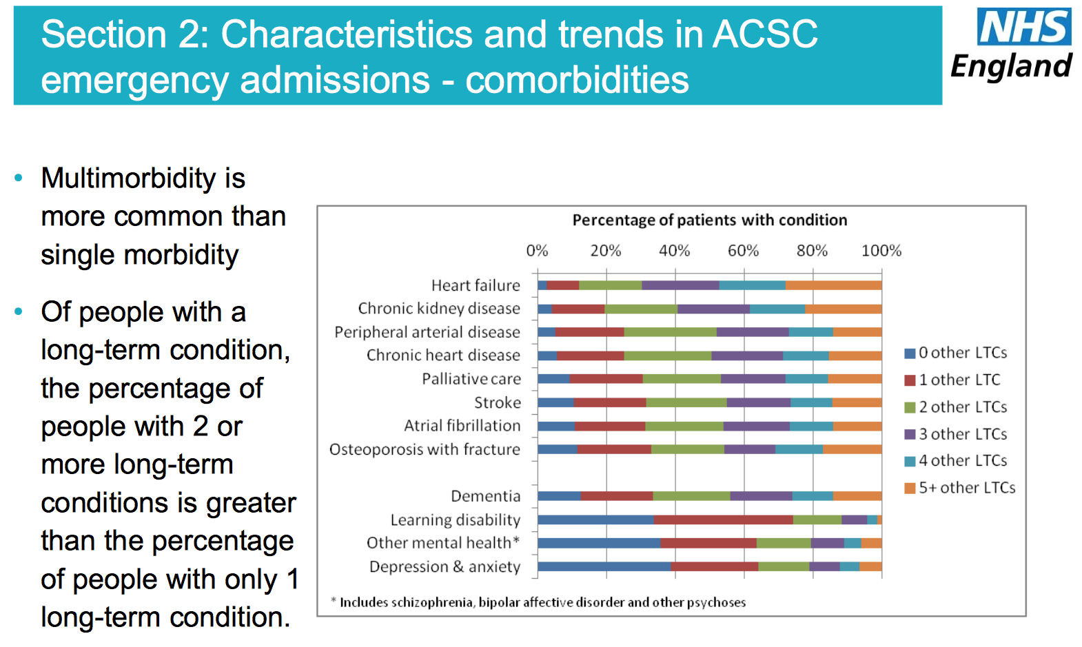
Efficiency & Outcomes
Problem: Emergency Hospital Admissions
ACSC: Ambulatory Care Sensitive Condition
https://www.england.nhs.uk/wp-content/uploads/2014/03/red-acsc-em-admissions.pdf

Slide 8
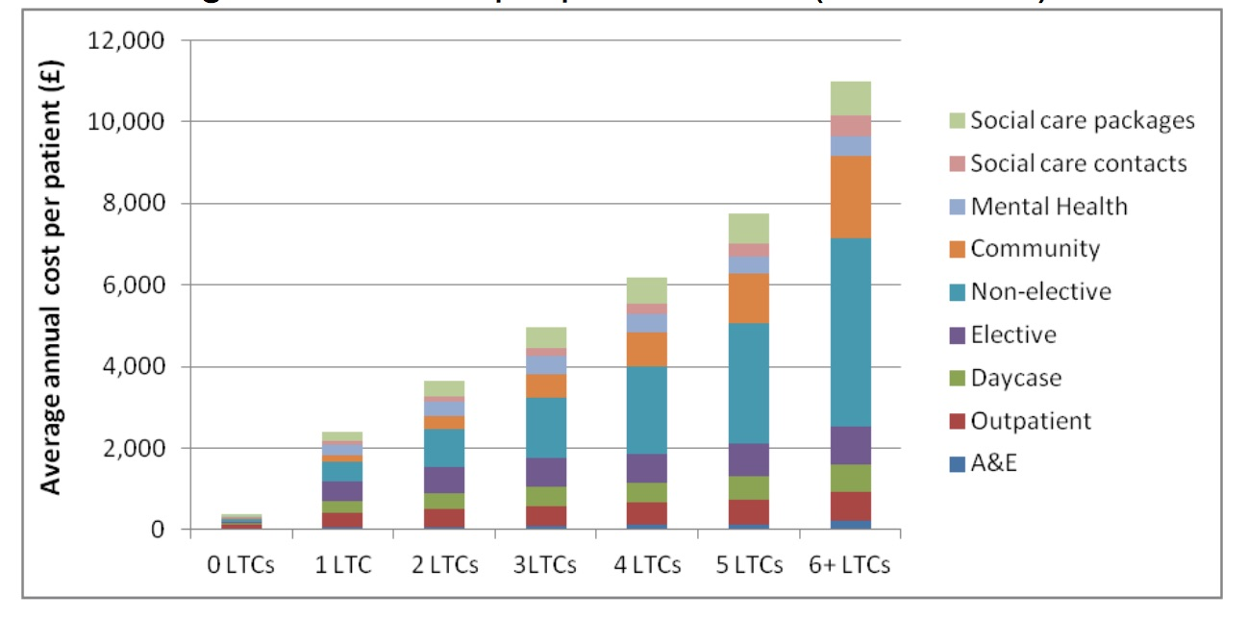
Poor Care is Expensive Care
Costs rise with Co-Morbidity: Substantially if Admitted
NHS England (2014) ibid

Slide 9
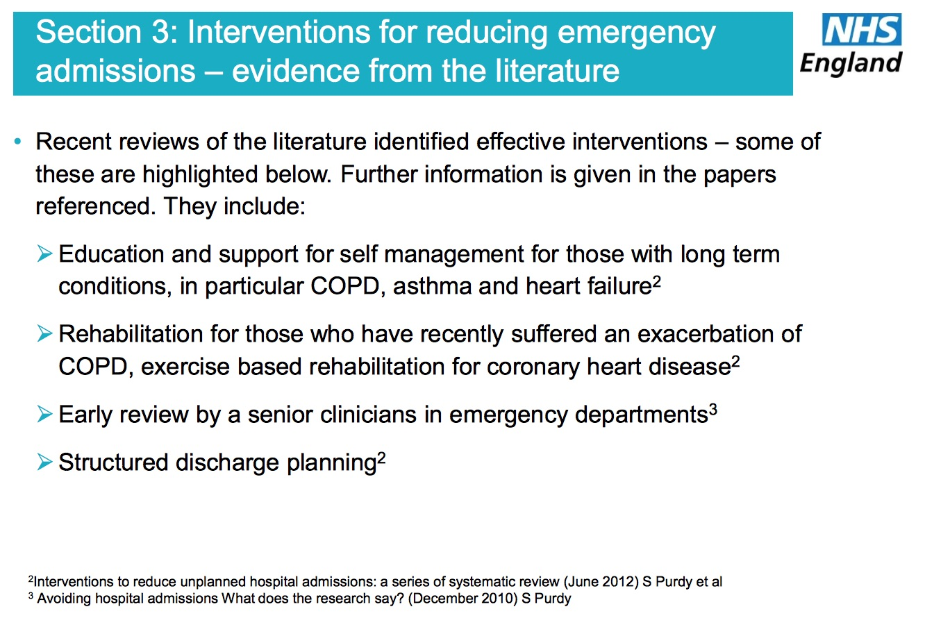
High-Impact Interventions
Audit Commission (1997)
Notes:
During the recent strikes by Junior Doctors some interest results have been observed in London hospitals as a result of the increased presence of senior medical staff in Accident & Emergency Departments.
20% fewer patients presented at A&E, but admission rates were unchanged suggesting that all who warranted admission did still attend. Adherence to the maximum waiting time target improved, with lower use of diagnostics
Vancheeswaran R “Unexpected insights on variation from the doctors’ strike” Health Service Journal, 13 may 2016

Slide 10
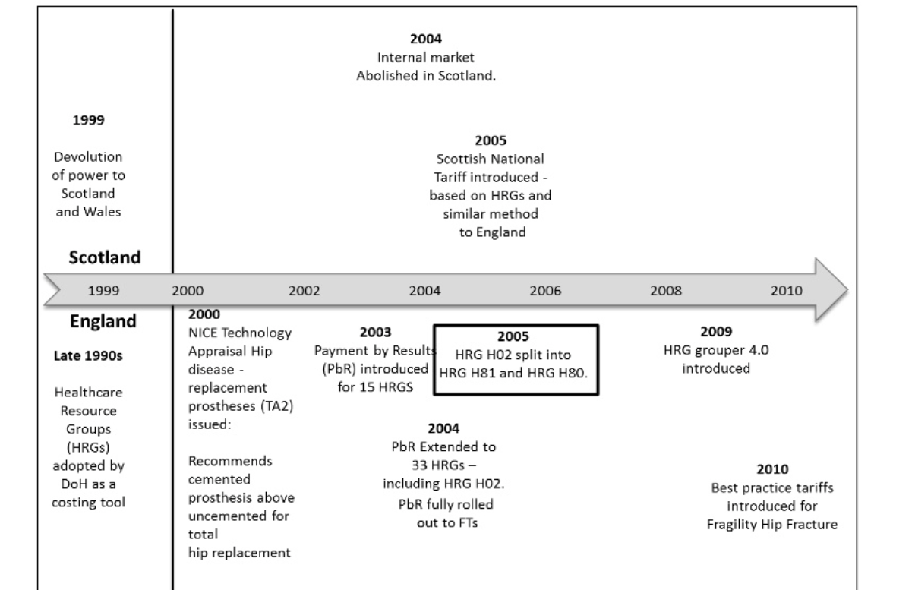
Incentives v Guidance: Hips
https://www.ohe.org/news/do-financial-incentives-trump-clinical-guidance-hip-replacement-treatment-england-and-scotland
2015
Notes:
1983 Nurofen, Imodium, Triludan switched
Note: Each step may be a small battle, but less likely to be reversed than major reforms.

Slide 11
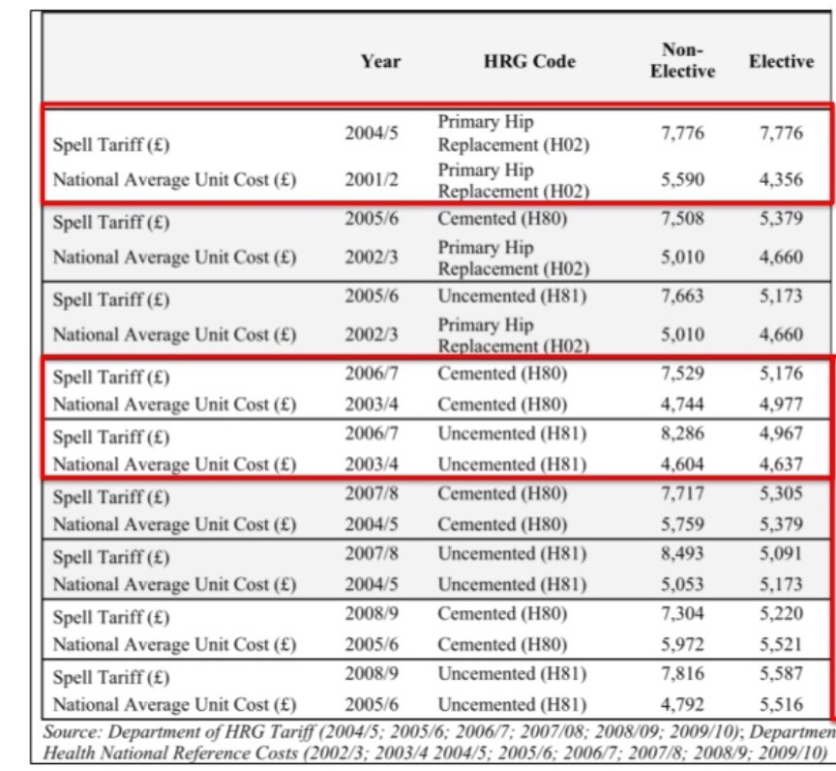
Incentives or Guidance? Hips
Provider may receive greatest net return from uncemented prostheses
NICE (2000) Guideline:
“more evidence of long-term viability of cemented prostheses…”

Slide 12
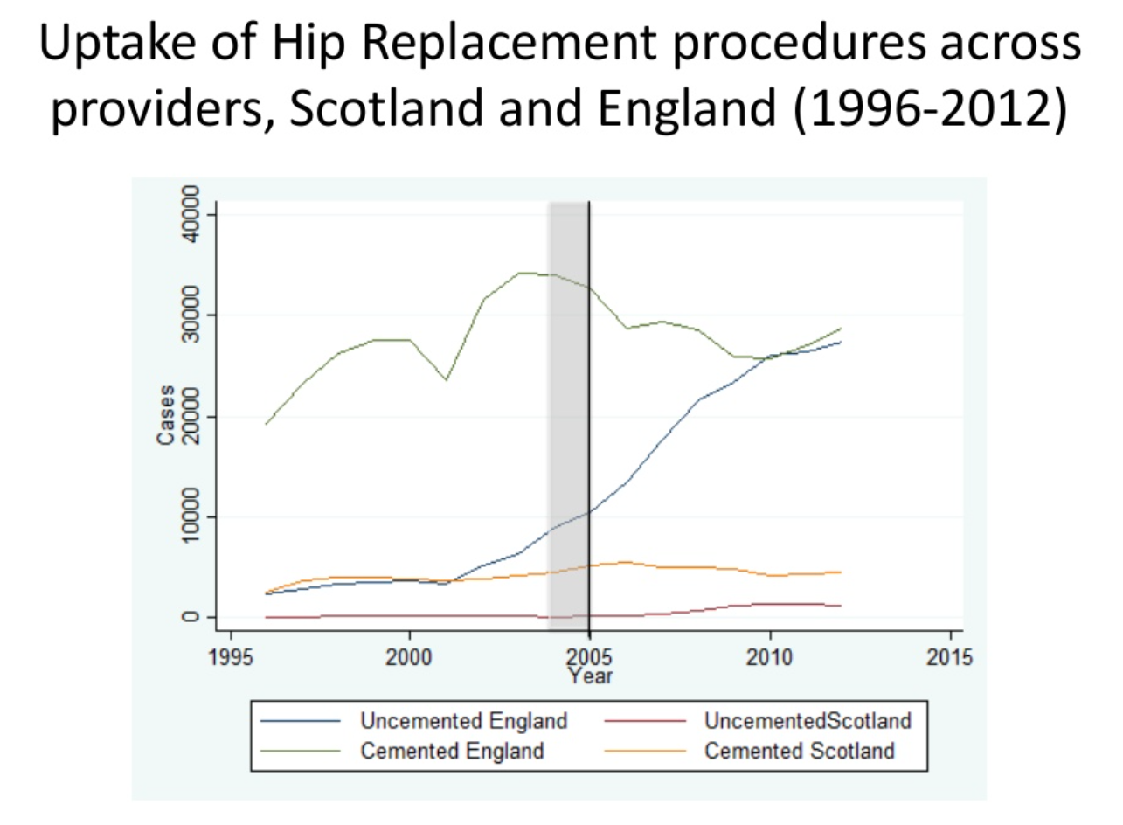
Incentives v Guidance: Hips

Slide 13
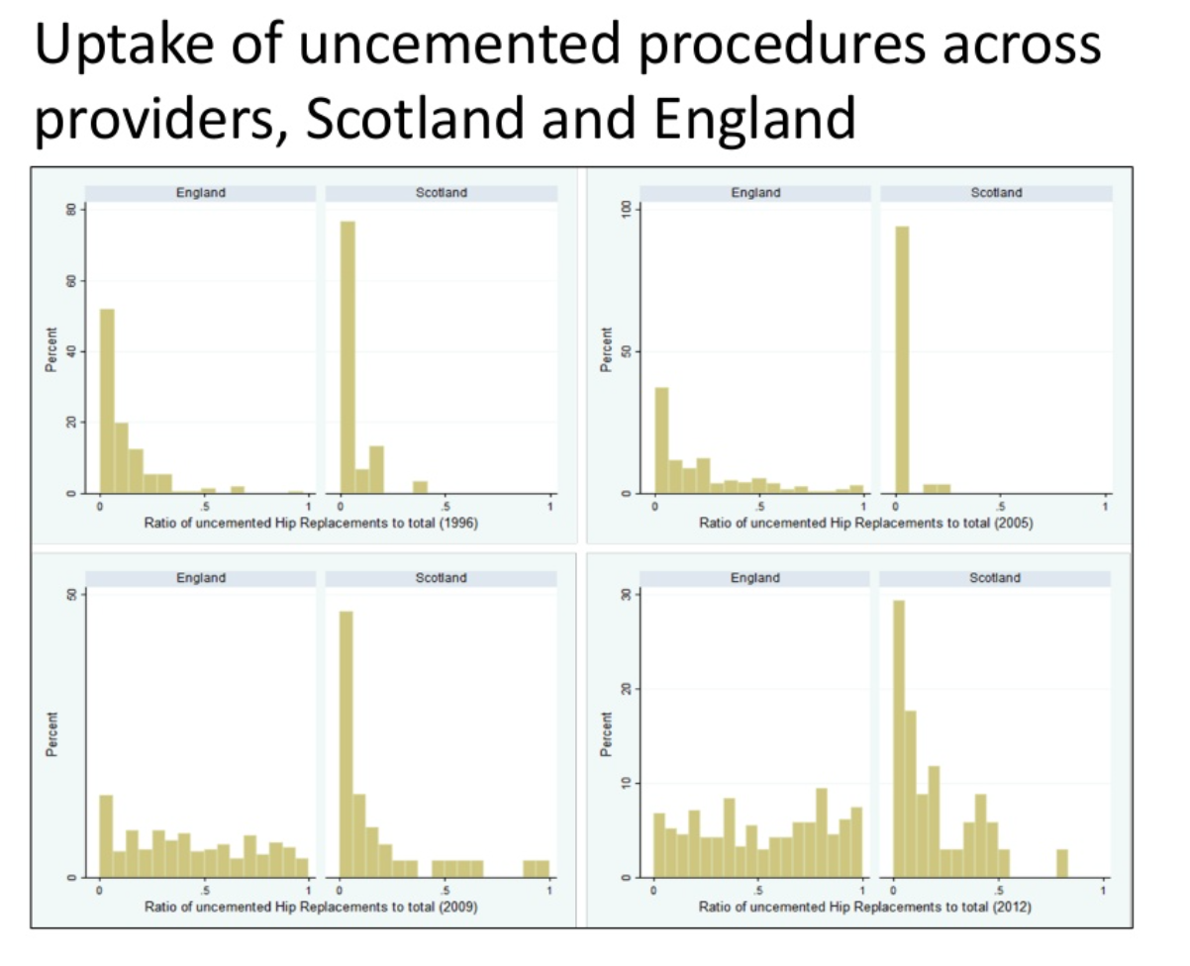
Incentives v Guidance: Hips

Slide 14
The “Quality Premium”
Annual Reward for Purchasers (CCGs)
  Maximum £5/registered patient
  (= max £1.2m/average CCG)
  National Measures = 70% of QP
    Cancer (20%)
    GP Patient Survey Results (20%)
    E-Referrals (20%)
    Improved Antibiotic Prescribing in Primary Care (10%)
30% of QP for approved local “Right Care” work,
  tackling local variations, inequalities, population health
https://www.england.nhs.uk/wp-content/uploads/2016/03/qualty-prem-guid-2016-17.pdf

Slide 15
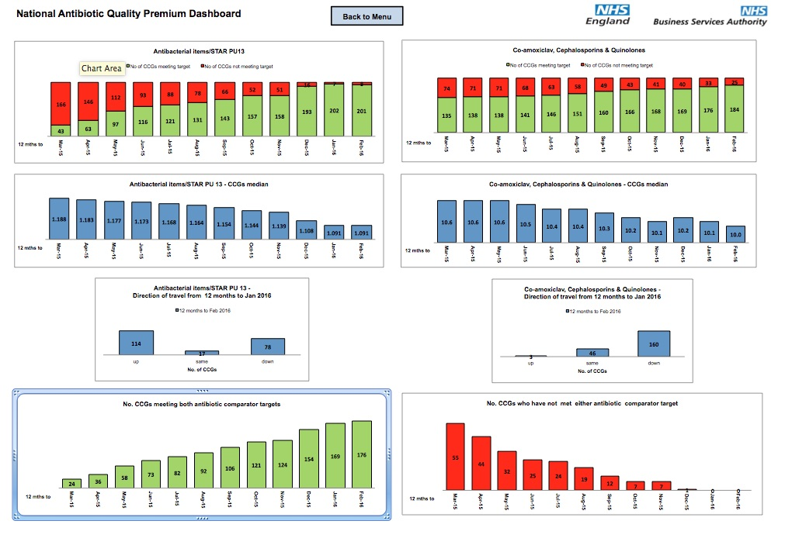
Quality Premium: Antibiotics
https://www.england.nhs.uk/resources/resources-for-ccgs/ccg-out-tool/ccg-ois/anti-dash/ (Feb 2016)

Slide 16
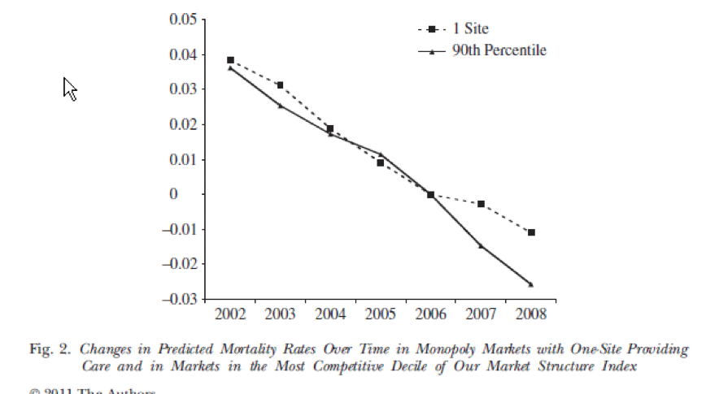
Competition, Choice & Quality
Cooper et al “Does Hospital Competition Save Lives?” (2011) Economic Journal 121(554) F228-F260

Slide 17
Incentives for Quality
“Robust” incentives
    align motivation of clinicians & managers
Appeal to both intrinsic & extrinsic motivations
  better to assume both motivations
Potential for spillovers
(+ve or –ve)
Ineffectiveness of inspection systems

Slide 18
Transparent Public Ranking
4 Essentials
Public
Understood
Maintained
Ranked
Hibbard, J.H. et al. (2003) “Does publicizing hospital performance stimulate quality improvement efforts?” Health Affairs, 22(2): 84-94.

Slide 19
Health Spending Review
Amenable Mortality
Care Standards for ACSCs (CHD, Stroke. Diabetes, COPD) – Monitoried, Reported & Ranked
Voluntary Pilots of integrated care (SHI, Hospital, GP, Pharmacy) for chronic disease
Improved status & training for qualified nurses within new programmes, supplemented by Health Care Assistants
Support Patient Advocacy development

Slide 20
Health Spending Review
Pharmaceuticals
GP Prescribing
  – Feedback cost data & with public ranking
INN Prescribing
- for all Newly-licensed Prescription Medicines
Liberalised OTC market, with advertising

Slide 21
Health Spending Review
Hospitals
Assess & Rank
  Day Surgery Rates
  Average Length of Stay
  Hospital-Acquired Infection Rates
  Costs/Weighted Activity Unit
  % consultations without patient records
  % of non-clinical floorspace
  Facilities Costs/m²
Develop “Model Hospital” Best Practice benchmark
Set target for capital funds raised from hospital land sales
Build efficiency & outcomes into DRG development

Slide 22
Further Information
Carter Report on Hospital Efficiency
https://www.gov.uk/government/publications/productivity-in-nhs-hospitals
NHS “Anytown Toolkit”
https://www.england.nhs.uk/tag/any-town/
t.c.hockley@lse.ac.uk
+44 77 68 23 73 89

