Slide 1
IT Spending Effectiveness (Spending Review): Applicable Lessons from the Canadian Experience
Peter Brandon, Expert Advisor
Public Financial Management Division
Slovakia: Spending Review Management
Bratislava, 30 May – 6 June, 2016

Slide 2
National Reform Program of the Slovak Republic 2016 E-Government
In 2016, the National Framework for the Informatization of the Public Administration will be updated. Its aim is to elaborate, model and coordinate IT solutions in the public administration.
The centralized definition of rules and the implementation of the strategic architecture of the public administration will serve as a tool for the achievement of these aims.
Individual strategic priorities, which are defined by the framework, will then be developed to the level of initial analyses and proposals for projects in the Operational Program Integrated Infrastructure (OP II). Within OP II, the implementation of several national projects will be carried out in individual ministries in 2016.
The time needed for obtaining a building permit will be reduced.

Slide 3
Spending effectiveness (spending review)
An assessment of public spending effectiveness (spending review) represents a new instrument for achieving a balanced GG budget and increase the value for money.
The government will, under the leadership of the Ministry of Finance, and in close cooperation with the Government Office and all government departments, reform the rules, set up the processes and strengthen the institutions to support clear decision making process for every public decision and higher value for money in the Slovak public sector.
Decisions on key investments, policies, regulations of public and business behaviour and operational expenditure of the state will undergo a complex economic assessment.

Slide 4
IT Spending Effectiveness Review Problem definition
Based on a preliminary situation review in respect of the effectiveness of Slovak government IT spending, it would appear that the government cannot, at this point, be provided with sufficient assurance that:
The aggregate IT contribution to – and enabling effect on – government is optimal.
IT is firmly aligned with – and structured, led, and organized to deliver on – key government policies, directions and priorities.
IT resources are consistently allocated and used to support high value and high-impact priority objectives in clear preference o lower value and impact spending.
IT capital investments (CAPEX) and operations (OPEX) consistently leverage resources effectively and economically to achieve the right objectives and priorities.
A sufficiently developed set of rules (policies, directives, standards, guidelines, templates, etc.), supported by adequate internal capacity, is in place to guide IT stewardship in ministries and agencies.
The same rules are applied judiciously, fairly and consistently in planning, targeting, approving, managing, and reporting on the performance of IT operations and investments.
The public, businesses and NGOs are persuaded that information and opportunities arising from IT investments and operations are consistently available to them fairly, openly and transparently.
The “ownership,” control and accountability system in place for IT investments, both government-wide and in ministries, is effective.
Sufficient relevant performance data is available at this point to reach reasonable conclusions on how Slovak IT performance compares with other jurisdictions and the commercial sector.
Information Management (IM) rules and practices currently in place ensure that government information is effectively managed as a critical strategic, operating and accountability asset.
Under these circumstances, It would be difficult to assure the government that, in the aggregate, IT spending consistently achieves the objective of value for money.

Slide 5
A few principles going forward for the spending effectiveness review
What: Not a “cutting,” but a spending effectiveness enhancement exercise, aiming to strengthen IT’s overall “enabling effect” as an important Slovak government policy instrument
Increase the ability of IT to further policy objectives (policy enabling impact);
Enhance the potential of IT to enable effective and efficient program and services delivery to citizens and businesses (program enabling impact); and
Optimize and improve the efficacy (effectiveness, efficiency, economy) of IT investments (economies enabling impact).
Savings targets identified will be met through monetized combinations of these three types of spending effectiveness gains
Relevant information will be collected and maintained for benchmarking and ongoing performance tracking and reporting purposes
Appropriate internal capacity will be available to support effective value for money IT spending and the achievement of the goals below.
Strong information management practices support the management of government data as a critical asset.
Goal: Achieving and maintaining alignment between government policy and IT
IT is led and governed, and resources are allocated and spent, as befits a strategic government policy instrument
IT budgets in ministries and agencies are public resources to be stewarded responsibly in support of (a) government policies and priorities; (b) ministry objectives; (c) the public interest.
Goal: Shifting IT resources from lower impact to higher impact and reducing duplication
From commodity spending to strategic spending
From wasteful spending to fruitful spending (including terminating unproductive investments)
From uncontrolled (e.g., “rogue” or “vanity”) spending to disciplined, coordinated, transparent, responsible and accountable spending
From duplicate spending to shared spending on common IT enablers
Goal: Disciplined stewardship of IT investments
Strategic alignment (government, ministry, public) and cost-benefit footing
Governed firmly (both centrally and within ministries), managed competently, accountably and transparently, within a clear IT policy, planning, and performance and benefit realization framework
Opportunities (e.g., for private industry) distributed fairly, transparently and on merit
Goal: Effective accountability for IT outcomes and the use of IT resources
No spending without accountability
Clear ownership, IT controls, responsibilities and accountabilities are set out and distributed through IT policy and governance
Compliance with central IT policies is monitored, tracked and reported
Program and IT managers are “co-creators” of IT outcomes, and remain jointly accountable for them.

Slide 6
Prioritizing possible opportunities (1)
Opportunity | Alignment with and contribution to: |  |  | Assessment on: |  |  | Priority stream proposed
 | Digital society/ e-government directions | More effective and efficient programs and services | More effective and economical stewardship of IT resources | Political and public support potential | Potential for consensus inside government | Ease and duration of implementation
Consolidate and centralize procurement of end-user devices and use-based management of SW licenses
Consolidate WANs/LANs into a single network capability (voice, data, image)
Shared “commodity” infrastructure services (e.g., e-mail, servers, printers, security/ access, support for users, messaging, asset management)
Consolidate government web and portal presence (web presence and web publishing consolidation, user experience, plain language use)
Back-Office Optimization (e.g., HR, Finance, Document Mgmt, Payment Processing, Employee Pay and Benefits, etc.)

Slide 7
Prioritizing possible opportunities (2)
Opportunity | Alignment with and contribution to: |  |  | Assessment on: |  |  | Priority stream proposed
 | Digital society/ e-government directions | More effective and efficient programs and services | More effective and economical stewardship of IT resources | Political and public support potential | Potential for consensus inside government | Ease and duration of implementation (easy & short)
Terminate unproductive ongoing investments
IT Executive “Tsar”
IT Governance (central and in ministries)
Central IT Policy Authority (the “rule-maker”)
IT investment life-cycle management framework (plan, justify, approve, execute, monitor, report)
Critical capacity development
Information Management (data integrity, common data semantics and standards, one instance for each information item

Slide 8
IT Spending Effectiveness Report Table of Contents
Executive Summary
Background
Problem definition
Analysis and Directions
Conclusions
Recommendations for Action
Annexes
IT Spending Effectiveness Review (Spending Review) Terms of Reference
Short-term Opportunities Roadmap
Short-term Opportunities – Value Chains, Logic Models, and Performance Tracking and Reporting Framework

Slide 9
Digital society and IT A Governance Structure
“E-LEARDSHIP” Leading and championing digital society, e-government and IT
GOVERNANCE Digital society, e-government and IT stewardship
“RULES” Policies, Standards, Guidelines, Templates
“EXECUTION” Investment
Selection, Resourcing and Implementation
“SERVICING” Shared Services Capability

Slide 10
Example: The “machinery” for generating value
FMT Outcomes
Effective departmental and GC-wide FM decision-making, effective & efficient operations and services, cost savings, and lower risk of funds misuse and misreporting
Deploy, through governance, engagement, implementation and change management activities
Capability leveraging
FMT Outputs
Modern capabilities for better FM decisions and a streamlined, enterprise approach to FM operations in departments
Measure, Evaluate Adjust
Develop and leverage transformation capabilities
Track performance and adjust pace and targeting
Develop, through targeted and coordinated portfolios of projects
Measure, Evaluate, Adjust
Capability generation
FMT Program

Slide 11
Example: Value Chain
Capability generation
Capability leveraging
The GC is well managed and the resources are allocated to achieve results
Project Inputs
Project Portfolios
Project Outputs
Program Activities
Program Outcomes
Program Impacts
Current FM activities
Current FM information
Current FM business processes
Current FM services
Existing FM transactions
FM internal controls
FM evaluation requirements, etc.
Targeted portfolios of projects focused on generating key transformation capabilities:
FMT project portfolios strategy planning and management
Architecture development;
Business Transformation development
Service Transformation
System Transformation
Enterprise Reporting and Analytics
Key transformation capabilities targeted by projects include:
Enterprise FM Architecture;
FMT implementation strategies and plans;
FMT engagement strategies and plans;
Enterprise Business Model for FM, etc.
FMT capability deployment;
FMT program management & governance
FMT change management and engagement
Immediate: GC departments operate through modernized FM business processes, capabilities, systems and services;
Intermediate: The GC operates through a modernized, enhanced value-for-money, enterprise approach to FM
Contributions to long-term impacts targeted by the FM Policy:
Safeguard the public purse;
Effective decision-making;
Efficient operations;
Accountability to Canadians
This value chain captures the essence of FMT’s value “manufacturing system”. FMT uses a coordinated and targeted set of project portfolios (from Architecture to Enterprise Reporting) to create key FM transformation capabilities (project outputs) that are leveraged to achieve FM transformation results (program outcomes) for lasting GC-wide impacts.

Slide 12
Example: Logic Model
Capability leveraging
Target FMT capabilities (project outputs)…
…are deployed through FMT program activities…
…that aim for FMT program outcomes…
Enterprise FM Architecture;
FMT implementation strategies and plans;
FMT engagement strategies and plans;
Enterprise Business Model for FM that drives continuous improvement;
Enterprise Service Delivery Model for FM for common and routine financial management activities;
Enterprise Reporting and Analytics Model providing a unified view of FM information;
Enterprise Solution based on a single financial management system environment;
Enterprise change management strategies and plans
Departmental
GC departments operate through streamlined FM business processes, systems and services that support:
Government-wide (long-term)
The GC operates through an enterprise approach to FM that supports:
Information available supports better GC-wide FM decision-making
Increased effectiveness and efficiency in FM operations and services;
Effective operational safeguards are in place to reduce systemic risks of misuse and misreporting of public funds; and
Ongoing GC-wide cost savings are achieved through operational realignments and better government-wide resource-related decision-making.
FMT program management and governance
FMT capability deployment
FMT change management and engagement
Immediate
Use of common, standardized FM business processes.
Use of common, standardized data definitions.
Use of a common, single-platform enterprise DFMS solution.
Intermediate
Mote timely and reliable information for FM decision-making and the exercise of authorities.
Enhanced and more efficient financial and resource management services.
Reduced reporting, compliance and administrative burden (through built-in safeguards, business rules and automated electronic information exchanges.)
Lower on-going costs of supporting DFMS.
Program (capability leveraging) performance measurement: Through key FMT program activities, project portfolio outputs (target capabilities) are turned into program results and eventually into long-term impacts. From a performance measurement perspective, tracking the achievement of these results and their long-term impacts using a set of indicators and related measures will form the basis of FMT program performance measurement.

Slide 13
IT Spending Review Report Short-term Opportunities – Performance Tracking and Reporting Framework (example only)
Opportunity: Financial Management (FM) System Consolidation
Outcomes | Measures | KPIs | Data sources
Information available supports better government-wide FM decision-making | improvements in the accessibility, consistency and quality of system-wide financial and performance information across government | Information available supports resource management, costing and performance management needs across the government. Information available supports an enterprise management perspective, including a more complete understanding of the effectiveness of programs and the efficiency of operational and internal services functions across government. | Relevant findings from assurance reports – departmental and horizontal – targeting costing and performance management approaches in departments and across the government Relevant findings from assurance reports – departmental and horizontal – targeting effectiveness of programs and the efficiency of operational and internal services functions approaches in departments and across the government
Increased effectiveness and efficiency in FM operations and services | Improvements in effectiveness and efficiency of FM operations and services across government | Increase in FM service levels across government provided in assurance reports (vertical and horizontal) Service level satisfaction statistics maintained by departments Increase in operating effectiveness across government provided in assurance reports (vertical and horizontal) | Relevant findings from assurance reports – departmental and horizontal – targeting the performance of FM operations and services Information from departments on levels of satisfaction with FM operations and services based on statistics maintained in departments and Shared Services Canada Data on expenditures on FM operations and services as percentages of government-wide operating budgets.
Effective operational safeguards are in place to reduce systemic risks of misuse and misreporting of public funds | Progress in implementing essential systemic operational safeguards across government as set out in the FM Policy. | Effectiveness of standardized management processes and practices in departments in safeguarding of public funds evidenced in assurance reports (vertical and horizontal) and departmental statistics Effectiveness of processes put into place to support effective reporting, attestations and disclosure in increasing transparency and the quality of reporting to Canadians evidenced in assurance reports (vertical and horizontal) and departmental statistics. | Relevant findings from assurance reports – departmental and horizontal – targeting operational approaches used by departments in preventing misuse of funds Relevant findings from assurance reports – departmental and horizontal – targeting reporting, attestations and disclosure approaches used by departments in preventing misreporting of funds Reports and assessments in the wake of FM-related horizontal review and rationalizations exercises
Ongoing government-wide FM cost savings through operational realignments and better decision-making | The actual year-over-year FM unit and aggregate cost reductions across government that can be ascribed to FMT program results across departments | Percentage cost savings through lower ratios of FM FTEs to total FTEs, particularly in medium and small departments Percentage cost savings in FM services through provision of self-service capabilities to RC managers and their staff Percentage cost savings through lower compliance and reporting costs | Time series of the ratio of FM FTEs to total FTEs (from the current baseline) Time series of total expenditures on FM services as percentage of operating budgets (from the current baseline). Reports and assessments in the wake of FM-related horizontal review and rationalizations exercises

Slide 14
Achieving economies through IT Canadian lessons learned
IT in government is three things:
A resource management concern (as an “internal service”);
An enabler for other programs and services to achieve their objectives and efficient delivery; and
A policy instrument for the government to help create a cost-effective digital government that meets the expectations of modern “digital citizenship.”
As such, an IT spending review must achieve a balance between:
Gaining economies through better IT management strategies and techniques (direct IT economies); while
Maximizing the enabling potential of IT for other programs and internal services to achieve economies (indirect IT economies); and
Strengthening the positioning of IT as a policy instrument for efficient e-government in an increasingly digital society (policy impact).
To achieve this balance, it is important to:
Optimize the delivery and cost-effectiveness of the IT function, but not weaken the ability of IT to function effectively through excessive direct economies;
Protect mission-critical systems
Place greater emphasis on indirect economies (e.g., through IT substitutions where appropriate); and
Strengthen leadership focus and governance mechanisms to drive a portion of the savings and freed capacity toward e-government
Take a “continuous optimization” approach
Strong policy framework and governance
Canada has strong Information Management and Information Technology policy suites;
Strong governance is essential to exercise guidance, oversight and overcome resistance
Important differences between smaller and larger governments
Large governments (UK, US) tend towards an enterprise framework with several service providers and enabling systems; while
Smaller governments (e.g., Canadian provincial governments) often have a single provider and system

Slide 15
Achieving economies through IT Canadian lessons learned
Implementation of shared services and systems is a long term continuous improvement effort, requiring sustained commitment to change
Transition from a decentralized, departmental model to a consolidated, centralized (or shared) model takes 5-7+ years from initial decision to completion
Many of the expected savings and economies of scale take longer than expected
The change process is long and difficult
Need to standardize first, then implement shared services/systems
Standardize business processes and information architectures around a common model
Implement first, standardize later, does not work
Need sustained attention to performance measurement, business case analysis and central agency oversight
Departments resist standardization and “no customization” rules
Effective performance measurement and benefits tracking
Strong policy direction and oversight
The most lasting benefits come from simplification and reduction of diversity
Simplify business processes
Reduce diversity and variety of equipment, systems and practices
The second most consequential benefits come from “commoditization”
Many transactional activities are commodities – focus on reducing the cost of transactions
End-users equipment is a commodity – focus on reducing diversity and on buying through common procurement
Software licenses are a commodity – focus on reducing aggregate costs and eliminating unnecessary numbers

Slide 16

Achieving economies through IT IT cost optimization strategies used in Canada
Structural changes, business process simplification/ improvement, new methods, innovations
Highest potential for optimization and economies
Most difficult to achieve and long-term to harvest savings
Canadian examples: Shared Services Canada, Service Canada
Joint business/IT optimization
Implement cost-saving IT solutions within programs and internal services
Savings are shared between IT and business lines
Second highest potential for cost savings
Canadian examples: HR Modernization, Financial Management Transformation, Gated Investment Management, Management Accountability Framework (MAF)
Cost economies within IT
Act on opportunities to save on IT costs through cost-optimization approaches and eliminating “excess IT spending”
Track benefit realization
Canadian examples: revamp the back-office application portfolio, computing centres and network consolidation, virtualization of storage and servers, use of cloud computing, better IT investment oversight
Procurement, negotiations and license management
Reduce diversity, standardize specifications, rationalize licenses
Leverage government buying power to get the best price
Renegotiate enterprise licenses and keep “license creep” to a minimum
Canadian examples: consolidated procurement for all end-user devices and software
Higher savings Greater difficulty and risk

Slide 17
Achieving economies through IT Strategic and Operating Review, Back Office Services and Systems (Deloitte), 2012
Government-wide transformation program
Focus on major opportunities, starting with HR and finance functions.
Program management approach (and processes)
Ability to have a top-down, government-wide view of all initiatives across all departments.
Enterprise governance
Culture that embraces cost (and performance) management
Consolidate transactional activities into shared services operations
Streamline and simplify business processes and underlying systems

Slide 18


Achieving economies through IT Blueprint/Destination 2020 (2013-2014)
A whole-of-government approach
Enhances service delivery and value for money
Focus on efficient and—where they make sense—consolidated operations to increase flexibility, drawing on innovative and proven approaches to complex problems.
An enterprise-wide management culture and supporting structures
Enhance collaboration on complex, cross-cutting issues and solutions, and that simplify the web of rules and reporting requirements while maintaining transparency and accountability.
Effective and efficient business processes
Draw on collective expertise to achieve economies of scale in areas of common interest across the Public Service while maintaining high standards of quality, accessibility and equity of services to Canadians.
Widespread adoption of common and shared services
Standardize, streamline and consolidate administrative functions within and across organizations
Focus on functions such as finance, human resources, pay and benefits, and security to help get value for money.

Slide 19
Achieving economies through IT Modernization, common systems and shared services
Shared Services Canada (SSC)
Delivering more effective and efficient IT services, including data centre, networking & security, email, and end-user devices.
Pay Modernization and Pension Modernization
Standardizing and consolidating the delivery of compensation and pension services within a single organization serving all departments and agencies.
The Human Resources Service Modernization initiative
Standardize the delivery of HR services across government
Enterprise-wide approach to HR management practices
Common HR system (PeopleSoft)
Shared Services Integration
Common HR services to departments
Services are fully cost recovered
Developing shared services offerings for case management and financial systems and services (attractive for small departments and agencies which do not need to develop their own capabilities)
Standard on Enterprise Resource Planning Systems
Designates SAP as the target financial management system platform for the GC.
The Back-Office Transformation Initiative
Reduce variety in the back office systems
Look for common solutions and shared delivery services
HR Modernization
Enterprise-wide approach to HR services
Common enterprise financial management system (PeopleSoft)
Financial Management Transformation
Enterprise-wide approach to Financial Management services
Common enterprise financial management system (SAP)

Slide 20
Achieving economies through IT Government On-Line (1999)
“The Government will become a model user of information technology and the Internet […] with Canadians able to access all government information and services on-line at the time and place of their choosing.”
Government On-Line (GOL)

Slide 21
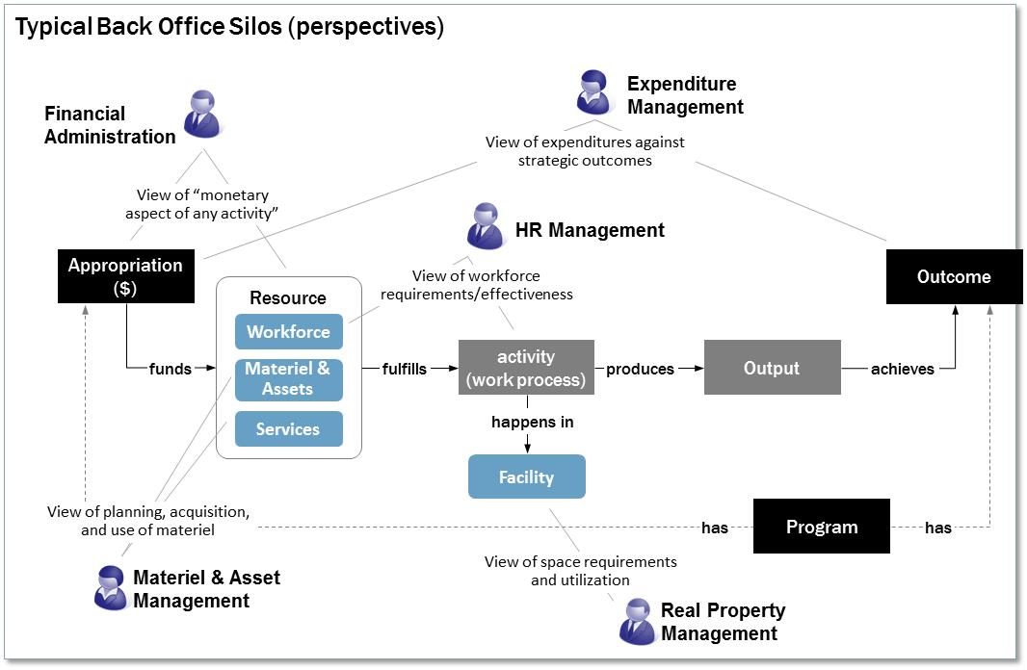
Achieving economies through IT Taming the back office “beast”…

Slide 22
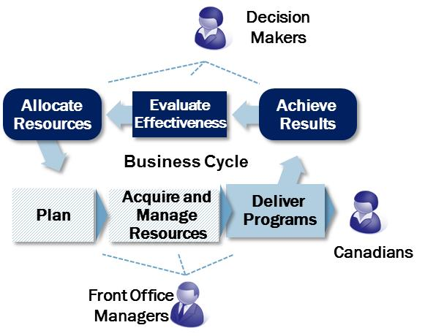
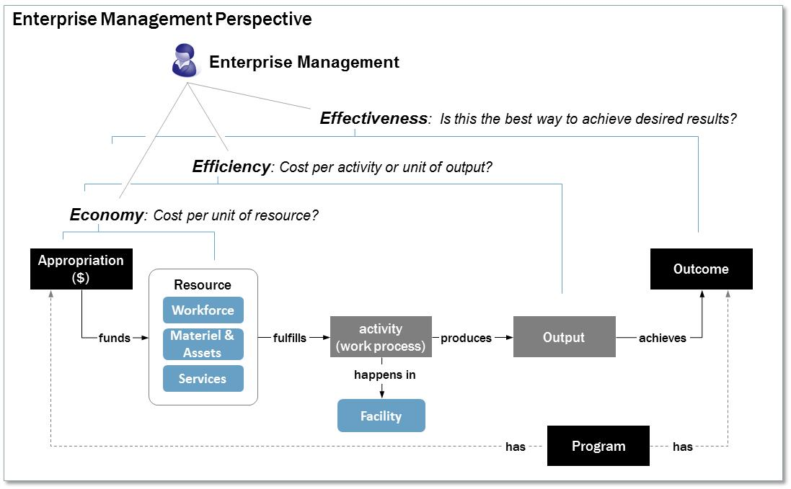
Achieving economies through IT …and get an integrated enterprise perspective

Slide 23
Financial Management Transformation Problem and opportunity definition
The current decentralized, largely departmental model for financial management is ineffective and inefficient from an enterprise, GC-wide perspective:
Business processes, information and financial management system configurations are customized by each department, despite a common legislative and policy framework. It is very difficult, time consuming and costly to assemble useful government-wide information for decision-makers and enterprise management needs, and the cost of maintaining 50 different systems, spread across five different platforms (plus many other bolt-on applications) is much greater than necessary.
While large departments as a group benefit from economies of scale, medium, small and very small departments do not. Financial management business processes and services are too often burdened with manual processing, redundant activities, and over-reliance on the intervention of back office specialists in routine work. Efficiencies and cost savings could be gained if all departments could achieve the same performance as the most efficient.
Across government, significant amounts are expended by departments every year on projects related to financial management systems, many of which duplicate efforts of other departments. These investments do not achieve near the value-for-money that could be realized in a more coordinated, enterprise approach.

Slide 24
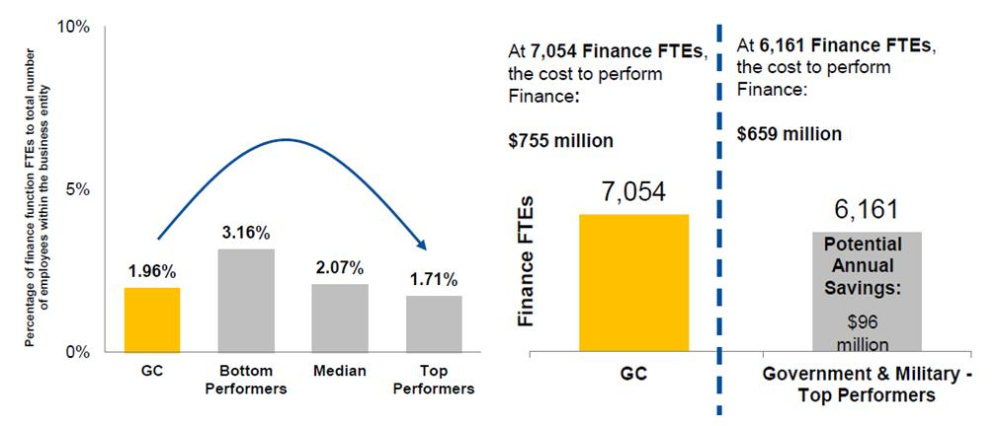
Financial Management Transformation Analysis of Efficiency Gains, Gartner Inc.
Gartner estimated that if the GC could improve the aggregate GC ratio of Finance FTEs to GC FTEs to match top performers in the benchmark, potential efficiency gains could be in the range of $96M.

Slide 25
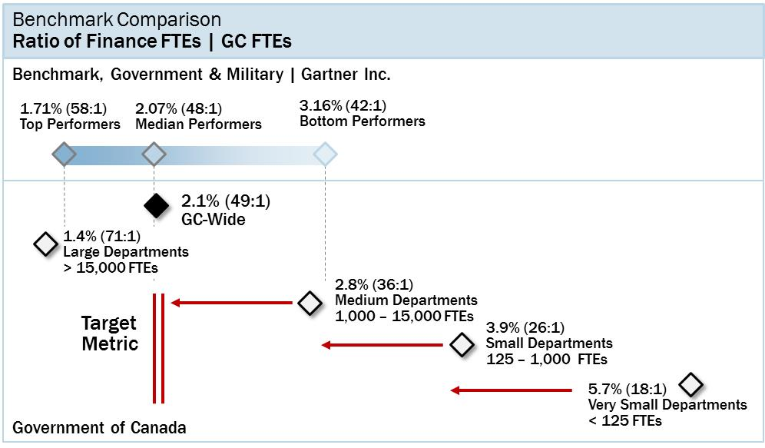
Financial Management Transformation Potential Improvements in Financial Management Cost Metrics

Slide 26
Financial Management Transformation Potential Efficiency Gain from Financial Management Services

Slide 27
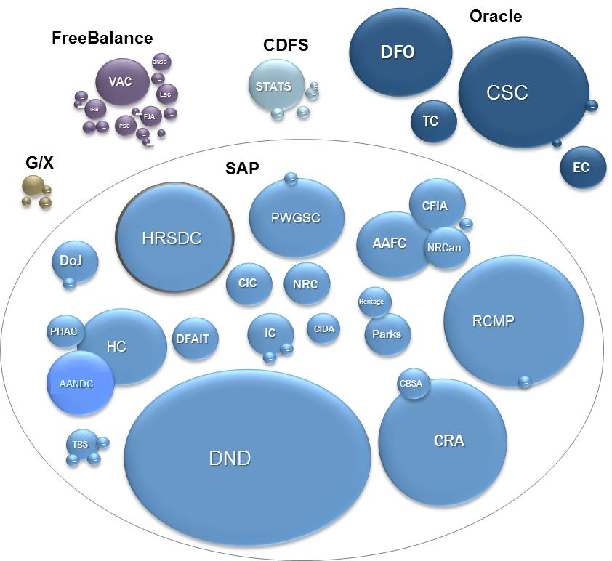
Financial Management Transformation The problem
The GC Financial System Landscape
50 different system instances, 5 platforms.
More complex and customized than industry.
Cost of steady-state support is $150M per year.
Benchmark analysis: this cost can be reduced by 40-50%
Common business model and platform,
Less customization
An additional $100M annually is spent on related projects
Enhancements;
Customizations;
Duplicate efforts

Slide 28
Financial Management Transformation The opportunity
Standardizing, and streamlining business processes across government.
Using financial management systems as intended by their vendor to automate processes and introduce self-service capabilities, making services more responsive to the needs of program managers.
Redirecting back office specialists away from routine administrative tasks towards higher-value financial and resource management disciplines such as costing and performance measurement.
Standardizing and integrating data and information across processes, systems and departments, making it more useful, consistent and readily available to stakeholders at a departmental and enterprise level.
Consolidating delivery of routine, transactional financial management services to enforce and maintain standardization, implement more modern service delivery strategies, and make service more responsive to the needs of managers and staff.
Focusing and redirecting investments that will be made regardless towards a common financial management solutions and an enterprise model, instead of duplicative departmental projects.

Slide 29
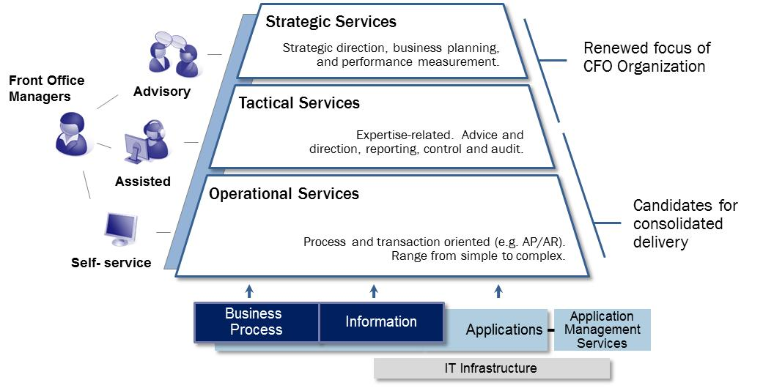
Financial Management Transformation Financial Management Service Delivery Model

Slide 30
Financial Management Transformation Single GC Solution Model
The foundation of the target-state enterprise model for financial management is a single GC solution for financial management, built around common business processes, data definitions and application configuration.
The solution will adopt best practice business processes and application configuration, proven in industry and the public sector and already supported within the application platform as delivered by its vendor.
Customization will only be supported for truly unique GC requirements.
Standardization of processes and data will be enabled through use of the single solution, and enforced by enhanced GC-wide process and data standards that apply to all departments.
Business needs and requirements for the single GC solution will be defined by the Office of the Comptroller General (as business owner), in collaboration with departments and common service providers.
The solution itself will be supported from a consolidated application management service (Shared Services Canada)
The single GC solution for financial management will evolve through several versions. The scope of the first version will be oriented to the business needs of smaller, less complex departments. Subsequent versions will increase capability to address the full range of business needs met by current departmental systems, including those of larger, more complex departments. To accelerate timelines and mitigate technical risk, elements of existing departmental solutions, including that being developed for Economic and Social Development Canada (ESDC) will be harvested for the first version of the single GC solution.

Slide 31
Financial Management Transformation Options assessment and cost-benefit picture
Business Need
Extent to which desired outcomes can be met and sustained.
Extent to which requirements can be met and sustained.
Considers probability, timeline and scope or scale of outcomes, as well as stakeholder satisfaction.
Strategic Alignment
Consistency with Government policy direction and objectives.
Consistency with related initiatives and approaches adopted for other functional areas.
Consistency with solutions and approaches adopted by comparable jurisdictions.
Risk
Project, implementation and financial risk
Risk to program operations of departments
Organizational capacity
Stakeholder commitment
Cost-Benefit
Size and timing of investment costs, and resulting quantitative benefits.
Net financial benefit (benefits less costs).

Slide 32
Financial Management Transformation The critical role of Functional Policy Centres
TBS functional policy centres are primary stakeholders. The target state model and expected outcomes all depend on the adoption of common business processes, information and system configuration across government, as well as consistent implementation of a modernized and efficient service delivery model. Functional policy centres must at a minimum facilitate, if not direct, the design of these common business models.
As the policy centre for financial management and materiel management, the Office of the Comptroller General is most directly involved in designing the target state, as a business owner for these functions must play a lead role in directing and governing change.
Many financial management functions have linkages with HR management, particularly if viewed from the perspective of a program unit manager, and all financial management functions are reliant on the capabilities of supporting applications and systems. Therefore the Office of the Chief Human Resources Office and the Chief Information Officer Branch will need to be engaged supporting and governing change.
All of the functional policy centres will need to take on more directive roles than has been the case in the past. In the past, policy centres have acted mostly through policy instruments prescribing minimum common requirements (without necessarily specifying how those requirements should be met). To achieve a common business model across government, and to realized benefits that depend on operational, procedural changes, policy centres will need to provide much more prescriptive and detailed direction, and the will need to collaborate extensively to ensure that the business model and services truly support the needs of program unit managers and are integrated across functional silos.

Slide 33
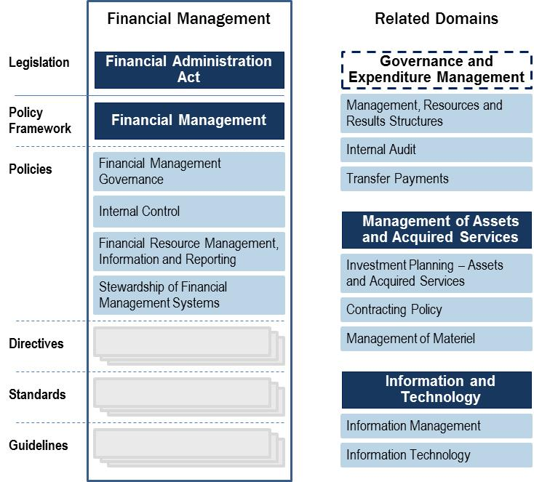
Financial Management Transformation Financial Management Policy Framework
Horizontal accountability for financial management flows from the role of Treasury Board, which “has the authority to ensure that the government as a whole is managed in a coherent and effective manner.”
Much of this authority is exercised through Treasury Board policy instruments, which specify mandatory requirements for financial management, as well as associated compliance measures and consequences.

Slide 34
Financial Management Transformation How is the FMT solution constructed?
Unique department-specific functionality
Department-specific
Common FM Business Process, Information, and Data Models
FM Core
Cluster Commonalities
Common FM Business Model
GC-wide FM functions, rules, controls, reporting, interfaces to other GC systems
Common functionality specific to a cluster of departments
Solution is built using:
Common GC functional and information architectures;
Commercial off-the-shelf software (SAP);
Common repository of reusable components/modules; and
Configurable components/modules to address cluster and departmental distinctions.

Slide 35
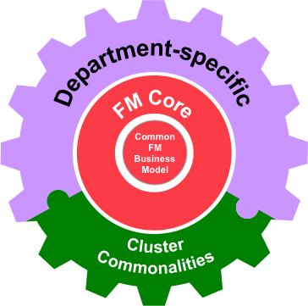
Financial Management Transformation FMT build-and-implement strategy
Departmental implementation of the common FMT solution
Wave 2 departments
Wave 3 departments
Wave 0 – Initial build
Wave 1 departments
Manage local implementation and deployment (Departments owners)
Use/ Contribute
Increasingly functionally-complete Repository of Reusable Components
Manage reusable FMT solution components (Program Office)
Out of the Box Functional Components
Assemble
Evolve/Mature
SAP
Year 0
Year 1
Year 2
Year 3

Slide 36
Outline of this Background
A few lessons from the Canadian experience in managing the government’s fiscal health
A few notes on the Canadian experience in managing and transforming the government’s IT function
Annexes
Annex A: Measuring and improving IT management across government – the Canadian Government's Management Accountability Framework (MAF)
Annex B: Establishing shared IT infrastructure services in the Canadian Government – Shared Services Canada
Annex C: An example of citizen-centric e-Government in Canada – Service Canada
Annex D: Measuring citizen satisfaction with e-Government
Annex E: – Applying the Canadian experience to structuring the thematic IT review process

Slide 37

A few lessons from the Canadian experience in managing the government’s fiscal health

Slide 38
Managing the government’s fiscal health The principal actors on the Canadian federal scene
Parliament
Approves the government's fiscal framework
Authorizes spending
Holds the government to account for meeting targets
Often called the department of the Prime Minister (note: there is also a Prime Minister’s Office – a political entity staffed by political appointees)
Non-partisan advice to the Prime Minister
Support to Cabinet
Coordinates key files, including strategic and operational reviews to ensure policy coordination and coherence across departments and agencies
Privy Council Office (PCO)
Develops the government’s fiscal framework
Sets government fiscal policy
Develops annual Budgets
Develops other tax, tariff, regulatory and related policies and legislation
Manages major transfer payments to other levels of government
PCO, the Department of Finance and TBS are the government’s Central Agencies
Treasury Board
Sets management and administrative policies for departments
Monitors management performance of departments
Oversees expenditure management and collects and reports on performance information from government departments
Department of Finance
Treasury Board Secretariat (TBS)
The Treasury Board is a committee of Cabinet composed of the president of the Treasury Board and four other ministers appointed by the prime minister. The Treasury Board is often called the government’s management board. The Treasury Board Secretariat is the department established to support the Treasury Board.
Departments prepare Expenditure Plans, divided into two components:
Reports on Plans and Priorities: These include information on the specific programs and services and how much each intends to spend to provide those programs and services.
Department Performance Reports: These reports entail assessments of each federal government department or agency, and whether it meets the expectations as set out in the Reports on Plans and Priorities.
Individual Departments, Agencies and Crown Corporations

Slide 39
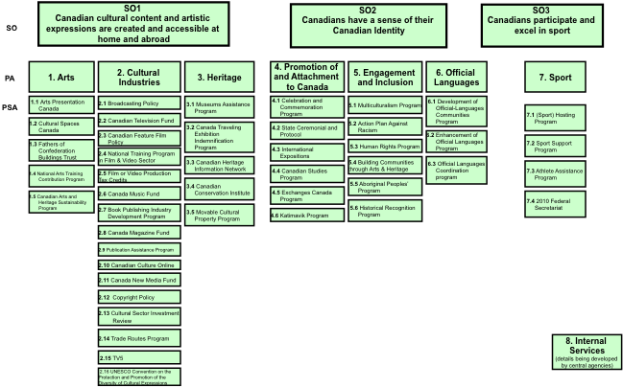
Managing the government’s fiscal health The main Government of Canada (GC) tools
Assessing the performance of Deputy Ministers (annual)
Deputy Ministers’ Performance Reviews
Cyclical assessments of existing spending to ensure alignment with priorities, effectiveness, efficiency and economy in expenditures (horizontal or thematic administrative reviews and vertical, department-by-department strategic, program and/or operating reviews)
Aggregate fiscal discipline (i.e. control of overall growth in spending)
Effective allocation of government resources to areas of highest relevance, performance and priority
Efficient and effective program implementation
Strategic, operational and administrative reviews
Expenditure Management System
Results for Canadians
Administrative compliance framework (including IT policy suite), evaluation and audit
Management and administrative policies, Internal Audit and Evaluation
Departmental Plans and Performance Reports
MAF Results
Management Accountability Framework (MAF)
Assessing management performance across government (annual)
Reports of the Auditor General
Modern Comptrollership
Management Resources and Results Structure (MRRS)
Investment in fiscal management practices and controls
Detailed program component-level knowledge
Example: Heritage Department Program Alignment Architecture (PAA)

Slide 40
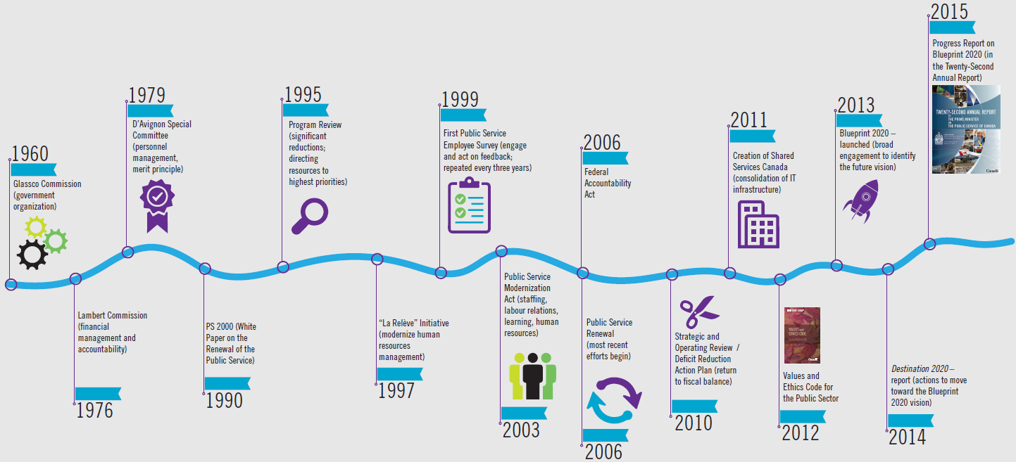
Managing the government’s fiscal health An ongoing search for good public service and fiscal sustainability
Operating principle: Fiscal sustainability is achieved via four broad categories of actions: (1) revenue increases; (2) changes in operations and in how public services are delivered (identified through horizontal evaluations and thematic/horizontal spending reviews); (3) cuts to and reallocations in program spending (identified through program evaluations and vertical strategic/program/operational spending reviews); and (4) managing the demand side of expenditures (up-front fiscal discipline.) Tough choices are at the core of the budgetary process, especially in times of fiscal stress. Spending Reviews provide a systematic process to support government in making these tough choices in a manner that supports both management excellence and fiscal credibility.

Slide 41
Managing the government’s fiscal health Spending reviews (strategic, operational and administrative)
Structure and Targeting
Focus and Conduct
Over a four-year cycle: all direct program spending reviewed - 25% each year
Treasury Board and its Secretariat set terms of reference:
Comprehensiveness – assessment of mandate, departmental objectives, program effectiveness, efficiency and alignment to government priorities
Reallocation proposals – options for program reductions or eliminations to reallocate to government priorities and support overall spending control
Reinvestment proposals – options to better support government priorities
Departments review the relevance and performance of all their direct program spending
Once organizations have completed a comprehensive review of all of their programs, they are required to identify a minimum of 5% of their program spending from their lowest-priority and lowest-performing programs.
Each organization is required to seek advice from arm's-length external advisors to get a third party perspective on the process and its results.
The Privy Council Office identifies review departments every year and assesses, with Treasury Board and the Department of Finance, the departmental proposals.
Final results are published in the Budget.
To answer specific questions in key areas:
Government Priority, Federal Role, Relevance (i.e. continued need and relevance of the program)
Performance (effectiveness, efficiency, value for money)
Management Performance
Conducted using the following key elements:
Analytical Framework: The department’s Program Alignment Architecture (PAA)
Information Sources: Evaluations, Audits, Management Accountability Framework assessments, Auditor General Reports, benchmark results, and other reports
Reporting Requirements: Outlined in the Terms of Reference
Steering Committee: A departmental steering committee to be established with ex officio membership from TBS
External Advice: Expert outside advice to be involved on each Review to ensure neutrality and credibility
Comprehensive Program Assessment questions:
Is the program a government priority?
Is the program consistent with core federal roles?
Does the societal need for which the program was designed still exist?
Is the program achieving expected results?
Is the program achieving results efficiently?
Can improvements be made to maximize efficiencies?
Are there opportunities to reduce overlap and duplication to achieve greater efficiencies and savings?

Slide 42
Managing the government’s fiscal health Lessons learned from Canadian spending reviews
Strategic, program, operations
IT spending reviews
Sufficient time for deliberative process and comprehensive review
Political (Prime Minister) and PCO leadership and ministerial engagement throughout the Review process
Clear and strategic alignment of programs and results (value of a strong Program Alignment Architecture)
Comprehensive assessment of all programs (100%)
Careful management and monitoring to avoid shortfalls and ensure decisions are fiscally, socially, economically, politically, and programmatically sound and sustainable
Multiple lines of evidence – evaluations, audits, benchmarking, international benchmarks
Consultations with other government and Parliamentary bodies (e.g., Auditor General, Parliamentary Budget Office, etc.) are useful
Arm’s length expert advice as effective challenge to proposals and alternatives
Expenditure reduction exercises should include consideration of strategic issues (e.g., instrument choice, outsourcing, changes in machinery, etc.)
Quality of evidence base and sharing of best practices are important
A “one size fits all” approach creates challenges for small organizations. Large and small organizations need different approaches
Results and commitments (e.g., savings) are quickly “booked” into the expenditure management and budgeting system to ensure follow-through (announcement, implementation, monitoring) and sustainability.
Robust up-front discipline to carefully manage spending demands and protects the gains achieved through reviews.
Beware of three key risks to expenditure reduction:
Resistance Risk from departments and public servants protecting their jobs;
Reversal Risk arises when decisions to reduce or eliminate certain programs are reversed.
Execution Risk is commonly associated with the implementation of an operational efficiency measure. The implementation of an efficiency measure often requires new skills, business processes, and infrastructure
Take a “government as enterprise” approach and establish essential markers/targets (costs, operating practices, management practices)
Can be resource intensive and face difficult challenges of governance and accountability (clash between horizontal review perspective and vertical structures of governance and accountability)
Need a “home” in one of the central agencies (TBS). In the IT review, the government's Chief Information Officer (GC CIO) at TBS “owned” the results and had the mandate and tools to initiate and sustain structural changes
Strong political leadership to ensure follow-through and political commitment to move beyond simple incremental alterations to the status quo and towards a more fundamental re-think of how government does business
The “home” organization has the authority and the policy and oversight tools to drive the change agenda based on review recommendations
Limited impact on departments (yeah, but we are different…) unless supported by clear policy statements, targets from PM/PCO and follow-through by TBS (e.g., through the Expenditure Management System and the MAF).
Benchmark assessments are important, but the results need to be carefully framed (e.g., government and the commercial sector differ in how they can treat the demand and in the range and depth of change options available):
Cost benchmarks (cost leadership);
Practices benchmarks (best operating practices);
Management benchmarks (leading management practices).

Slide 43
Managing the government’s fiscal health Lessons learned after a thematic IT spending review
“Efficiency improvements will be necessary, but not sufficient on their own to fill the fiscal gap. It will also mean revisiting the role of government, stopping some activities, prioritizing some areas over others, and re-designing service delivery.” -Rethinking and Reshaping the business environment: Government and the Global CEO. PriceWaterhouseCoopers, 2010.
So, you have completed the IT spending review, you have analyzed the results and have prepared proposals on revamping the government's IT function. What now?
Recognize that sustainable solutions will require political will and ownership at the highest level.
Anticipate resistance. Individual departments will tell you that the changes proposed, while worthwhile, do not really apply to them.
Be very clear where your proposals fit (see graphic.) Relative priority is somewhat subjective (determined politically), while cost performance is more objective (driven by cost-benefit assessments and benchmarking.)
Make sure the proposals are rooted in documented best practices, credible benchmarks, and target first the top spending departments
Formulate clear IT transformation targets, priorities and roadmaps
Ideally, a government CIO with a strong mandate oversees the transformation effort, supported by an IT Transformation Office with appropriate skillsets.
Establish a policy framework that anticipates the target IT environment and sets out rules, roles and responsibilities for those involved in the IT transformation
Set up a governance structure anchored at the highest levels, and advisory panels on specific topics
Develop and put in place a mechanism to track and report on progress (like the MAF – see Annex A)
Mandate that IT transformation targets be included in performance evaluations of key individuals
Be prepared to defend the results and choices made against counter-arguments put forward by the top spending departments, whose IT budgets may see the largest impacts.
Relative Cost Performance
High
Low
Do. Consider doing more.
Invest to improve cost performance.
Relative Priority
High
Privatize, outsource or run as cheaply as possible.
Stop doing, sell or privatize.
Low
Credit PriceWaterhouseCoopers, 2010

Slide 44
A few notes on the Canadian experience in managing and transforming the government’s IT function

Slide 45
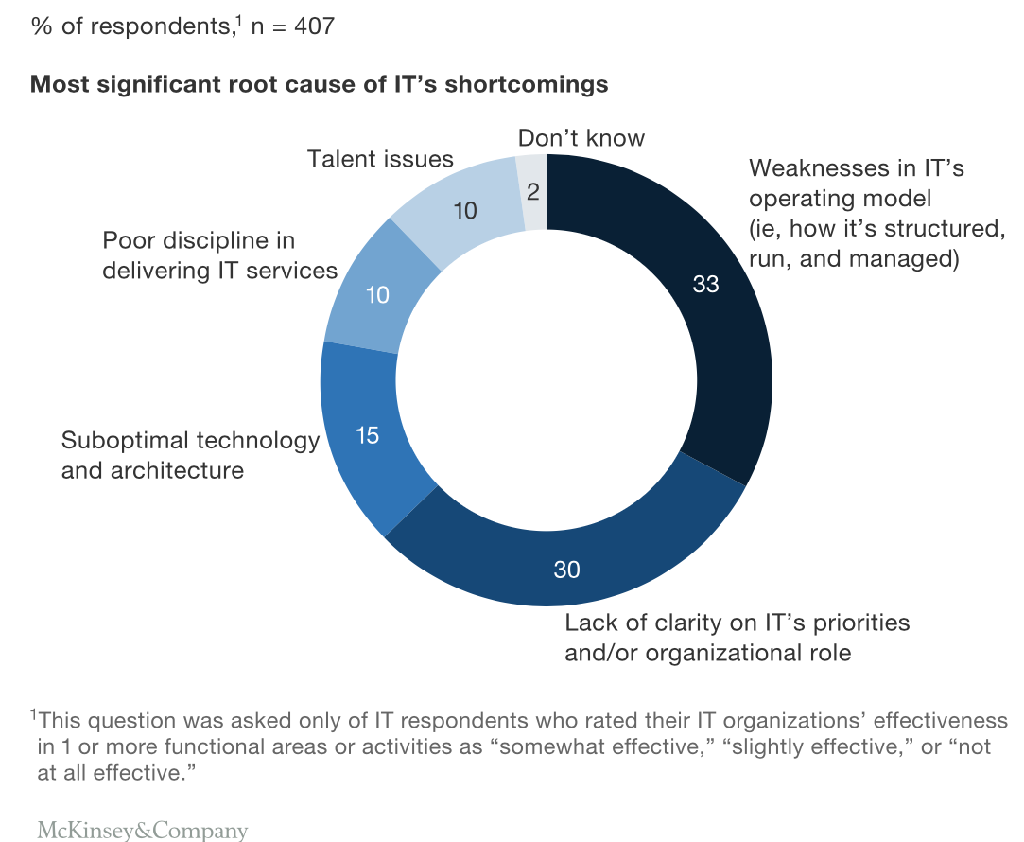
Managing IT Sources of management evil (McKinsey survey of IT executives)

Slide 46
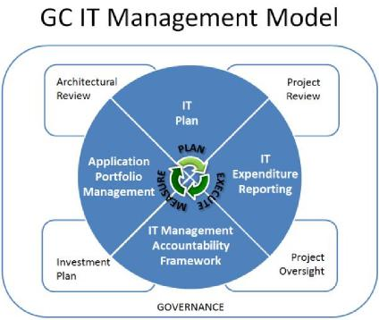
Managing IT in government The management model in the Government of Canada (GC)
Complete policy suite on the management of IT – policies, directives, standards and guidelines
Common, standardized methodology for departmental management of IT (including architectural reviews, project reviews, reporting and monitoring)
Tools, templates and guidance for gating, reporting IT planned investments, IT expenditures, and IT applications
IT Management Accountability Framework (MAF) for oversight and evaluation (see Annex A)
Repositories for departmental IT data (planned investments, expenditures, applications). This is the main source of data for integrated IT planning.
The core elements of the GC IT Management Model are supported and influenced by Architectural Review, Project Review and Oversight, as well as standardized departmental Investment Planning.
The GC IT Modernization Priorities is a list of priorities established by the GC that departments need to incorporate into their departmental IT Plans.
TBS CIOB has established enterprise governance committees to drive the alignment of IT and IT-enabled initiatives to enterprise-wide business priorities.
GC IT Management Policy Suite (sampling)
Policy Framework for Information and Technology
Policy on Management of Information Technology
Directive on Management of Information Technology
Policy on Acceptable Network and Device Use
Operational Security Standard: Management of Information Technology Security (MITS)
Standard on Web Usability, Interoperability and Accessibility
Standard on Optimizing Websites and Applications for Mobile Devices.

Slide 47
Managing IT in government The IT enterprise governance model in the GC
Prime Minister
President of the Treasury Board
TBS Secretary
The Treasury Board Secretariat (TBS)
The Privy Council Office (PCO)
Clerk of the Privy Council
GC CIO
GC IT Governance (Enterprise)
Accountability relationship
Minister
The GC CIO provides strategic direction and leadership to standardize, consolidate and transform the way the Government of Canada (GC) does business to improve services and achieve efficiencies by:
Standardizing & consolidating IT for more efficient and effective government;
Managing government information to improve transparency, availability and inform decisions;
Establishing trust by safeguarding government information, assets and individual; and
Improving the service experiences and outcomes for Individuals & business.
Shared Services Canada (SSC)
Functional relationship
Deputy Minister
Deliver IT infrastructure services
Departmental IT Governance
Dept. CIO
Department or agency

Slide 48
Managing IT in government GC IT modernization priorities
General principle: To achieve all the benefits of IT, government needs to act more like a cohesive IT enterprise that effectively works against the grain of vertical structures, mindsets and accountability in government programs
IT Operations (OPEX)
IT Investments (CAPEX)
Shared service delivery for infrastructure services (Shared Services Canada)
Consolidation of data centres
Consolidation of networks
Migration to enterprise Identity, Credential and Access Management services
Back Office Transformation – adoption of managed enterprise HR (PeopleSoft), Finance (SAP) and Electronic Records and Document Management Systems (GCDOCS) solutions, and Transfer Payments
Migration to single enterprise email solution
Comparability with commercial sector operating performance throughout IT operations
Migration of the Government of Canada’s externally facing websites to a single presence www.Canada.ca
Consolidation of all procurement for “commodity IT” to leverage the buying power of GC as an enterprise (e.g., Shared Services Canada buys all hardware and software for end-user devices)
Transformation from a vertical, departmental IT services delivery model, to a more horizontal, cross-government delivery focused on functional commonalities, common information architectures, and horizontal opportunities
Revamp the back-office application portfolio and reduce some 12,000 distinct back-office applications spread across 100 departments by at least 50% (in 7-10 years)
Greater interoperability across departments and agencies
Open government
Rigorous scrutiny of projects and investments for value creation, risk, and alignment with GC priorities.
Consolidation to a fixed set of common optimal solutions with certain common development and operating characteristics.
Horizontal collaboration among agencies.
Robust governance (both government-wide and within agencies.)
Political support and central enterprise (TBS) leadership.
Continuous search for identifying specific opportunities to capitalize on commonalities, to further reduce costs, to reduce risk, and to improve service quality.

Slide 49
Managing IT in government Prioritizing IT investments – typical GC criteria used
Business Value
Monetized business value (cost benefits)
Criticality to the business of the government/department
Non-monetized results (e.g., contribution to achieving results for Canadians)
Alignment
Government strategic priorities
Departmental business and operational priorities
IT modernization priorities
Government IT architectures and standards
Complexity and Risk
Complexity (sustaining, tactical, evolutionary, transformational)
Project risks
Strategic Management Risks
Procurement Risks
Human Resource Risks
Business Risks
Project Management Integration Risks
Project Requirements Risks
Ability to mitigate critical risks
Residual risk and ability of the project office to manage it

Slide 50
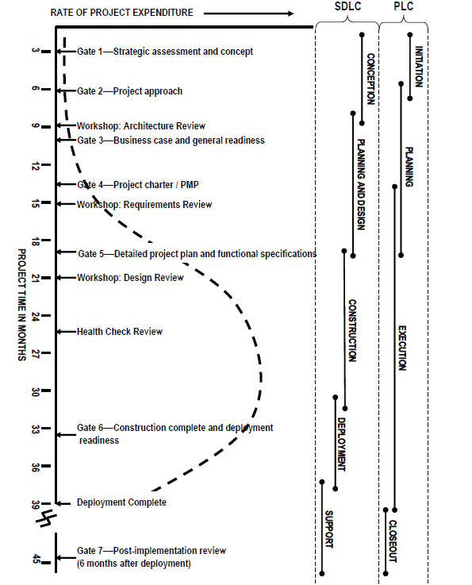
Managing IT in government Disciplining IT investments – the full GC gating model
The full gating model defines seven gates that might logically be present in every project. Its actual application, however, will depend on each case. The seven gates are:
Gate 1—Strategic assessment and concept
For confirmation of the project's objectives—both what is to be done and why—and the identification of key stakeholders
Gate 2—Project approach
For confirmation of how the project's objectives will be achieved
Gate 3—Business case and general readiness
For confirmation of funding and business outcomes
Gate 4—Project charter / project management plan (PMP)
For confirmation of resources, support, and governance
Gate 5—Detailed project plan and functional specifications
For confirmation of readiness to proceed with construction
Gate 6—Construction complete and deployment readiness
For confirmation of readiness to deploy for both business and IT domains
Gate 7—Post-implementation review
A post-mortem and final step to gather lessons learned

Slide 51
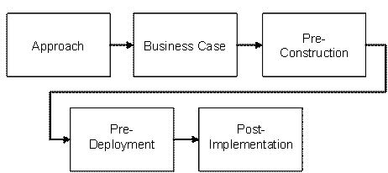

Managing IT in government Disciplining GC IT investments – streamlined and light gating
Streamlined gating for projects of medium size, risk, and complexity
Light gating for small, low-risk projects with little complexity

Slide 52
Managing IT in government Lessons learned on benchmarking opportunistically
Benchmarking serves a number of purposes that include:
Comparing IT performance across government (inside perspective)
Comparing government IT performance with commercial sector performance and other governments (external perspective)
Establishing a cost and performance baseline against which future effectiveness and efficiency enhancements can be measured.
One purpose benchmarking does not serve well is getting all IT costs – there are more effective ways to achieve that. As such, benchmarking should provide a selective (not complete) perspective on key aspects of IT that can stand realignments and transformation.
The results of benchmarking typically launch (and then support) the construction and “selling” of the options for increasing effectiveness and economy and reducing diseconomies.
To make it easier on building the supporting arguments and data evidence, it makes sense to structure the benchmarking exercises with such an end in mind. In other words, to benchmark “with intent.”
As such, the structure and expected results should best anticipate and help support the development of, and the evidence base for, a range of options that may include:
Shared enterprise services for distributed (end-user) computer services
Centralized procurement of end-user devices (hardware and software)
Shared enterprise services for central computing services, through consolidation of data centres, servers and networks, and migration to cloud computing
Shared enterprise services for enterprise identity, credential and access management services (a key digital public services enabler)
Shared enterprise services for all telecommunications services (data, voice, video)
Shared enterprise approach to at least HR and Finance systems to reduce diversity and realize economies of scale
Migration of externally facing websites to a single presence
Migration to a single e-mail system.
The Shared Services Canada Program Architecture shown above provides ideas for possible frameworks for benchmarking “with intent”

Slide 53
Managing IT in government A possible framework for benchmarking “with intent”
For each ministry/agency | Running and maintaining end-user devices | Acquisition of end-user devices and software | Central computing services (data centres, servers, local and wide-area networks) | Telecoms services (data, voice, video) | IT support for HR system | IT support for Finance system | Maintenance of external agency website(s) | Other (TBD) (e.g., new projects)
Costs
FTEs
Notes on practices and management models used
Reasonable internal and external benchmark results in these categories should allow reviewers to make good evidence-based decisions and construct credible arguments in support of those decisions. For timely results, the approach to benchmarking could follow the following path:
Initiate, in parallel, both internal and external benchmarks (e.g., using Gartner for external benchmarking) using perhaps a variant of this framework
Focus first on the big spending ministries
Formulate options that have a good chance of working in the big spending ministries. If they work there, chances are they will work everywhere. Set realistic targets, with a few “stretch” targets in areas where progress is most urgently needed.
In positioning the implementation roadmap, you may want to ponder carefully whether the climate is right for:
Starting with those options that can be implemented incrementally, and leave the others for later; or
Starting with the more “transformational options” right off-the-bat (e.g., the start of a government mandate may be the only time when there is enough political will and momentum for serious structural changes in the service management and delivery models)
Either way, some early successes and demonstrable achievements and political announceables (e.g., first 100 days, first six months, first year, etc.) will be needed
Finally, a set of tools will be required to compel compliance, exercise oversight, measure and report progress, and sustain the momentum (see the Canadian government's management toolset for inspiration.)

Slide 54
Annex A: Measuring and improving IT management across government – the Canadian Government's Management Accountability Framework (MAF)

Slide 55
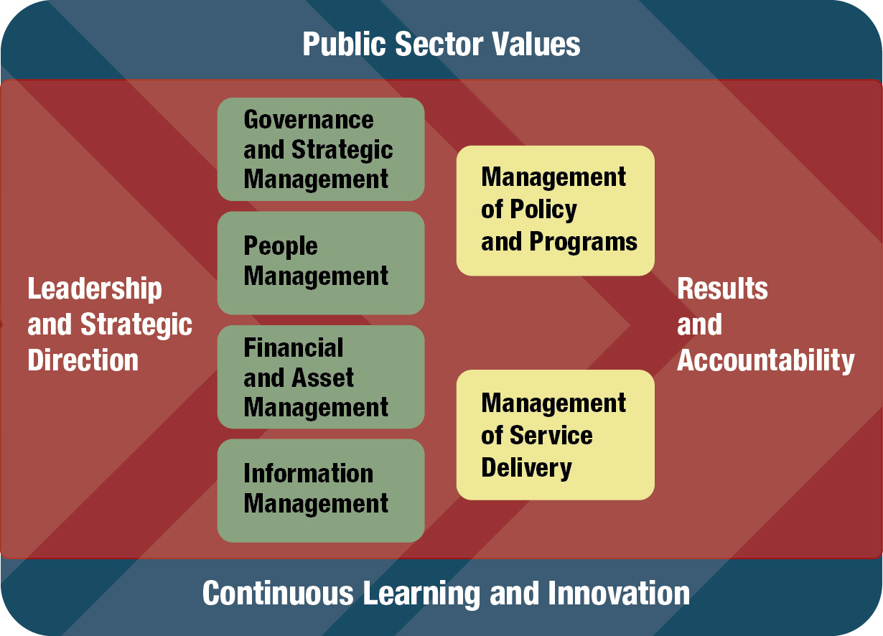
Management Accountability Framework (MAF) A tool for sound public sector management
The MAF is a tool established by the Treasury Board of Canada Secretariat (TBS) that sets the expectations for sound public sector management practices and performance in a number of Areas of Management (see diagram).
MAF assessments provide individual organizations with observations by TBS on where performance meets expectations on the specific performance indicators that are reviewed, and where there may be opportunities to improve. This information is of value to both deputy heads of departments and agencies and the TBS.
The objectives of the MAF are:
To obtain an organizational and government-wide view of the state of management practices and performance;
To inform Deputy Ministers and Heads of Agencies about their organizations’ management capacity;
To inform the Treasury Board of Canada Secretariat about the state of policy implementation and practices;
To identify areas of management strength and any areas that require attention;
To communicate and track progress on government-wide management priorities; and,
To continuously improve management capabilities, effectiveness and efficiency government-wide.
This Area of Management Includes (1) Information Management and (2) Information Technology Management
MAF assessments serve as management scorecards (or “league tables”) for management practices and policy implementation in each Area of Management. The MAF questions probe what the central agencies want the departments to do. The idea: measure what you want done. The questions change as the management targets and the maturity of the areas of management evolve. Some horizontal consistency year-over-year is maintained.

Slide 56
MAF Area of Management: Management of IT*
OVERVIEW
Information Technology (IT) supports the organization’s business strategy and government-wide objectives. The area of management is composed of three lines of evidence:
LINE OF EVIDENCE 1 - LEADERSHIP
Designation of a senior official to ensure that information technology supports the organization's business strategy and government-wide objectives and .
Participation in setting government-wide strategic directions for information technology.
LINE OF EVIDENCE 2 - PLANNING
Appropriate alignment and management of information technology and human resources to support departmental business and government-wide strategic directions and
information technology governance structures are integrated with the corporate governance structure and define appropriate decision rights
LINE OF EVIDENCE 3 - VALUE
Organizational use common or shared IT assets and services to avoid duplication, when such assets and services are available and appropriate, and Performance measurement tools and the use of metrics to guide departmental management of information technology towards improved efficiency, effectiveness and innovation.
RATING METHODOLOGY
Area of Management ratings are determined based on the line of evidence ratings according to the following decision rules:
Attention Required – Two or more lines of evidence are rated as Attention Required.
Opportunity for Improvement – Two or more lines of evidence are rated as Opportunity for Improvement OR one line of evidence is rated as Attention Required.
Acceptable – Two or more lines of evidence are rated as Acceptable AND no line of evidence is rated as Attention Required, OR one line of evidence is Opportunity for Improvement AND the remaining two lines of evidence are Acceptable or Strong
Strong – Two or more lines of evidence are rated as Strong AND no line of evidence is rated lower than Acceptable.
* This was the methodology in place during and after the Canadian Administrative Reviews that led to the changes in the IT management model. The methodology has now evolved to stay in tune with the maturing IT management practices, in line with the principle of “measuring what you want done.”

Slide 57
MAF Area of Management: IT Line of Evidence: IT Leadership
Designation of Senior Departmental Official
Participation in setting government-wide (GC-wide) strategic directions for information technology
Is there a senior IT official in place (e.g., CIO)?
What is the IT official’s span of control?
Does the senior official for IT have direction and control for all IT assets (hardware and software (intellectual property) agreements (e.g. contracts, software licensing) and applications)?
Does the senior official for IT have direction and control for all IT spending to ensure that IT spending is not occurring without the authority and guidance of the senior IT official?
Does the senior official for IT have direction and control of technology choices to ensure that technology choices are not occurring without the authority and guidance of the senior IT official?
Does the senior official for IT have direction and control of all application development to ensure that application development is not occurring without the authority and guidance of the senior IT official?
Does the senior official for IT have functional control of all significant information technology enabled projects to ensure that IT-enabled projects are not occurring without the authority and guidance of the senior IT official?
Does the senior official for IT develop, maintain and facilitate the implementation of a sound and integrated IT architecture, policies, directives, standards and guidelines to develop or maintain existing IT and acquire new IT?
Does the senior official for IT require a documented rationale and / or Business case when the use of Information Technology is inconsistent with the departmental IT architecture, policies, directives, and standards?
In Enterprise (TBS) governance
At CIO Executive Summit (one per year)
Using the collaborative tools available
At TBS, CIOB Information Technology workshops or working groups

Slide 58
MAF Area of Management: IT Line of Evidence: IT Planning
Appropriate alignment and management of information technology and human resources to support departmental business and government-wide strategic directions
Information technology governance structures are integrated with the corporate governance structure and define appropriate decision rights
IT PLAN - Are you submitting an IT plan?
IT PLAN - Does the IT plan fully address the planning topics required (a list of IT planning topics is set out in the GC Directive on IT Management):
Governance – Governance includes decision processes for the following areas:
IT strategies and policies;
Infrastructure;
Applications and systems; and
Resource allocations. IT resource allocation decisions are guided by governance selection and prioritization criteria and methodology.
IT business
IT’s role in enabling departmental business outcomes.
IT architecture, including but not limited to defined core IT competencies, technology choices and services, should support business outcomes.
IT should be aligned with departmental and government-wide IT priorities, technology, and common and shared services, when such services are available and appropriate.
Resource allocation targets are to be organized into the following four portfolio classes:
Innovation – resource allocations that focus on transforming the department's business model;
Business opportunity – resource allocations that realize measurable business benefits (e.g., revenue or service growth);
Maintenance – resource allocations designed to maintain existing service levels (e.g., ongoing operation of IT); and
Mandatory – resource allocations required for legal or regulatory compliance.
Performance measures
Business outcomes and key performance indicators (KPI) are required to measure delivery of core services.
Performance measures support continuous improvement by monitoring and gating planned IT activities.
IT risk management across the planned activities, which includes the processes and strategies to manage the following:
Resource allocation;
Scheduling;
Business risks (e.g., confidentiality, integrity, availability of core infrastructure and services, and infrastructure renewal); and
Capacity and sustainability.
GOVERNANCE DECISION MAKING PROCESS - Does the senior official for IT participate as a peer with other functional heads in the corporate planning process?
GOVERNANCE - Does the senior official for IT preside over established IT governance structures that include representatives from the business areas?
IT PLANNING PROCESS - Is there an annual IT planning process conducted by the senior official for IT within departmental governance structures to enable business transformation?
IT PLANNING PROCESS - Does the annual IT investment planning process include each of the following:
Risk assessment of the investment decisions?
Prioritization process
Alignment to GC wide priorities?
An oversight (gating) and reporting using a portfolio approach to monitor progress against planned activities, manage costs, and balance risk?
Does the organization have a “library” of documented financial/materiel processes?
Does the organization have plans to align with the CS community organizational standards endorsed by CIO Council?

Slide 59
MAF Area of Management: IT Line of Evidence: IT Value
Organizational use common or shared IT assets and services to avoid duplication, when such assets and services are available and appropriate
Performance measurement tools and the use of metrics to guide departmental management of information technology towards improved efficiency, effectiveness and innovation
Common and Shared Services
Does the IT organization receive all or some IT services from another Department?
Which services are provided (refer to the IT-SSO catalogue for details)?
IT organization as a recipient of IT services (Vendor management)
Are the IT services provided by another department or agency defined by Service Level Agreement(s) or Memorandum of Understanding?
Do these Service Level Agreement(s) or Memorandum of Understanding include costing models at the cost per IT service level?
Are all Service Level Agreement(s) or Memorandum of Understanding signed?
How often are these agreements (including service levels) reviewed?
Is there a process in place to allow a dialogue with the service provider to address (variety of topics, including service delivery levels, future requirements and unresolved issues)
IT organization as a service provider (Service management)
Are the IT services provided within the organization or to other departments and agencies defined by Service Level Agreement(s) or Memorandum of Understanding?
Do these Service Level Agreement(s) or Memorandum of Understanding include costing models at the cost per IT service level?
Are all Service Level Agreement(s) or Memorandum of Understanding signed?
How often are these agreements (including service levels) reviewed?
Is there a process in place to allow a dialogue with the service recipient to address (variety of topics, including service delivery levels, future requirements and unresolved issues)
Key elements to adopting Common and shared services
Does the organization have an asset management / tracking system?
Does the IT organization have a baseline for IT services?
Does the organization have a total cost of ownership for IT?
Are the IT services in the organization aligned to the Profile of GC Information Technology Services?
Performance Measurement - Does the IT organization have an IT performance measurement process (framework)?
Have you updated the previous year’s performance measurement process (framework)?
Does the framework include a set of KPIs to measure
Efficiency
Effectiveness
Alignment
Innovation
Transparency
Risk
How often are these KPIs reviewed?
Has your organization shared their KPIs with the TBS working group on Performance Management?

Slide 60
Annex B: Establishing shared IT infrastructure services in the Canadian Government – Shared Services Canada

Slide 61
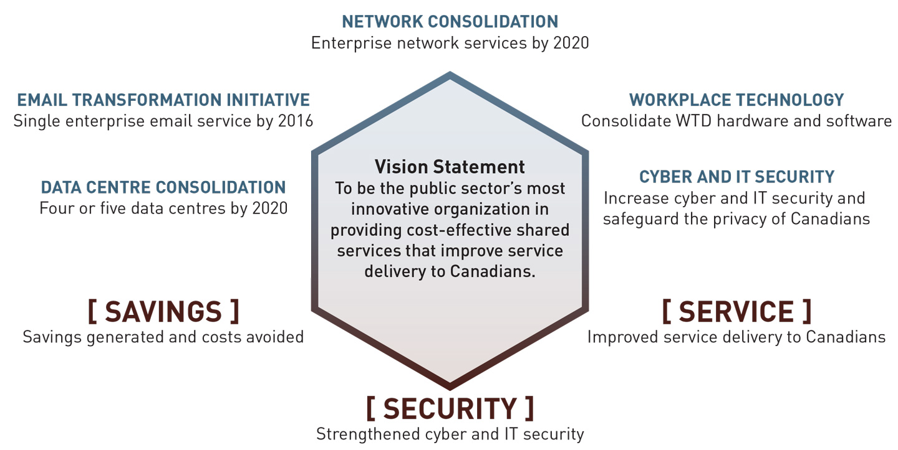
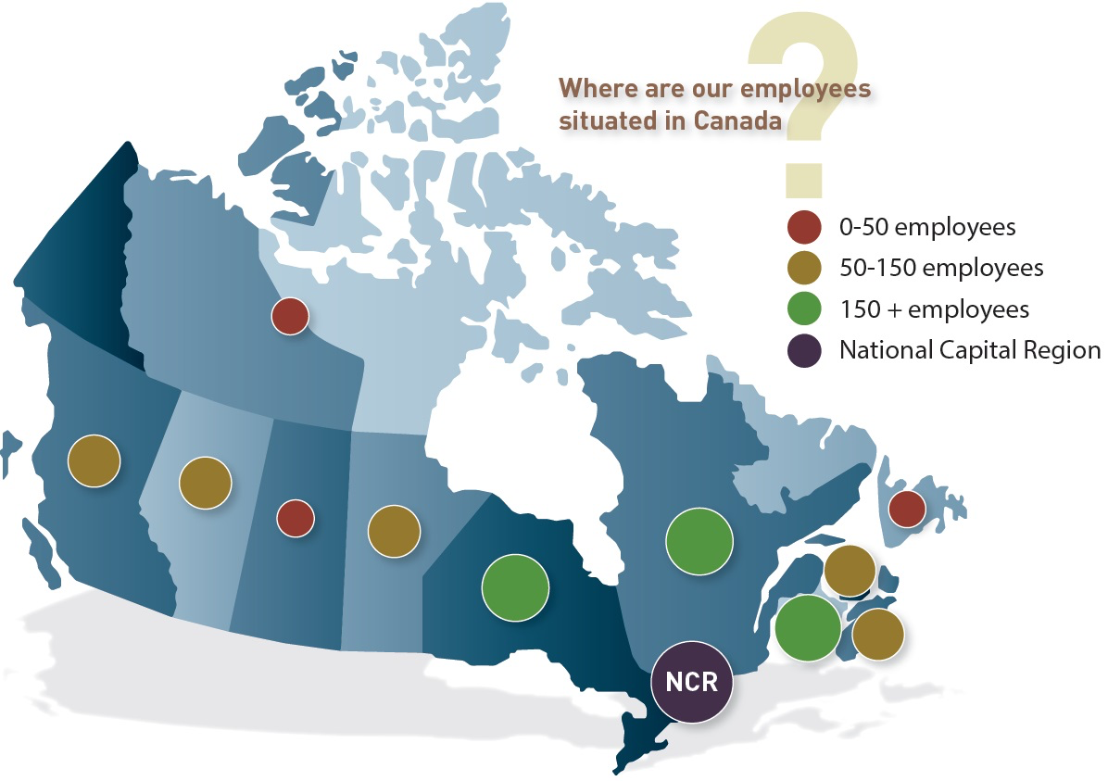
Shared Services Canada Dedicated, separate entity with a national presence
Consolidation targets:
From 63 email systems to 1
From 19 large data centres and 65 medium-sized data centres to no more than 20
From 50 wide area networks connecting over 3 000 buildings and data centres to 1
Common procurement of end-user devices and related software
Savings:
$150 million per year by 2014-15 and, by 2015-16, an additional $50 million in savings through migration to a single government outsourced email service
Mandate:
Established 2011
Separate agency established by Act of Parliament
6,400 employees
Mandated to deliver IT infrastructure services to 43 organizations representing 95% of federal IT spending
Core services are mandatory for the 43 partner departments

Slide 62
Shared Services Canada Program architecture
Shared Services Canada Strategic Outcome: Modern, reliable, secure and cost-effective IT infrastructure services to support government priorities and program delivery
IT Infrastructure services “lines of business”

Slide 63
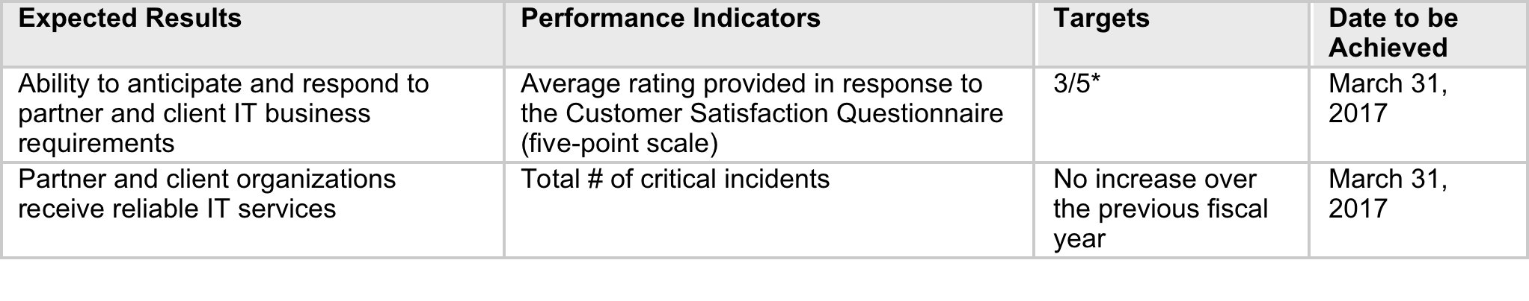
Shared Services Canada Overall program results
Consolidate and standardize email, data centres and network infrastructure of partner and client organizations across the government;
Leverage cloud computing services securely and efficiently;
Consolidate the procurement of workplace technology devices, thereby standardizing hardware and software, to increase security, leverage economies of scale and realize lower unit costs;
Transition from aging technology and legacy systems to a more advanced IT infrastructure; and
Enhance security of data and technology assets through enterprise cyber and IT security services.

Slide 64
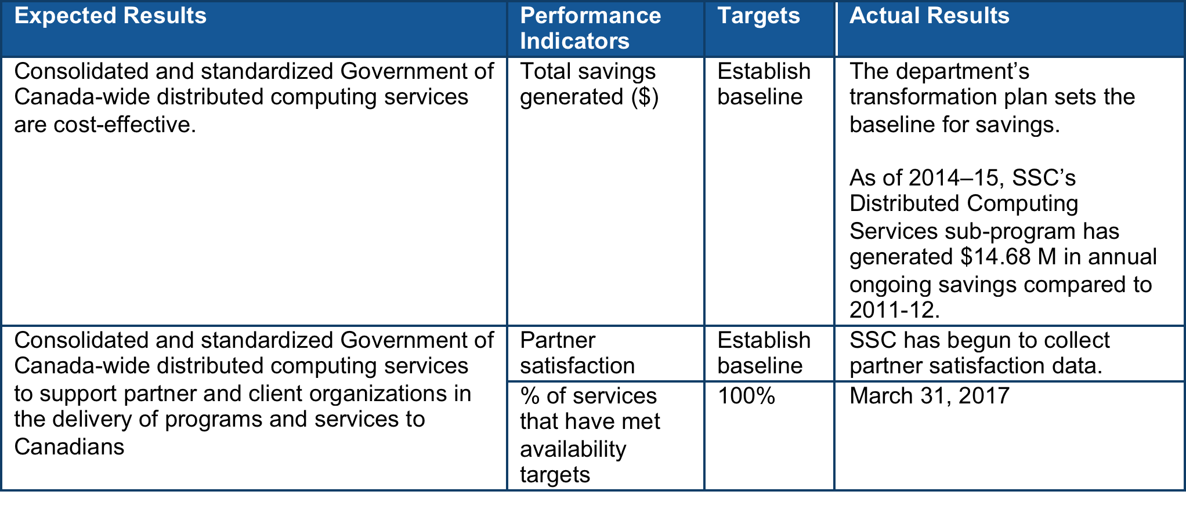
Shared Services Canada Line of business: Distributed Computing Services
Partner and client organizations have the IT equipment they require (such as laptops and software), the IT equipment is supported over the course of its lifespan, and it is disposed of in a responsible manner when no longer useful or operational.
Servers supporting email and scheduling capabilities both at workstations and on mobile devices are functional.
Services are in place so personnel in partner and client organizations are able to print from their workstations and to access the network remotely (from outside the office) when necessary.

Slide 65
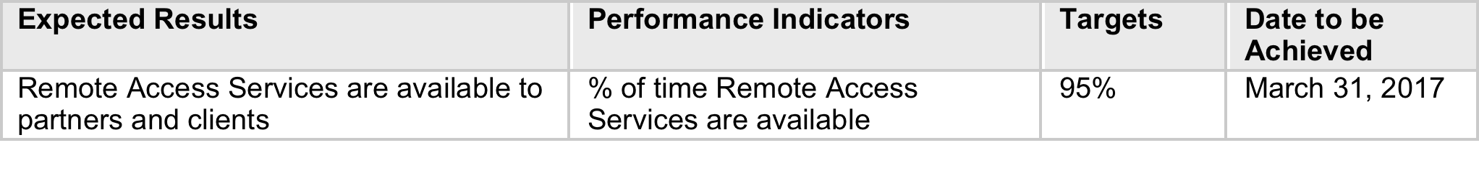
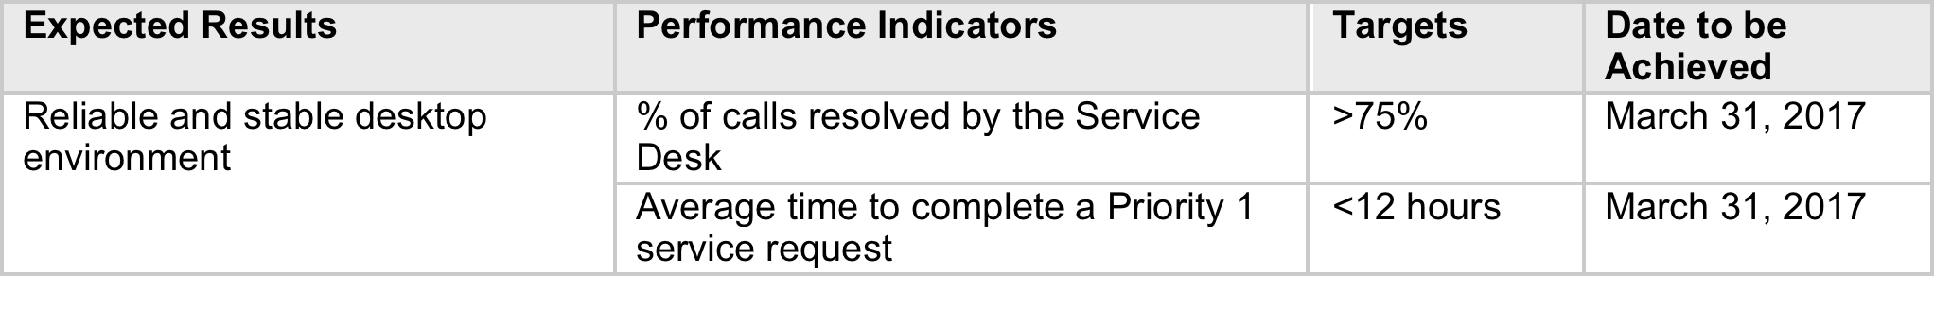
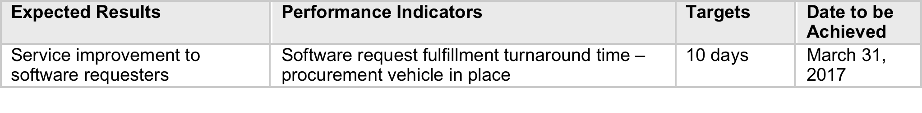
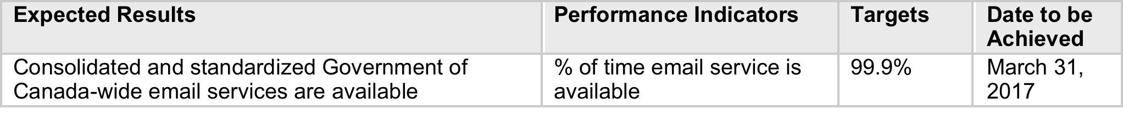
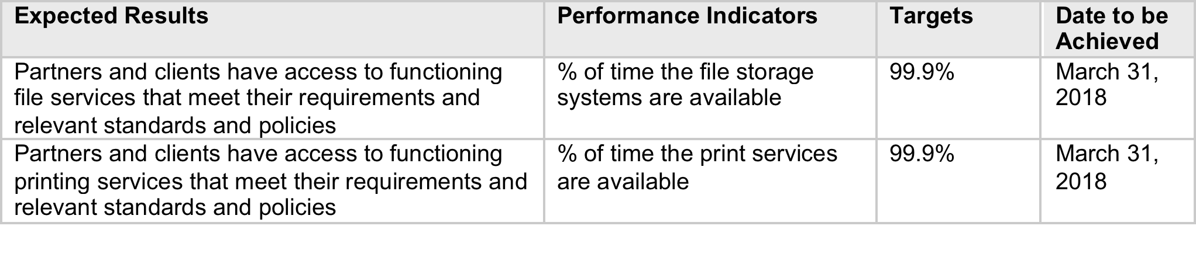
Shared Services Canada Line of business: Distributed Computing Services
Area: Workstation Services
Area: Desktop and Office Productivity Suite Services
Area: Email and Mobile Enterprise Server Services
Area: File/Print Services
Area: Remote Access Services

Slide 66
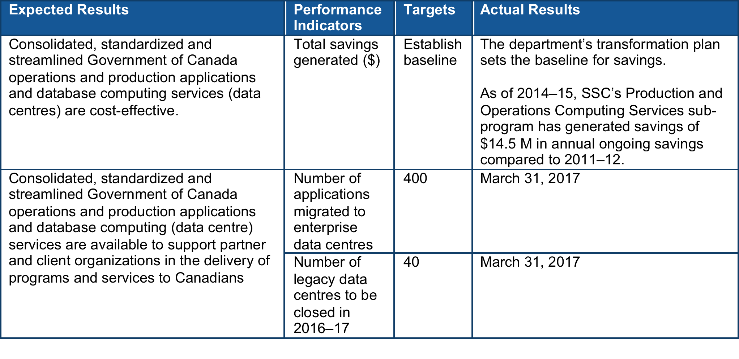
Shared Services Canada Line of business: Production and Operations Computing Services (Data Centre Services)
Consolidate data centre buildings and IT infrastructure;
Optimize data centre services and service delivery, including cloud computing services; and
Standardize technologies and consolidate licenses.

Slide 67
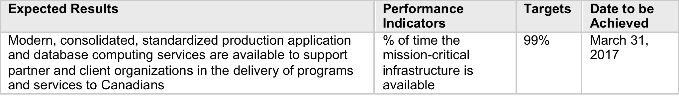
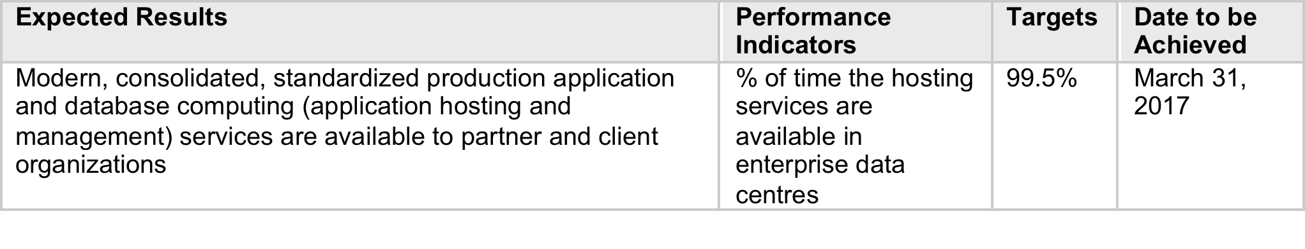
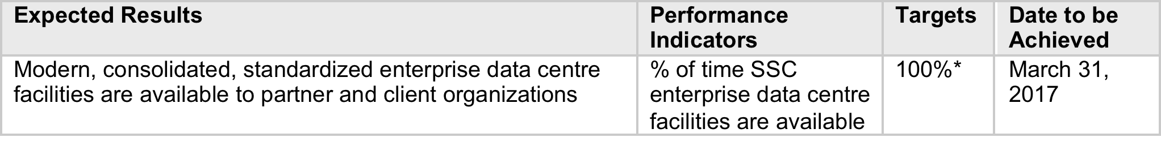
Shared Services Canada Line of business: Production and Operations Computing Services (Data Centre Services)
Area: Utility Computing Services
Area: Dedicated Application Hosting and Management Services
Area: Facilities Management Services

Slide 68
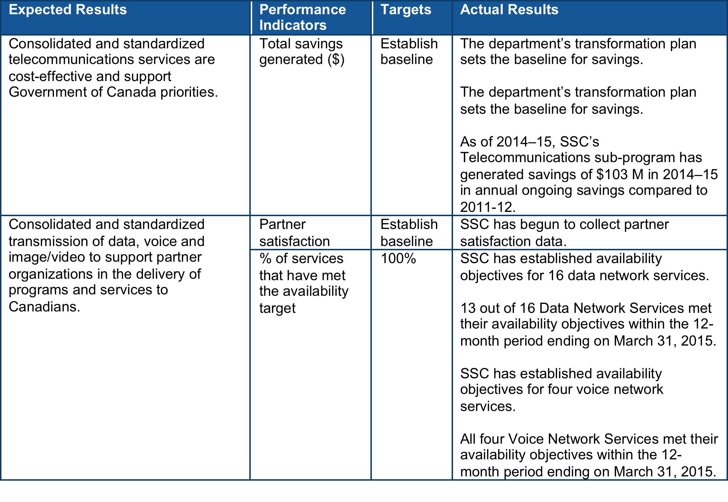
Shared Services Canada Line of business: Telecommunications (Data, Voice and Video) Services
SSC will continue to improve:
Efficiency – Reducing redundant technology and services by consolidating networks, providing one telephone device per employee, improving conferencing capability and developing a shared contact/call centre, to increase efficiency.
Cost savings – Modernizing and standardizing infrastructure and technology by moving from traditional telephone services to cellular and Voice over Internet Protocol (VoIP), using conferencing capacity instead of travel, and consolidating network infrastructure and call centre services, leading to cost savings.
Workplace 2.0 – The migration towards updated network and communication technologies supports the Government of Canada’s Workplace 2.0 initiative, which seeks to create a modern workplace, enabling public servants to work more effectively.

Slide 69
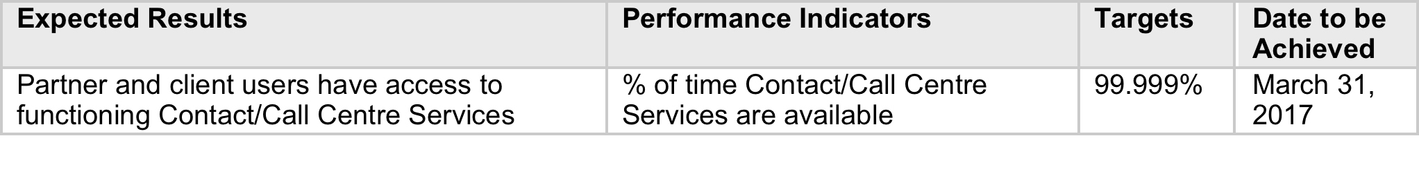
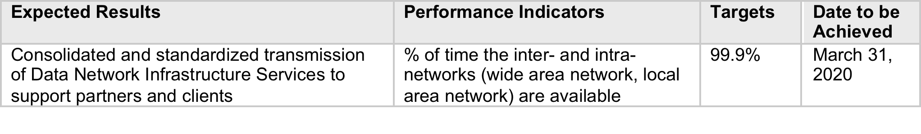
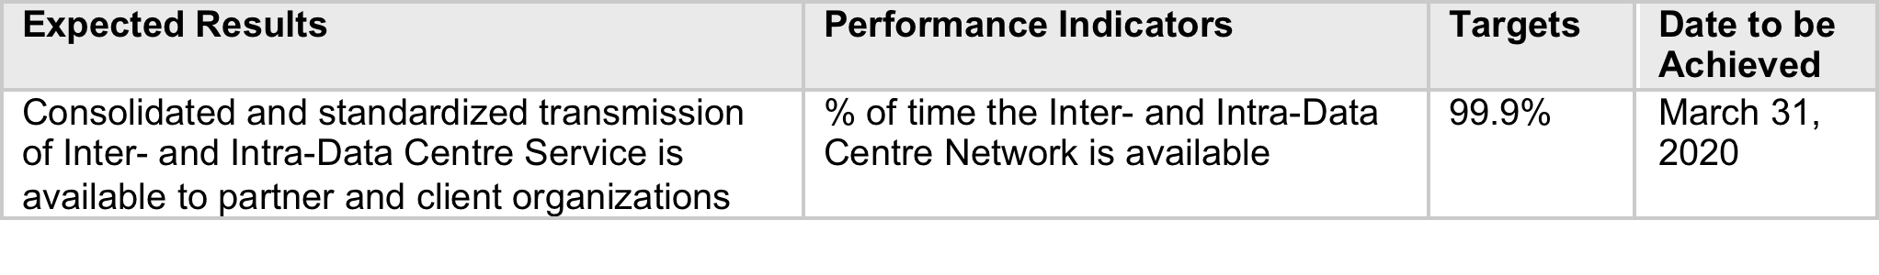
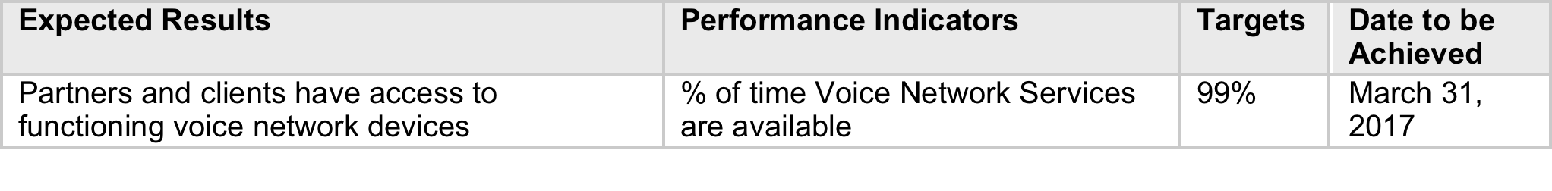
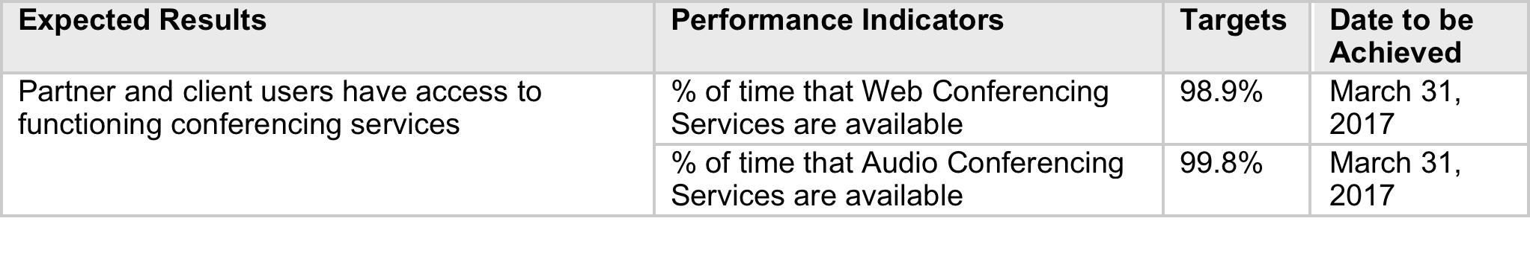
Shared Services Canada Line of business: Telecommunications (Data, Voice and Video) Services
Area: Data Network Infrastructure Services
Area: Inter- and Intra-Data Centre Network Services
Area: Voice Network Services
Area: Conferencing Services
Area: Contact/Call Centre Services (Data and Voice Network Infrastructure)

Slide 70
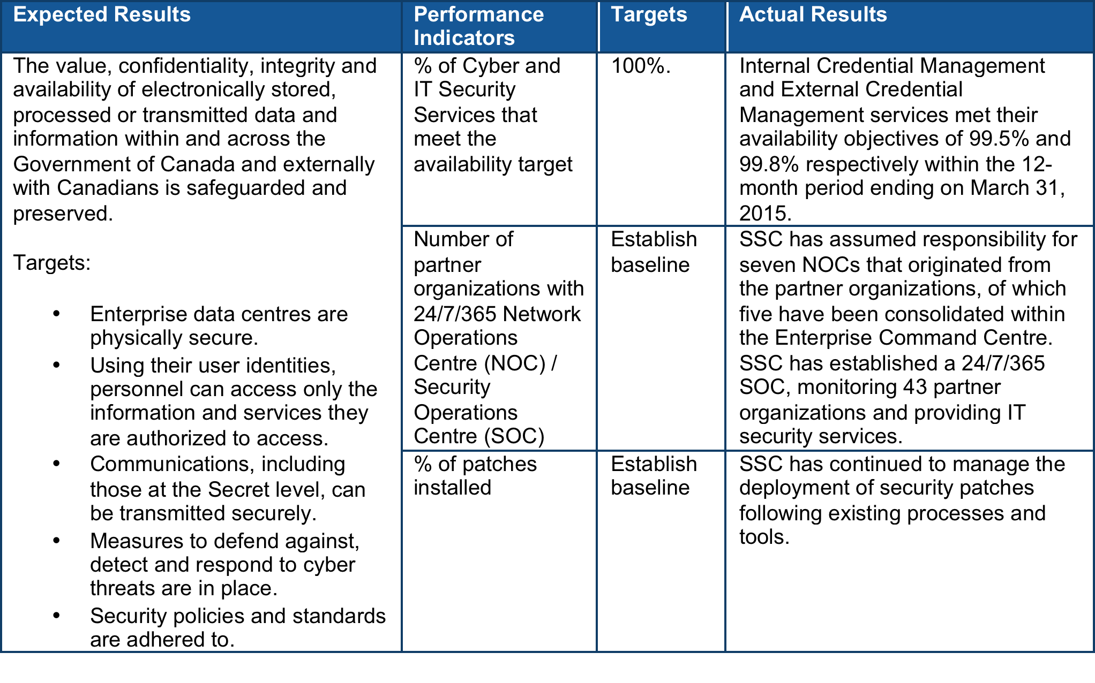
Shared Services Canada Line of business: Cyber and IT Security Services

Slide 71
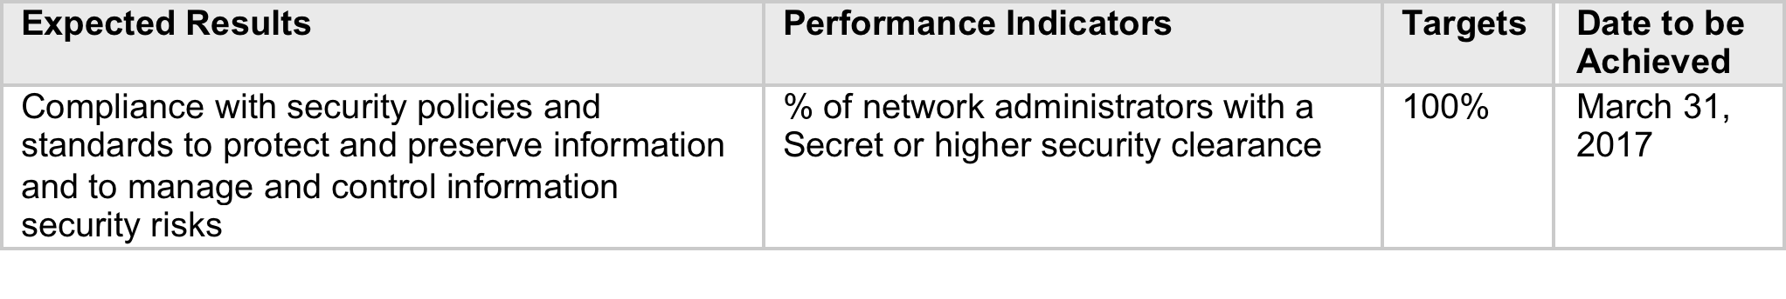
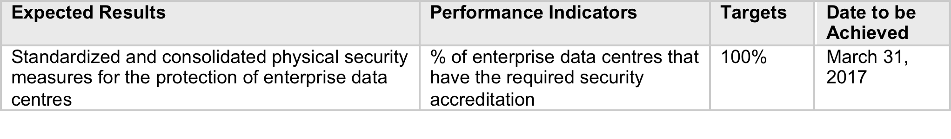
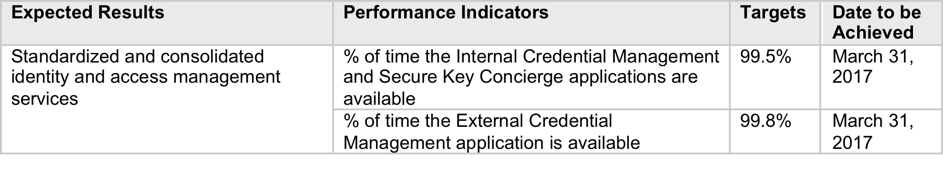
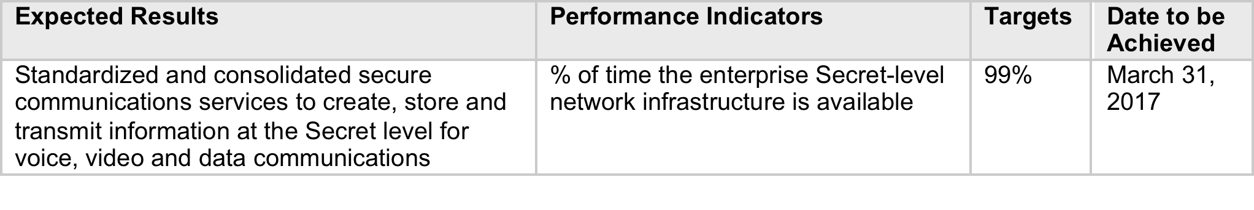
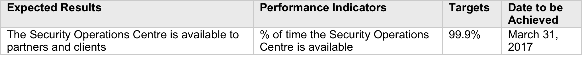
Shared Services Canada Line of business: Cyber and IT Security Services
Area: IT Environment Protection Services
Area: IT Identification, Authentication and Authorization Services
Area: IT Secure Communications Services
Area: Perimeter Defence, Detection, Response, Recovery and Audit Services
Area: Cyber and IT Security Management Services

Slide 72
Annex C: An example of citizen-centric e-Government in Canada – Service Canada

Slide 73
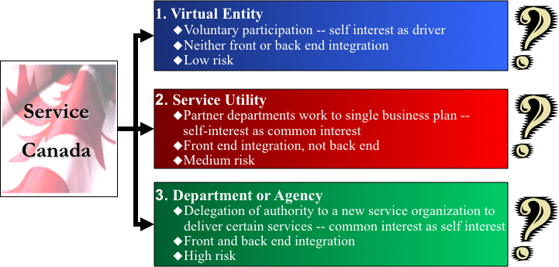
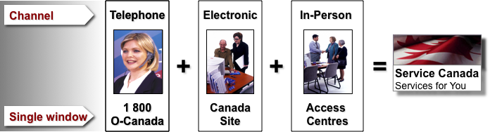
E-Government: Service Canada A Service Network Supporting Government Departments
Four defining concepts underpinning the business model:
Focus on the citizen: A citizen-centered organization connects people to the programs, services and information they need, regardless of who delivers them.
Deliver one-stop government service: One-stop service ensures that government is easy to find, easy to deal with and easy to access.
Integrate citizen information: Instead of asking for the same information every time a person accesses government, a citizen-centered organization asks for the information once and remembers it in the future, while strengthening privacy and security.
Collaborate and partner: Bringing services together in a way that is easy and integrated requires extensive collaboration and partnering, as organizations work together to leverage their collective potential to create new value for citizens.
Three broad strategic objectives:
A New Service Face – with the appropriate services delivered over 3 integrated channels, with services for the department of Employment and Social Development as the backbone
A New Service Approach – by putting citizens first, presenting services in ways that make sense to them, with a commitment to maximum service at the first point of contact and to continuous improvement
A New Coordinating Mechanism – based on a partnership of one-stop initiatives (1 800 O-Canada, the Canada Site, and in-person access centres, with shared ownership, strong governance and decisive leadership
Adds value to the government’s existing service network by:
Increasing the number of services delivered through low-volume centres (especially in rural communities);
Providing a basic information service that frees-up specialists to deal with more complex issues; and
Offering smaller departments an alternative to setting-up their own delivery infrastructure in order to reach more Canadians.
Gathering information about the needs of Canadians through service delivery and sharing that information across government to inform the policy and program development process.
A component of the department of Employment and Social Development (largest user)

Slide 74
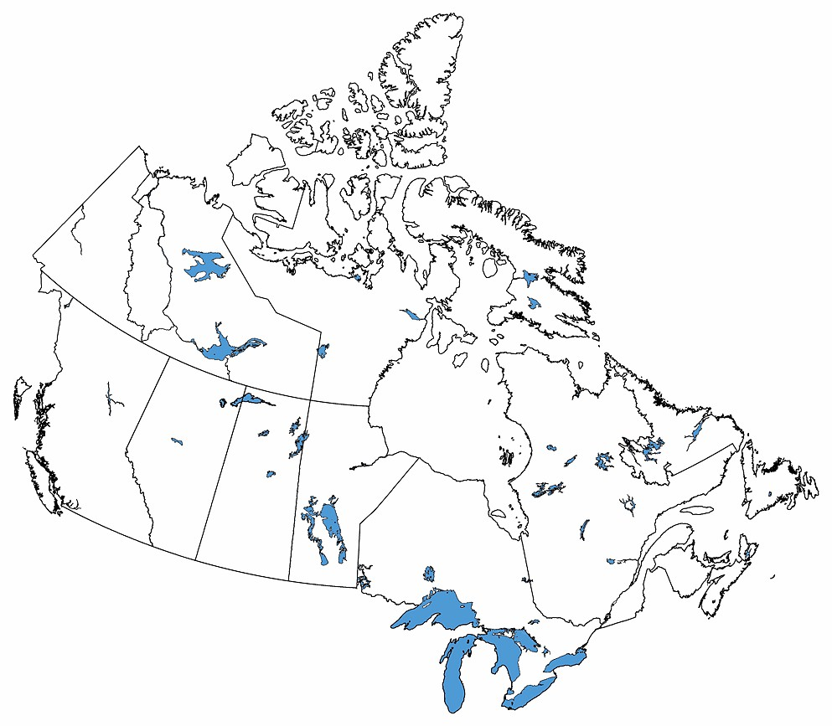
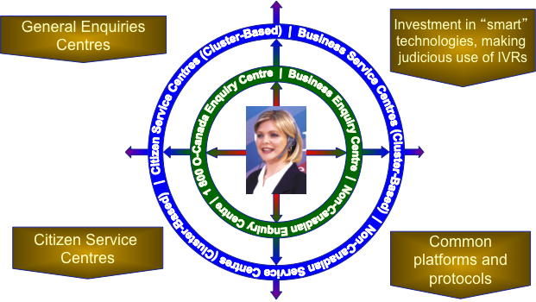
e-Government: Service Canada Key component elements
410 people, $60 Million budget, 3 delivery channels (some 270 people in face-to-face access centres)
Access centres also provide assisted self-service through the electronic channel
Use the government’s existing service infrastructure networks and back office capabilities to maximum effect
Maintain the right balance between serving Canadians and reducing delivery costs
Bring together all major one-stop service initiatives to improve coherence and avoid duplication
Provide a cost-effective common service provider for departments to use
Provide a means of managing service presence and profile in rural and remote communities
A level of integration of policy, operational and communications activities
Rigorous governance mechanisms
A policy framework for one-stop access, “tell-us-once” and secure credentialing
Rigorous performance management framework and client satisfaction tracking
Service Canada In-person Channel
Hub and spoke structure with manageable number of partners
Utilizing existing networks most Canadians will be able to reach an Access Centre easily
Links to provincial one-stop access in longer term
Strong coordination at regional level (tailored to meet local circumstances)
Service Canada Telephone Channel

Slide 75
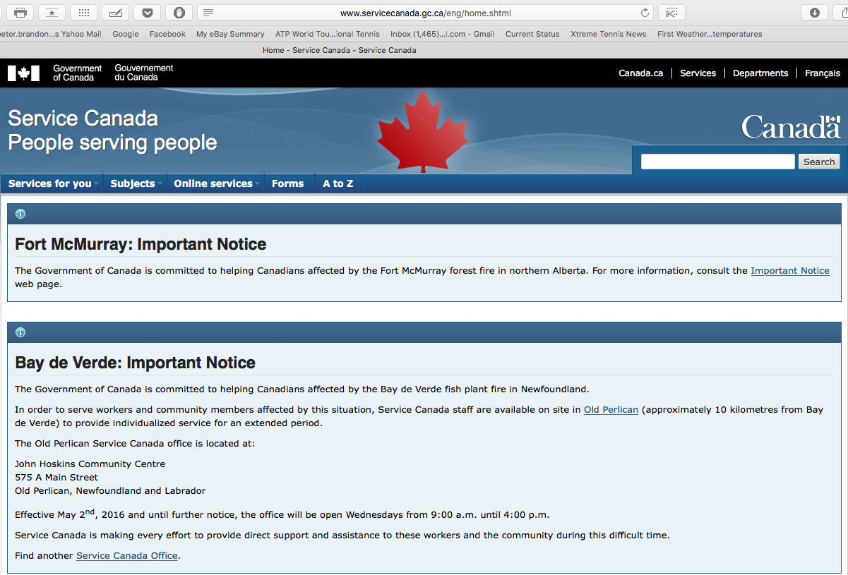
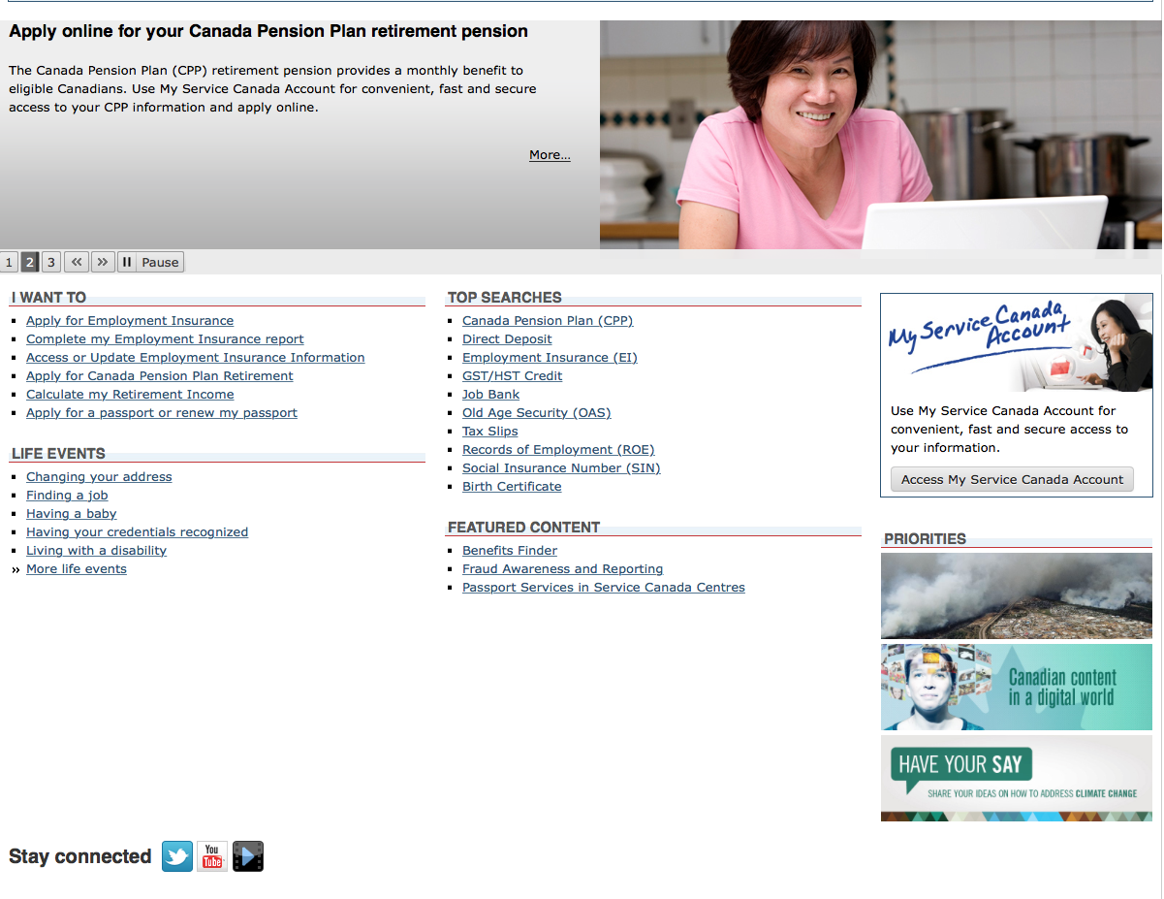
e-Government: Service Canada Critical Success Factors
Delivering seamless citizen-centred service
The service delivery system is designed to ensure a common service experience for all clients regardless of location.
The ability to collect and collate user feedback and accordingly address user needs.
Strategies are implemented to meet needs of specific segments of the population.
Enhancing the integrity of programs
Continuously identifying and improving the risk management process.
Working with third parties to ensure best possible outcomes are achieved.
Employing up-to-date technology to maximize efficiency and accuracy.
Working as a single collaborative Government
Creating partnerships with Government departments and community organizations.
Marketing Service Canada
Ensuring citizens are aware of Service Canada and its associated benefits
Create incentives and enablers for greater use of the electronic channel – migration to online use.
Service Canada Electronic Channel

Slide 76
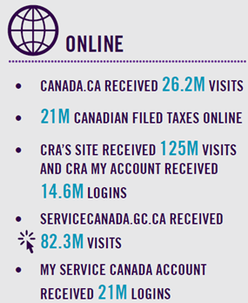
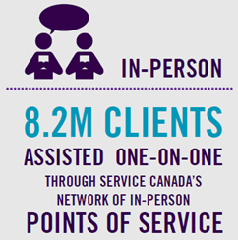
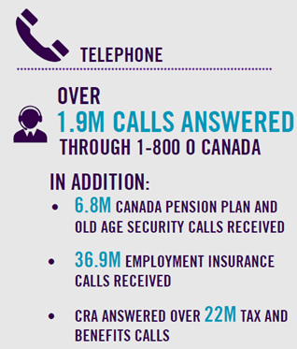


e-Government: Service Canada Key statistics on providing services to citizens

Slide 77

Annex D: Measuring citizen satisfaction with e-Government – Ideas from the Canadian Institute for Citizen-Centred Service (ICCS)

Slide 78


e-Government: Improving citizen experience with public services What drives citizen satisfaction?

Slide 79


e-Government: Improving citizen experience with public services How do we measure and improve citizen satisfaction?

Slide 80
Annex E: – Applying the Canadian experience to structuring the thematic IT review process

Slide 81
Thematic IT Review A possible roadmap based on the Canadian experience
Develop benchmarking framework
Review results
Develop Implementation Roadmap
Conduct background research
Formulate options
Seek approval and endorsement
Develop proposal
Test for impact on big spenders
Initiate internal and external benchmarking
Establish spending reduction targets
Develop fiscal framework for the proposal
Benchmark “with intent.” The structure and expected results anticipate and help support a range of options that may include:
Shared enterprise services for distributed (end-user) computer services
Centralized procurement of end-user devices (hardware and software)
Shared enterprise services for central computing services, through consolidation of data centres, servers and networks, and migration to cloud computing
Shared enterprise services for enterprise identity, credential and access management services (a key digital public services enabler)
Shared enterprise services for all telecommunications services (data, voice, video)
Shared enterprise approach to at least HR and Finance systems to reduce diversity and realize economies of scale
Migration of externally facing websites to a single presence
Migration to a single e-mail system.
Focus first on the big spending ministries
Formulate options that “work” and are testable in the big spending ministries. If they work there, chances are they will work everywhere. Set realistic targets, with a few “stretch” targets in areas where progress is most urgently needed.
In positioning the implementation roadmap, it is worth considering whether the climate is right for:
Starting with those options that can be implemented incrementally, and leave the others for later; or
Starting with the more “transformational options” right off-the-bat (e.g., this may be the only time when there is enough political support and momentum for serious structural changes in the service management and delivery models)
Either way, early successes, demonstrable achievements, and political announceables (e.g., first 100 days, first six months, first year, etc.) will be required
A set of tools will be needed to compel compliance, exercise oversight, measure and report progress, and sustain the momentum
Finally, the proposal should include the governance structure and processes needed to lead and manage the implementation process. A solid governance with recognized leadership is a critical success factor.

