Slide 1
Transport Spending – some thoughts
Catherine Adams, Expert Advisor
Public Financial Management Division
Slovakia: Spending Review Management
Bratislava, 29 May to 6 June 2016

Slide 2
Contents
Spending Review mandate
Improving effectiveness of investment
  Strategy
  Investment selection
  Governance and decision-making

Slide 3
Spending Review mandate
Outcomes: Make spending more efficient – maintain envelope’s current size
Input costs: 20% savings in operational unit expenditures – more efficient performance
  Expenditures on maintenance and rehabilitation of roads and motorways
  Subsidizing rail transport

Slide 4
Improving effectiveness of spending
Spending Review Priorities

Slide 5
Strategy
Why is Government investing in transport?

Slide 6
Getting the Strategy right – by asking the right questions in the right context – is the first step
  UK Approach: A new “paradigm” - an economic policy report, not a transport policy report
  Focused on fundamental goals, not transport outcomes or inputs (not modes, projects, providers…)
  No modal chapters and not a wish list of schemes
  Instead strategic geographic priorities and strategic intervention advice
  A new blue print for transport decision-making.

Slide 7
How we developed the strategy
Geography and Economy
Current network: performance and usage patterns
Future trends
Key challenges and strategic priorities
Don’t focus on modal solutions or specific projects
and not with “we should have one of those too”

Slide 8
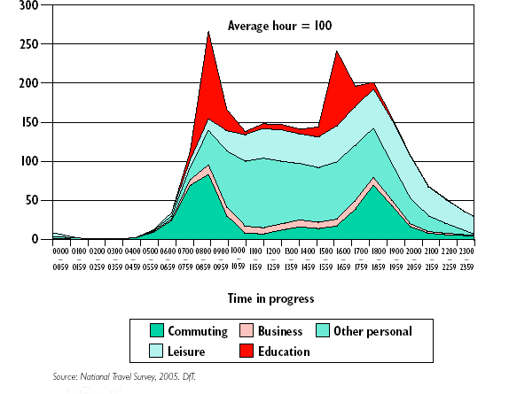
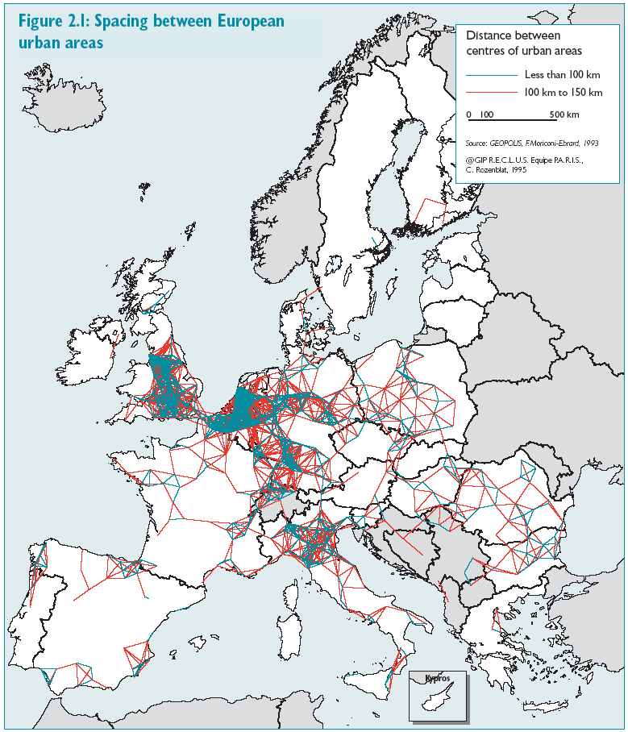
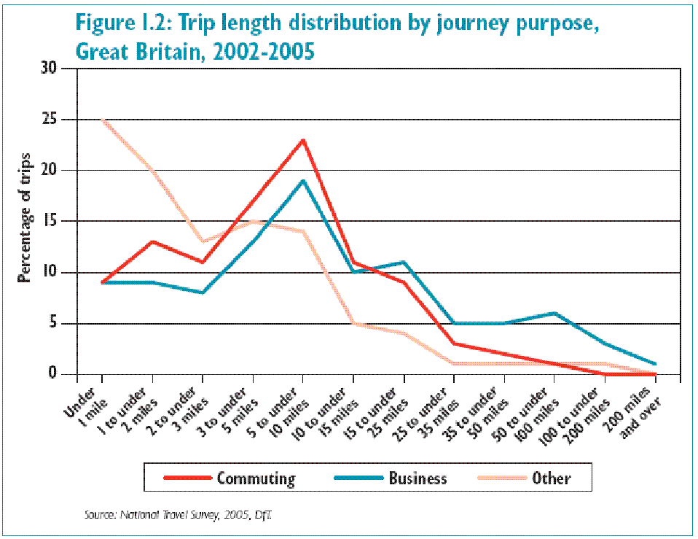
Issues: Density and concentration of journeys
Defining the challenge
Source: Eddington Transport Study

Slide 9
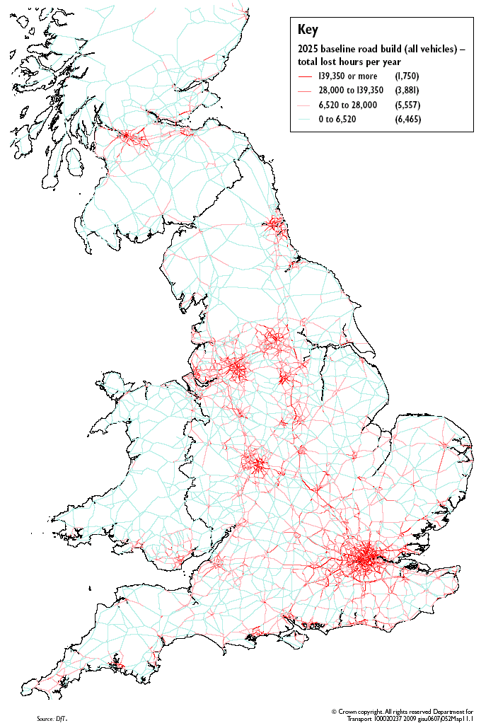
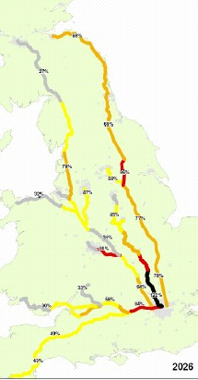
Understand how today’s patterns play out over time
Defining the challenge
Source: Eddington Transport Study
Improve network capacity and performance
Focus on cities and international gateways

Slide 10
Transport and economic success
Understanding the “how” helps to drive strategy
Understand the contribution that transport investment actually makes
Transport
intervention
DIRECT IMPACT
Cost
Time
Reliability
Quality
Comfort
Safety
User
response
INDIRECT IMPACT
Business efficiency
Business investment, innovation
Clusters/agglomeration
Labour market
Competition and trade
Globally mobile activity
Increasingly well understood.
Very significant in some places and some economies
Makes some projects much more worthwhile than others.
Well understood and measured
Traditionally, the bedrock of cost- benefit analysis.
This is why strategy matters

Slide 11
Investment selection
Improving the effectiveness of investment and intervention

Slide 12
Meeting the Challenge
Implement a new and rigorous policymaking process
DEFINE TRUE GOALS
What are the nation’s economic, environmental and social goals – not infrastructure outcomes
ASSESS THE MOST PRESSING PROBLEMS
Quantify the extent to which different infrastructure problems hinder those goals
FOCUS OPTION GENERATION ON THE MOST PRESSING PROBLEMS
Focus limited resources on identifying solutions to the most pressing problems
Investment selection
LOOK AT THE FULL RANGE OF POSSIBLE SOLUTIONS
Don’t jump to a favoured project or type of solution, e.g. modal preference or large capital projects
1
2
USE COST-BENEFIT ANALYSIS TO DRIVE DECISIONS
Develop a consistent BCR for all options, and use the data to drive decisions
3
4
5

Slide 13
Meeting the Challenge
What types of interventions offer the best returns?
Investment selection
Targeted transport policies offer the prospect of very high returns, even after accounting for environmental and wider welfare impacts
But adopt a sophisticated policy mix:
  Get the prices right across modes – fundamental economic principle, as well as critical for combating emissions (NRP = £25bn/yr by 2025, 80% fewer roads)
  Look at “better use” measures: longer trains, junctions improvements
  Small is beautiful, and speculative step change measures unlikely to offer good VFM
  Measuring all impacts means making different decisions

Slide 14
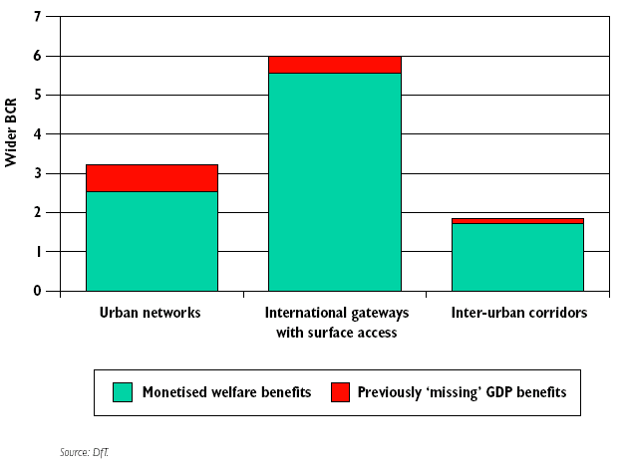
The impact
Establishing the primacy of economic appraisal
Investment selection
Wider Economic Benefits (WEBs) can have a major impact – especially in cities

Slide 15
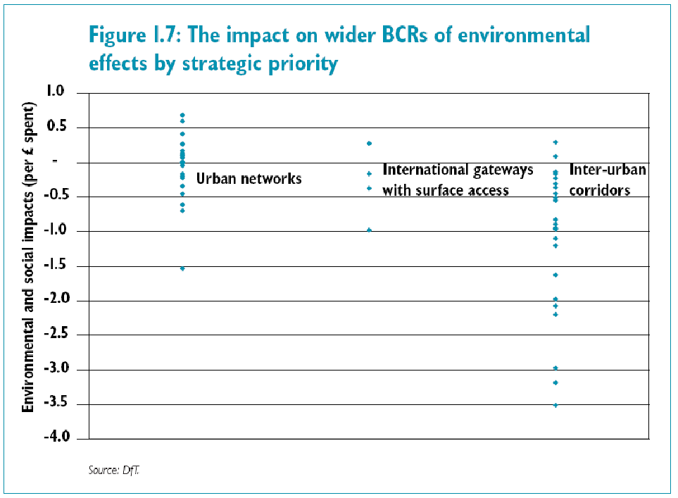
Meeting the Challenge
Environmental and social effects are highly location specific:
The Study’s key findings and recommendations
Source: Eddington Transport Study
Source: Eddington Transport Study

Slide 16
Implications for Slovakian policymakers - summary:
  Could transport policy be better focused on achieving economic, environmental or social goals – not transport for transport’s sake?
  Is there a clear strategy and a rigorous policy process, or are things politically driven or project-led?
  A need for consistent and reliable data to feed into a consistent CBA approach.
  Is policy too focused on large capital projects at the expense of pricing, regulatory and better use measures?
  Does policy seek to drive up the returns from investment?

